Slide 1
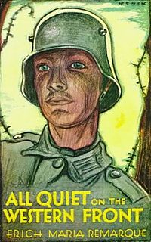
Understanding
The LIFE of
Soldiers
…In Reference to the Character of Tjaden
Notes:
Unlike the regular stories of heroism about soldiers fighting in wars, this story represents the more devastating side of being a soldier.
Apart from heroism comes the unsung hardships of the life of a person who is entangled between the disagreements of nations they at some point do not even understand. In this presentation, this assumption of soldierhood shall be realized in the character of Tjaden.

Slide 2
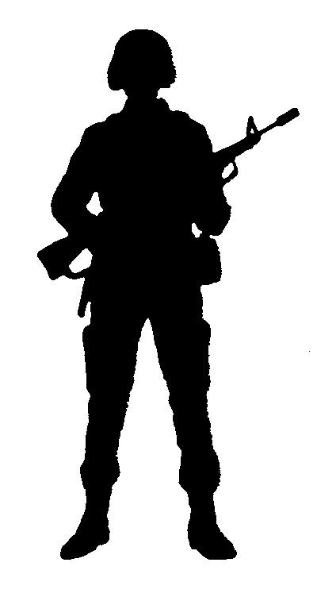
The Character
Tjaden was known to be among the friends of Paul Baumer who was not a school-mate.
Known as a locksmith
A person with big appetite
A person who has great grudge against the post-man turned corporal Himmelstoβ
Notes:
Being a basic person having a basic life, Tjaden was described to be somewhat a regular individual who had his own attitudes and own perceptions in life.

Slide 3
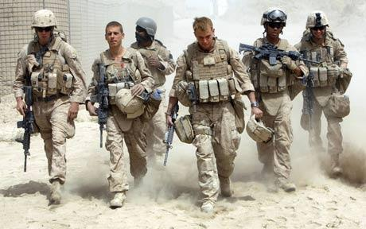
The Recruitment of Soldiers
Like other soldiers of their time, Tjaden was recruited. Out of his young manhood, he was given the chance to join the army and face the real picture of an actual war.
Notes:
The story shows that some of the soldiers [in the past] have been recruited and at some point even forced to join the army just so to make sure that the man power is able to content with the army of the enemies. Do they have the right training? Do they have the right mindset? It did not matter as much as they can add up to the number of soldiers who would face combat.

Slide 4
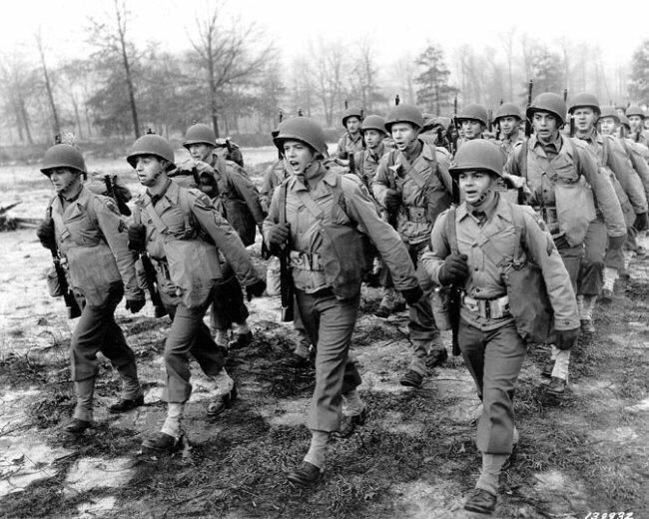
Looking for a Reason:
Tjaden: Well. how do they start a war? Albert Kropp: Well, one country offends another. Tjaden: How could one country offend another? Tjaden: You mean there's a mountain over in Germany gets mad at a field over in France? [Everyone laughs] Albert Kropp: Well, stupid, one people offends another. Tjaden: Oh, well, if that's it, I shouldn't be here at all. I don't feel offended. Katczinsky: It don't apply to tramps like you. Tjaden: Good. Then I could be goin' home right away.
Notes:
This script from the story shows how much confused Tjaden was as he tried to create a reason for him to stay longer alongside the army and continue with the war.

Slide 5
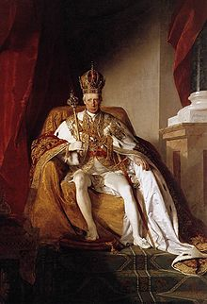
Fighting Alongside the Keiser
Tjaden: Me and the Kaiser, we are both fighting. The only difference is the Kaiser isn't here!
Keiser is a term
used to refer
to the
German Emperor
Tjaden: Me and the kaiser felt just alike about this war. We didn't either of us want any war, so I'm going home. He's there already.
Notes:
To make his stay a little bit more meaningful, Tjaden believes that he is fighting alongside the Keiser hence giving him more worth in the field. Nonetheless, when the Keiser has gone home, he found no reason for him to stay in the war at all.

Slide 6
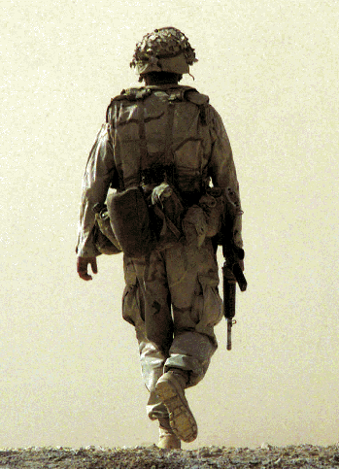
Implications of Tjaden’s Character
A soldier forced to face the war
A person forced to face the
hostility of life in the middle of fighting for life while running away from death
A regular individual who wanted nothing but peace and yet is in the middle of a crunch between bullets, integrity and respect for life.
Notes:
Soldiers then and now may have different starting points. Today, instead of being forced to join the army, most soldiers are allured by the heroism and reputation of being a man of war. Nonetheless, the situations they face are the same. Is it really worth it to fight for life when you are running after death?

