Slide 1
Andrew Jackson
The Challenges Facing the Seventh President of the United States

Slide 2
Campaign of 1828
Andrew Jackson Ran Against Incumbent President John Quincy Adams in 1828
Jackson Was Still Outraged By the “Corrupt Bargain” Between Adams and Henry Clay That Had Denied Jackson the Presidency in 1824
Jackson Ran The First Populist Campaign, Positioning Himself As The Candidate of the “Common Man”
Notes:
With the help of Henry Clay, John Quincy Adams was selected President by the House of Representatives in 1824. Adams then appointed Clay to Secretary of State. Andrew Jackson was outraged by this, calling the dealings between Adams and Clay a “corrupt bargain.” Jackson vowed to avenge himself, and he spent the next four years preparing to run for President in the 1828 election. Jackson campaigned in all 22 states, and developed a new populist and democratic approach to electioneering that was in marked contrast to the republicanism of earlier campaigns. Adams ran on his record as President, and made campaign promises about developing land in the West and promoting American manufacturing interests, but he made these promises from the comfort of the White House. Jackson, meanwhile, turned his campaigns into rallies and public gatherings that were replete with alcohol, food, and entertainment. In so doing, Jackson helped to set the stage for a new form of campaigning that set the tone for the nation’s future. His influence on campaigning, with its advertisements and appeals to the public, is still seen in contemporary political campaigns.

Slide 3
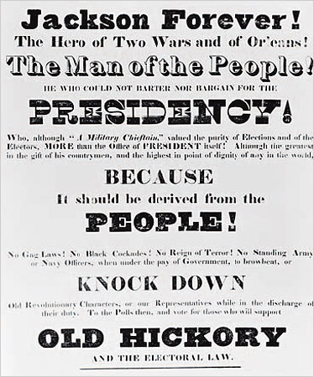
Andrew Jackson Campaign Poster
Notes:
This poster for Andrew Jackson’s 1828 campaign proclaims that he is the “Hero of Two Wars” and a “Man of the People.” Although Jackson was a strong proponent of a powerful central government, he was also heavily influenced by democratic, Jeffersonian ideals. Jackson combined his influences and political outlook into an entirely new style of campaigning.

Slide 4
Nullification Crisis
The Nullification Crisis Was The Greatest Challenge the U.S. Faced Since The Revolutionary War
The Crisis Was Centered on The Issue of States’ Rights
Southern States Felt Left Out of The Economic Benefits of U.S. Tariff Policies
South Carolina Declared the Tariffs of 1828 and 1832 Null and Void
Through the Threat of Force and Congressional Compromise the Crisis was Eventually Averted
Notes:
The issue of states’ rights vs. the federal government’s rights was a contentious issue from the earliest days of the new nation. The Articles of Confederation, which comprised the first effort to develop a national government, left almost all power in the hands of the states. The U.S. Constitution granted more power to the federal government, but still left the states with a significant degree of autonomy. Regarding the issue of tariffs, however, the federal government had, from the outset, assumed authority. By the early 1800s, some states in the South felt that the economic benefits of U.S. Tariff policy were being felt in the North and the West, but not in the South. Believing that the Southern states were largely subsidizing the economic boon in other parts of the nation, South Carolina threatened to nullify the tariffs. In 1832, it declared the U.S. tariffs null and void, forcing a political showdown with Congress and President Jackson. While Jackson threatened to use the military to force South Carolina to comply with the tariffs, Congress passed compromise legislation, and the crisis was eventually averted.

Slide 5
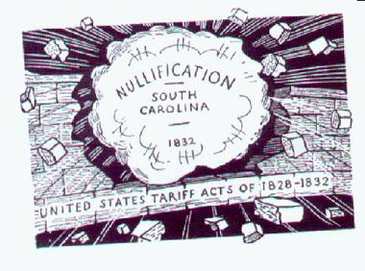
Nullification Crisis Political Cartoon
Notes:
This political cartoon shows a powerful South Carolina smashing through the brick wall of U.S. tariff policy. Despite the hard line taken by the cartoonist, South Carolina relented in the face of opposition and political maneuvering by Congress and President Jackson

Slide 6
Opposition to the Second Bank of the United States
Jackson Distrusted Banks in General
and Supported the Use of Specie (Silver) Currency
Jackson Opposed the Second Bank of the U.S.
In 1832 Congress Approved the Renewal of the Bank’s Charter
Jackson Vetoed the Charter, Claiming That the bank Represented the Special Interests of the Wealthy and Powerful Financiers and Bankers, Rather Than the Interests of the American People
Notes:
Having lost money in a bank in the years prior to his presidency, Andrew Jackson was distrustful and suspicious of the power of large banks. When Nicholas Biddle, the head of the Second Bank of the U.S., applied for renewal of the bank’s charter in 1832, Congress voted to approve the measure. Jackson immediately vetoed the charter, and vowed to crush the bank. Jackson argued that the bank was an instrument of the rich and powerful, and that it did not serve the best interests of the common man whom Jackson had promoted and defended throughout his campaign and his presidency. Jackson also asserted that the National Bank was Unconstitutional, as the Constitution had no provisions for, and granted no authority for, the federal government to create a national bank. Jackson’s decision was popular with many in the South and the West, who agreed that the national bank represented the narrow interests of an elite few. The destruction of the National Bank, however, would have significant negative consequences, as it opened the doors to the “wildcat banks,” currency speculation, and a number of other problems in the coming years.

Slide 7
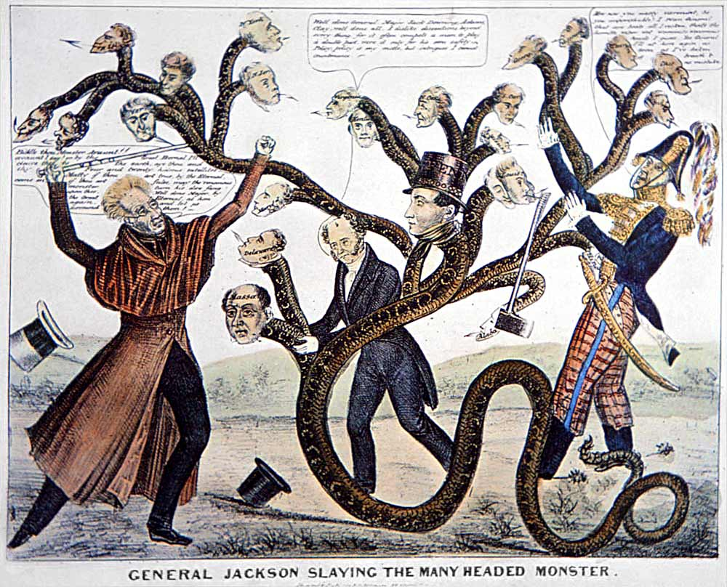
Political Cartoon-
Jackson’s Opposition to the National Bank
Notes:
This political cartoon shows Andrew Jackson, as President, fighting off a multi-headed monster that represents the wealthy and powerful interests that comprised and supported the National Bank.

Slide 8
Indian Removal Act
One of Jackson’s Most Controversial Moves Was the Signing of the Indian Removal Act of 1830
The Indian Removal Act Allowed the U.S. Government to Force Indians to Relocate to the West
Indians in Eastern U.S. Were Forced to March the Trail of Tears
Jackson Claimed to Have a Paternalistic View of the Indians, But History Shows That This Was Not an Accurate Assessment of Jackson’s Attitudes Towards Indians
Notes:
In 1830 Congress passed the Indian Removal Act, which was supported by Andrew Jackson. The Indian Removal Act allowed the government to “trade” land in the West for land East of the Mississippi River which was occupied by Indians. Some Indian tribes fought the decision to forcibly remove them fro their land; the Cherokee Indians of Georgia took their fight all the way to the Supreme Court. While the Supreme Court ruled in favor of the Cherokee, proclaiming their territory to be a sovereign nation, Jackson simply ignored the court and forced the Cherokee off their land. The march from East to West for the Cherokee became known as the Trail of Tears, as many Indians died en route. Jackson publicly proclaimed that he had the best interests of the Indians at heart, and that the Indian Removal Act would protect Indians from the greed and violence of white men. This paternalistic position that Jackson claimed to hold is not borne out by the facts of history.

Slide 9
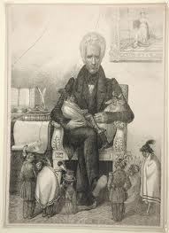
Political Cartoon- Jackson and the Indians
Notes:
This political cartoon mocks and satirizes Jackson’s professed paternalism towards the Indians. It shows Jackson as a benevolent, grandfatherly type, and the Indians as children or dolls that he is holding and protecting.

Slide 10
Panic of 1837
A Combination of Factors Combined to Undermine the U.S. Economy in 1837
Land Speculation in the West Was Paid For With Currency From the “Wildcat Banks”
Unstable Currency Prompted Banks to refuse to Trade for Specie, Rendering Paper Money Valueless
Banks Across the Country Closed Down, and the U.S. Plunged Into Recession
Many Americans Blamed Jackson for the Panic
Notes:
A number of economic factors came to a head in 1837, leading to a serious crisis in the U.S. economy. Jackson’s earlier decision to force the closing of the national bank and to redistribute the bank’s holdings to state banks led to problems associated with the conflicting and competing currencies issued by those banks. Counterfeiting was rampant, and speculators attempted to guess which currencies would hold or grow their value. The lenders and credit that helped fuel the development of western territories was undermined as these currencies started to collapse. Banks in New York and elsewhere began refusing to trade full value of specie (silver) for paper bank notes, further driving down the value of the paper currency. Meanwhile, as the economy in Britain rebounded after the war with Napoleon, overseas demand for U.S. cotton and other goods slumped. These and other factors combined to plummet the U.S. into an economic recession that would last for years. Many Americans blamed President Jackson for the economic calamity, and there I no question that some of his policies and decisions did help contribute to the problem. The recession was not entirely his fault, however, but the fact that many people balmed him for the problems showed the downside of being a man of the people.

Slide 11
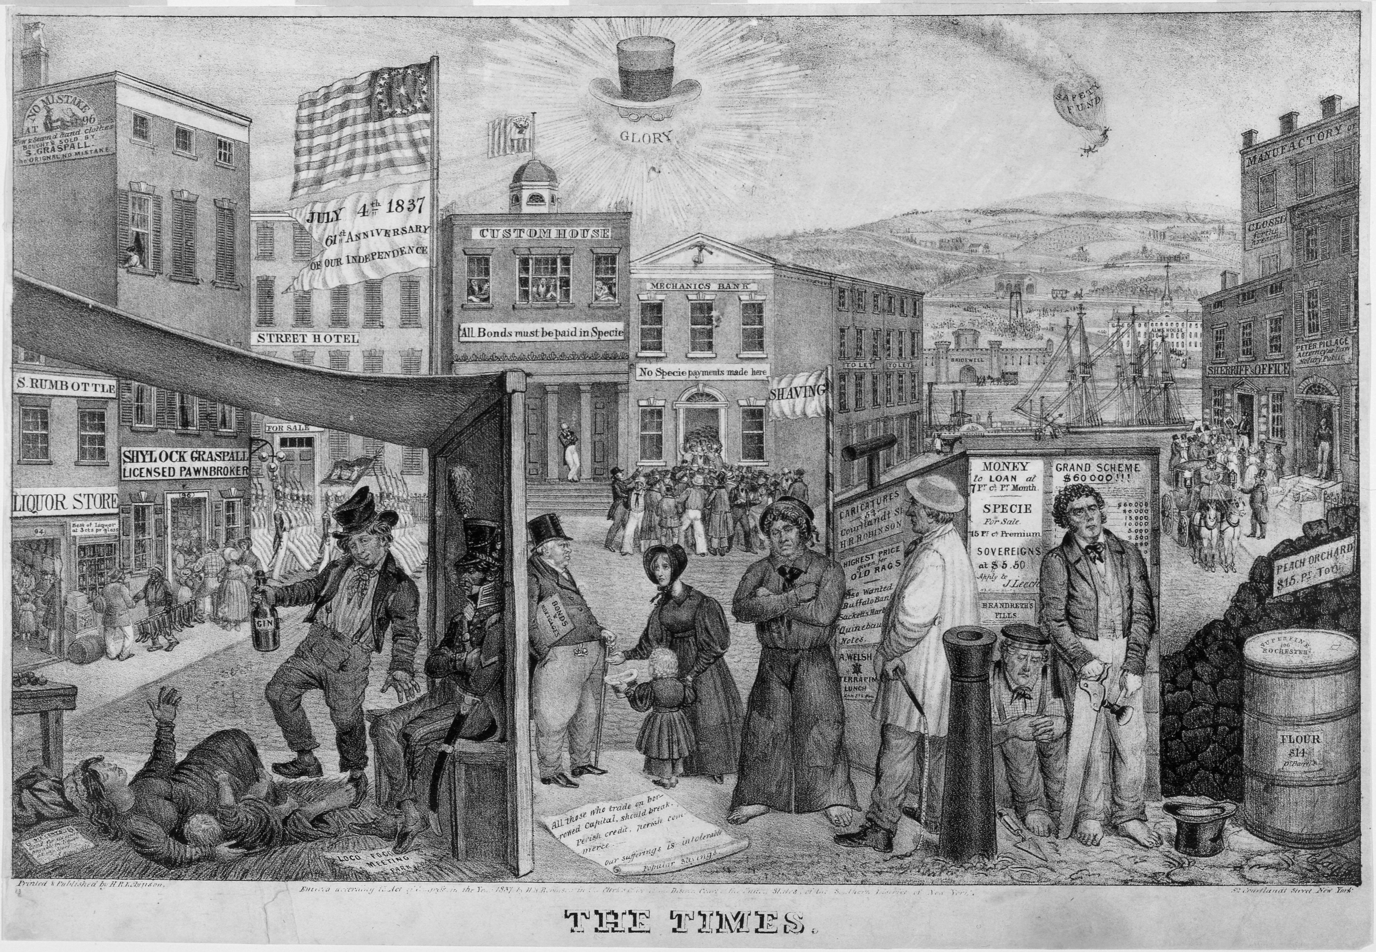
Political Cartoon- Panic of 1837
Notes:
This political cartoon takes an exaggerated view of life in America during and after the Panic of 1837. People are living in tents, pawnshops are open, and banks have signs announcing their refusal to accept paper currency.

Slide 12
References
http://falconinvestigators.wikispaces.com/Jacksonian+Democracy
http://kis-ushistory.wikispaces.com/States'+Rights+and+the+Nullification+Crisis
http://www.neh.gov/humanities/2008/januaryfebruary/feature/king-andrew-and-the-bank
http://origins.osu.edu/article/40/images/
http://www.picturehistory.com/product/id/21
Schultz, K. M. (2012). HIST2, Volume 1. Retrieved from The University of Phoenix eBook Collection.

