Slide 1
Corporate Gender Gap
Name
Course

Slide 2
Introduction
Gender Gap: The Concept
The difference between women and men, especially as reflected in social, political, intellectual, cultural, or economic attainments or attitudes (Dictionary.com)
Women in America: Statistics
College Enrollment
Women outnumbered men every year during 2000-2009 (National Center for Education Statistics)
Women earned 36.8% of MBAs in 2010-2011
Women made up 47.2% of all law school students (Catalyst, 2011)
Labor Statistics
Women composition of labor force: 46.7% (2010)
Women who were lawyers: 31.5% (2010)
Women who were partners at law firms: 19.5% (2010)
Women’s share of Fortune 500 leadership: 13.5% (2009), 14.4% (2010) (Catalyst, 2011)

Slide 3
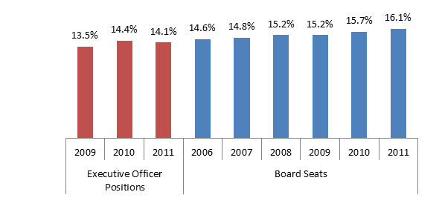
Problem
Wide discrepancy between qualification and advancement opportunities
Women outnumber men in academic qualifications yet lag behind in leadership positions
The chart shows women status at Fortune 500 companies (Catalyst, 2011)
Pay Discrepency
Women make less than men at similar jobs
Women median income (2010): $36,278
Men median income (2010): $47,127

Slide 4
Problem (Cont.)
Women take longer to be promoted
Women have to put in more efforts and time to achieve same career milestones as men
Women work three years longer than men before becoming school principal (Kelchner)
Exclusion
Women face exclusion at social gatherings and events
Social gatherings and events provide valuable networking and learning opportunities
Women face barriers in demonstrating their potential
Testing, tokenism, dismissal, and interruptions during meetings

Slide 5
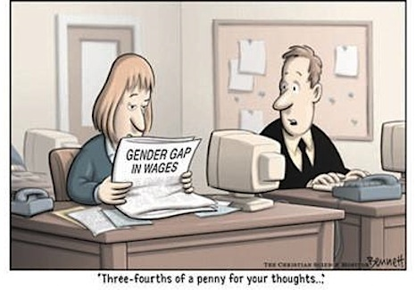
Cause
Wage Discrimination
Full-time women earn 77 cents for each dollar earned by men (Center for American Progress)
Gender Discrimination
Among married couples with dual-career, women make greater career sacrifices
Take less-appealing jobs and are geographically constrained in job search
Lack of progress by organizations over work-family balance
Women play greater roles in taking care of household responsibilities

Slide 6
Cause (Cont.)
Stereotypes
Women with children considered less productive despite lack of evidence
Women perceived to be less committed to long-term career than men
Women receive less recognition than men for similar-quality work (Brehm, 1997)
Women don’t negotiate
20 percent of women claim they never negotiate (Fairbanks, 2011)
Cite feeling guilty as the reason
Personal Choices
Women choose low-paying careers (Fairbanks, 2011)
Sometimes influenced by future expectations of having a family

Slide 7
Effect
Stereotypes are strengthened
Women are less capable than men
Women have greater responsibility for family
Women are not as ambitious as men
Women have lower leadership potential than men
Depression
Women earn less than men, thus, more likely to be in poverty
Feeling of loss of control over life goals (Mayo Clinic)

Slide 8
Effect (Cont.)
Higher preference for part-time jobs
Women in full-time jobs spend twice as much on household tasks as men (EurActiv, 2009)
This increases their preference for part-time jobs
Part-time jobs translate to lower earnings as well as career accomplishments
Lack of Self-confidence
Women may doubt their potential and leadership skills
May be less motivated to excel at work due to lower hopes of future
May be more attracted towards safer, low-paying jobs

Slide 9
Solution
Increased paid parental leave for fathers
This will allow men to share family responsibilities
It will help weaken the belief that family is women’s responsibility
It will create an environmental of neutral attitude towards both men and women
More and better part-time career opportunities for both genders
Hours should not matter, work quality should matter
This will allow both men and women to balance family-work life
Women will be able to continue with career even after starting families

Slide 10
Solution (Cont.)
Affordable childcare with flexible hours
Allows women to focus on work without worrying about parenting
Flexible hours help ease work-family conflicts
Reduce gender wage gap
Through better legislations and voluntary measures by organizations
Will motivate more women to seek long-term career
Will create sense of fairness and greater loyalty to organizations
Will improve economic status of women

Slide 11
Summary
Gender gap is a reality
Women outnumber men in college degrees yet lack behind in career accomplishments
Women paid less than men for similar work
Women excluded from advancement opportunities
Traditional stereotypes still alive
Gender Gap can be reduced
Companies provide more flexible hours
Give more flexibility to male employees so they could share family responsibilities
Improve the work quality and compensation of part-time jobs

Slide 12
References
Brehm, D. (1997, November 12). Researchers analyze causes of gender gap in tenured faculty. Retrieved March 7, 2012, from http://web.mit.edu/newsoffice/1997/gender-1112.html
Catalyst. (2011, December). Statistical Overview of Women in the Workplace. Retrieved March 7, 2012, from http://www.catalyst.org/publication/219/statistical-overview-of-women-in-the-workplace
Center for American Progress. (n.d.). Families Can’t Afford the Gender Wage Gap. Retrieved March 7, 2012, from http://www.americanprogress.org/issues/2010/04/equal_pay.html
Dictionary.com. (n.d.). Gender Gap. Retrieved March 7, 2012, from http://dictionary.reference.com/browse/gender+gap
EurActiv. (2009, April 16). The gender gap in household work: Causes and effects. Retrieved March 7, 2012, from http://www.euractiv.com/socialeurope/gender-gap-household-work-causes-effects/article-181306
Fairbanks, A. M. (2011, June 13). 'They Don't Negotiate': Why Young Women College Graduates Are Still Paid Less Than Men. Retrieved March 7, 2012, from http://www.huffingtonpost.com/2011/06/13/negotiate-young-women-college-graduates-first-job_n_875650.html
Kelchner, L. (n.d.). Gender Differences in the Workplace & Statistics. Retrieved March 7, 2012, from http://smallbusiness.chron.com/gender-differences-workplace-statistics-13294.html
Mayo Clinic. (n.d.). Depression in women: Understanding the gender gap. Retrieved March 7, 2012, from http://www.mayoclinic.com/health/depression/MH00035/NSECTIONGROUP=2
National Center for Education Statistics. (n.d.). Fast Facts. Retrieved March 7, 2012, from http://nces.ed.gov/fastfacts/display.asp?id=98

