Slide 1
Student Name
Professor Name
Course Title
Date

Slide 2
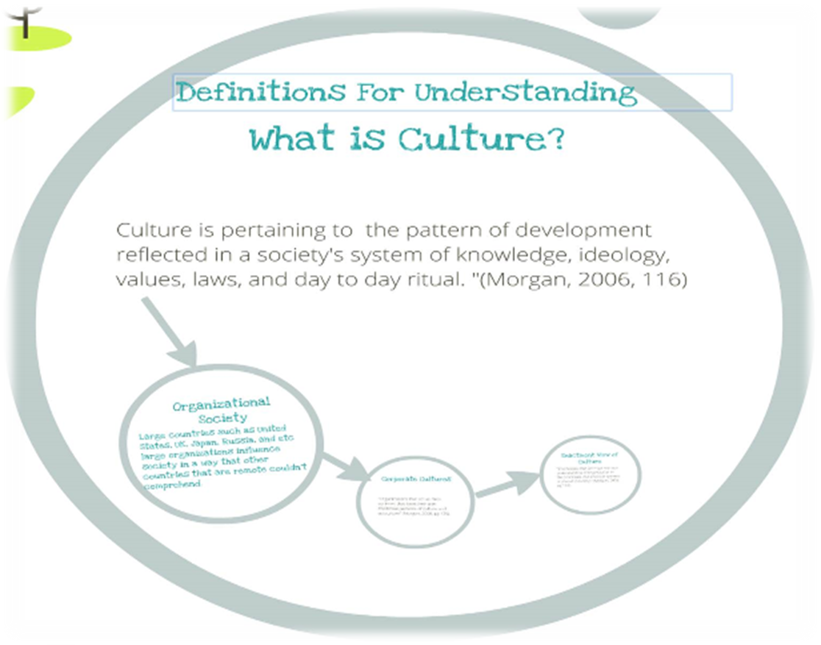
Enactment View of Culture
“Emphasizes that we must root our understanding of organization in the processes that produce systems of shared meaning.” (Morgan, 2006,pg. 137)
Organizational Society
Large countries such as United States, UK, Japan, Russia, and etc. Large organizations influence society in a way that other countries that are remote couldn’t comprehend.
Corporate Cultures
“Organizations that act as mini-societies that have their won distinctive patterns of culture and subculture.” (Morgan, 2006, pg. 125)

Slide 3
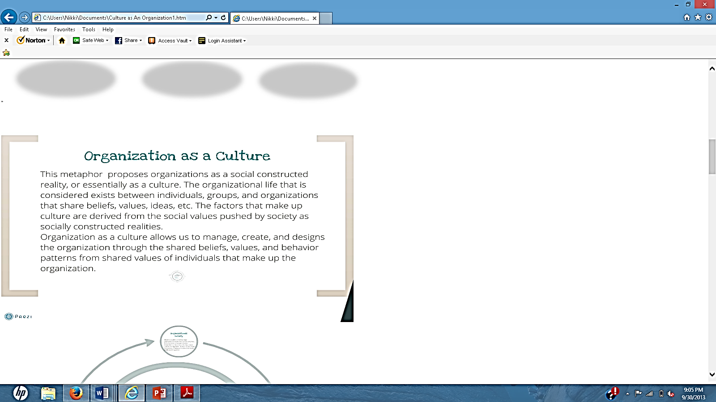

Slide 4
The Breakdown:
Culture
Share Beliefs, Value, Norms, etc.
Subculture
Organizational Society
Influential countries that have large organizations have influence on our daily lives;
Strengths and Weaknesses of Culture as a metaphor
Culture as a metaphor reminds leaders of organizations have a role in shaping they also can manipulate the type of work environment around them.
The limitations of the way that cultural realities are shaped influence the type of culture that is established within the workplace.
System of Knowledge, ideology, values, laws and day to day rituals.
Professional Groups
Gender
Leadership
Social class
Distinct patterns of leisure and work.
Cultural Management Division of labor that is characteristic of industrial society that creates problems of integration.

Slide 5
Country Culture Changes
Japan
A feudal System that off in the rice fields and samurai weaponry. Now has moved into a different modern society made of television and technology
United States
Most have winner’s attitudes that creates a competitive and boastful work culture with the need to punish and reward successful and unsuccessful behavior.
Great Britain
Generations of class struggle ad conflict create divisions within the workplace that has proven to be detrimental in organizational culture.

Slide 6
Organizational Culture

Slide 7
IKEA Case Study

Slide 8
Long Answer Question
The metaphor “Culture as an Organization” is used to describe work cultures in several developing countries, however would the same principles still apply in undeveloped countries where the hour per wage is significantly lower, and the culture is less diverse?
In order to answer this question effectively, the student must go back to Morgan’s definition of culture and what it means for the work place. Also examine large organizational influences in other countries. By doing so the student can answer how other countries have contributed or influence other undeveloped countries work place culture’s, routines, and day to day operations in their workplace. Taking account for the cultural, social, and economic differences that felt throughout the society in which they HAVE to go to work, and same “work cultures” such as the UK, Japan, and US are not the same.

Slide 9
Works Cited
Morgan, Gareth. Images of Organization. Sage Publications. Inc. Thousand Oaks. 2010. Book.
IKEA. Culture. YouTube. 2010. Web. 29 Sep, 2013. Accessed from http://www.youtube.com/watch?v=kfQFAzsC9r8
Organizational Culture: What is Organizational Culture and why does it matter. Organization Culture. YouTube. 2011. Web. 29 Sep, 2013. Accessed from http://www.youtube.com/watch?v=6AFn0vFtLC0
THE END

