Slide 1
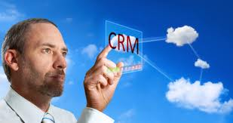
CUSTOMER RELATIONSHIP MANAGEMENT & CLOUD COMPUTING
Reasion why understanding this merging marketing concept is important:
To evaluate how different businesses are using this concept in boosting thier marketing strategies.
This is achieved through
the exploitation of the
mechanisms that arise
as a result of this
strategy.
Notes:
CRM and cloud computing are very popular in today’s business world. Cloud computing being CRM’s latest technology, its used to computerize activities such as sales and record keeping in many business organizations. It is cost saving and effective at the same time. The interaction between business agents and customers is greatly facilitated. CRM cloud computing is essential in trailing data relating to orders, discounts, references and even competitors. showcase

Slide 2
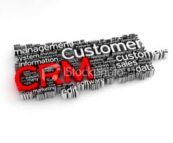
CUSTOMER RELATIONSHIP MANAGEMENT (CRM)
FACTS TO NOTE:
The CRM tool is vital in spearheading the dealings between organizations and the current and prospective customers.
CRM is a cutting-edge marketing paradigm in the contemporary market place.
The chief objective of CRM is to drive businesses towards the realization of efficiency with regard to the exchange of information with their customers.
It is based on the expertize of automating, synchronizing and organizing of customer services, sales and technical support teams.

Slide 3
CRM MODELS
1. Sales Automation System
It employs a range of softwares in streamlining the sales flow
It enables the sales department to come up with a management system that records and tracks sales at every point
It cuts on the cost of marketing that is incurred by the sales team by avoiding blind marketing
It brings about market segmentation that results into higher sales
There are more repeat customers due to high satisfaction from the customers
Customers are less likely to be won over by the competing businesses thus ensuring a large pool of loyal customers who sustains the business even during hard economic times
The loyal customers are also the source of adequate information that is useful to the sales force in dealing with increased demands from market forces
Notes:
The sales automation system is used mainly by the sales department. Its major aim is to recording and tracking all processes realating to new and old customers in the whole starting from the time of first contact until the closing of the business deals (Adrian & Frow, 2001). The sales automation system also ensures that the highest exploitation of every presenting opportunity during the course of sales. Additionally, the system is useful in ensuring equitable resource allocation to all the other departments. This is facilitated by the sales forecasts (Joachim, 2002).

Slide 4
CRM MODELS
2. Marketing CRM Systems
It is the main enabler of sales
Creates awareness of existing products and the new ones
It enables the marketing team to keep track and also measure marketing campaigns in all avenues
It analyzes customer responses and other leads thus realizing an objective sales machinery
Increases sales revenues by providing credible data that enables delivery of products and services to customers who greatly need them
Notes:
It acts as a remainder to the customer about a particular product or service from the company thus minimizing on the chances of turning to the substitutes. Marketing campaigns done through the social media (such as facebook), by direct mail or telephone are also controlled favorably depending on their
outcome.

Slide 5
CRM MODELS
It is a very important tool which brings growth to businesses as a result of meeting the needs and demands of customers in time.
It also leads to a large pool of customers by safeguarding customer confidence.
It is useful in pointing out some of the most loyal customers in a bid to reward them so that they continue to exercise their loyalty to the business.
3. Customer support and service
It is largely used to give a positive image of the business to the general public thereby attracting more and more customers.
Its is at the same time used to by businesses as a an effective means of creating, assigning and managing the requests made by their customers.
Notes:
Customer support is crucial as it warrants that the needs of current customers are met duly so that they continue being satisfied with the business’s services and products. This will keep the customers. At the same me, prospective customers who observes or learn from other will get attracted by a caring customer support and service program. They are likely to turn to businesses that have friendly and competent customer support programs.

Slide 6
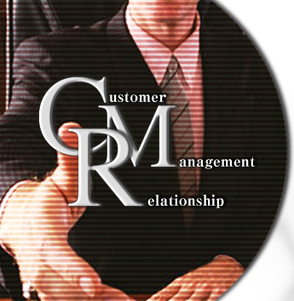
CRM MODELS
4. Business intelligence systems
5. Sales Analytics (CRM) systems
It consists of technologies, methodologies, processes and other mechanisms used by the marketing department to collect and utilize big volumes of data from the market in expanding its horizons in the market in relation to its goods and services offered by the business.
It leads to a higher degree of market competence of the businesses involved.
It is closely related to the sales automation model
Helps in trailing the customer preferences and activities that are technical and in turn making it easier for the marketing team to plan and carry out campaigns directed toward particular customer preferences and actions
Notes:
Business intelligence systems are critical in leveraging new opportunities which will improve the availability of services and products of organizations that are using these systems in the market. They thus have a an added advantage as compared to businesses that have no or flawed intelligence systems. It leads to business growth by putting in place suitable infrastructure for carrying out marketing undertakings.

Slide 7
Cloud Computing Marketing Strategy
Cloud computing is essential in enhancing the interaction between the customers and the organizations themselves.
Through this platform, the two parties can engage in direct interactions, network functions or cold calls as part of the sales endeavors.
Certainly, cloud computing strategies are defined by the kind of customer relationship management that a certain organization will seek to deploy.
This is achieved through;
1.Enabling of Effective Marketing Messages
It involves the development of a marketing message to be used by a business. The message must meet the needs of the organization. Its elements are;
i. An action call
ii. A client testimonial
iii. A query form that has an emotional
message and a pain point description
Notes:
Cloud computing marketing being a newer strategy to customer relationship management has come at a time when it is most needed in a world which is increasingly becoming globalized. It has become a great facilitator to CRM, therefore giving rise to the coined term “Cloud CRM”. An effective message is used to identify the pain pin t through the evocation of emotions in the customer. The message psychologically affect the customers (including the prospective ones) which persuade them to buy the goods and services of that organization sending the message.

Slide 8
Cloud Computing Marketing Strategy
2. A Website
Well leveraged websites forms part of an effective cloud computing marketing strategy.
It delivers special bits of information to the customers.
It acts as the link between the business and its current as well as prospective customers, promoting the growth of the organization.
It is also a good avenue where customers can seek clarification concerning various products thus fostering a close interaction that will lead to loyalty.
3. Email Marketing
This strategy works even better when the marketing team has ensured the creation of a database of emails from prospective customers. Emails relating to various services and products offered by the
business are send to the prospective customers from time to time. This acts as a means of luring the customers into buying the products and services for the first time
Notes:
Emails can be used as a form of marketing through updating of current and prospective customers. In important advantage that come with email marketing is that it is very cheap and fast across long distances. It then becomes one of the most suitable mode of communication between the organizations and long distance customers e.g. those overseas. Accordingly, websites which are also part of the internet community just like email provide vibrant avenues for the interaction between the customers (especially the prospective ones) and the marketing teams. Ironing out issues in this particular platforms opens a door of trust and confidence between the two parties which makes them to establish a long lasting relationship that touches on a number of business dealing that they engage in. The potential buyers are turned into constant buyers hence leading to business growth.

Slide 9
Cloud Computing Marketing Strategy
4. Marketing Lists
An adequate marketing list should contain updates and accurate information. It must also be able to provide the prospective customer with an overview of the organizational efforts in ensuring accessibility of its products and services to global customers. In most cases, these listings are based on a website. If designed well, it can lead to increased customer confidence. It should comprise of a customer segment where the prospective customers can place their enquiries. In addition, the marketing team must see to it that they respond to these queries.
Notes:
This is one of the best platforms that gives the organization an opportunity to showcase what it is worth and as a result appeal to its customers. This appeal will go a long way in improving the sales of products and services. For it to be effective, it therefore needs to be as eye-catching as possible. At the same time, it provides an opportunity for the customers to make informed choices before they resolving to purchase particular products and services.

Slide 10
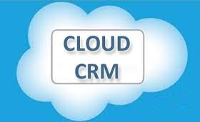
Cloud CRM
Conclusion
The merging of Cloud computing marketing strategies and Customer relationship management strategies is what is simply referred to as cloud CRM. These merging strategies have proved very effective and beneficial to organizations in terms of profit realization.
The mechanism of this concept works through the utilization of the multifaceted components of both the cloud computing marketing strategies and customer relationship management techniques. Growth that is realized at every stage when combined forms a milestone in the organization’s overall performance. Notwithstanding their size, businesses should adopt this instrument because of the huge benefits associated with it.
Notes:
Cloud CRM is the way to go since the employments of technology makes it easier to reach to both current and prospective customers. The cost of carrying out things such as marketing of products and services is also greatly minimized, thus making it the most suitable mechanism for realizing growth in various organizations.

