Slide 1
Present and future value formulae for uneven cash flow based on the performance of a business
FULL NAME:
COURSE :
TUTOR:
DATE:

Slide 2
RESEARCH QUESTIONS
1. How is the
compounding process
related to the payment of interest on
savings?
2. What is the general equation for future value? What effect would a
decrease
in the interest rate have on the future value
of a deposit? What effect would an
increase
in the holding period have on
future value?
3. What is meant by “the present value of a future amount”? What is the
general equation for present value?
4. What effect does
increasing
the required return have on the present value
of a future amount? Why?
5. How are present value and future value calculations related?
6. How is present value of a single amount calculated?

Slide 3
How are present value and future value calculations related
Clearly, using the ENFV and ENPV approaches yield opposite shapes of
the term structure of discount rates, except in the special case of certainty (Stern, 2006).
This shows that, in general, the choice of the discount rate cannot be disentangled
from how the investment is financed, and from how the risky payoff
of the project is allocated through time.
FV=PV*(1+I)^n
PV=500/(1+0.08/12)^(5*12)=355.60

Slide 4
Question 1- How is the compounding process related to the payment of interest on savings?
To solve this problem, determine the present value of each cash flow discounted at 9% for the appropriate number of years (Weitzman, 2001). The sum of these individual values is the present value of the total stream. Table presents the calculations needed to find the present value of the cash flow stream, which turns out to be $1,904.60. Present Value * (1 + i)n = Future Value
First, divide both sides by the Present Value:
(1 + i)n = Future Payment/Present Value.
Take the nth root of both sides:
1 + i = (Future Payment/Present Value)1/n.
Then subtract 1 from both sides, to arrive at i, the interest rate for the discount:
Interest Rate of a Discount (IRD) Formulai =(FVPV)1 ― n- 1i = Interest Rate of Discount per time period n = number of time periods FV = Future Value PV = Present Value
Why does it matter? Because interest adds up faster. E.g.:
10%, 3 years, semi-annual compounding: (1 + .1/2)^{3*2} = 1.34 > (1 +.1)³ = 1.31

Slide 5
Compounding
Number of times per year interest is calculated
May be annually, semi-annually, quarterly, etc.
However: Interest rate is expressed on annual basis, unless stated to be for another period. Therefore: if annual interest rate is 10% ----→

Slide 6
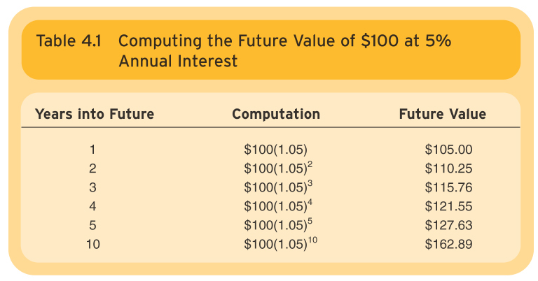
Question 2. What is the general equation for future value? What effect would decrease in the interest rate have on the future value of a deposit? What effect would an increase in the holding period have on future value?
FV = PV + PVxi
= PVx(1+i)

Slide 7
Question 3. What is meant by “the present value of a future amount”? What is the general equation for present value?
Sometimes it is necessary to calculate the number of time periods needed to generate a given amount of cash flow from an initial amount (Stern, 2006). Here we briefly consider this calculation for both single amounts and annuities (Weitzman, 2001). This simplest case is when a person wishes to determine the number of periods, n, it will take for an initial deposit, PV, to grow to a specified future amount, FV, given a stated n interest rate, i.
Of course, we cab use a formula shortcut to calculate the present value of the annuity “
Therefore, = $1000*4.33*1.05 = $4545.95

Slide 8
Question 3. What is meant by “the present value of a future amount”? What is the general equation for present value?
. The present value of a future amount is the future amount that will be accumulated, and the amount of money today that is equivalent to the higher the effective, or true, annual rate (EAR). The given future amount, considering the return that annual percentage rate (APR)—a nominal annual can be earned on the current money. Present value Rate is quoted on credit cards and loans.
i = interest rate
= discount rate
= yield
annual basis

Slide 9
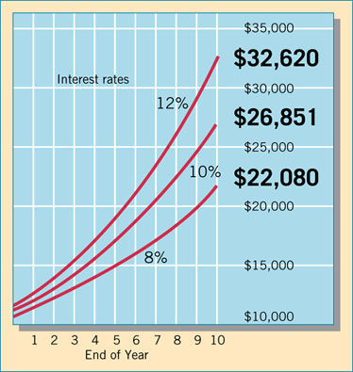
Question 4. What effect does increasing the required return have on the present value of a future amount? Why?
Because of the relationship between present value interest factors and future value interest factors, we can find the present value interest factors given a table of future value interest factors, and vice versa (Stern, 2006). For example, the future value interest factor for
Future value = Present amount x (1 + r)n r = interest rate n = number of periods 10 percent and 5 periods is 1.611.
FVn = PVx(1+i)n

Slide 10
Question 5. How are present value and future value calculations related?
Consider a simple investment that generates a sure payoff Z at date t per
euro invested at date 0 (Weitzman, 2001). If ρ is the continuously compounded interest rate
during the period, it is optimal to undertake the project if its Net Present
Value
NP V = −1 + Ze−ρt
is positive. This NPV rule is sustained by a simple arbitrage argument:
implementing the project and borrowing Ze−ρt at date 0 until date t would
generate a sure payoff NP V today, with no other net payoff along the lifetime
of the project (Stern, 2006). One could alternatively consider another arbitrage strategy,
in which the investor borrows one euro at date 0 to finance the project. In
that case, only one net payoff is generated. It takes place at date t and is
equal to the Net Future Value
NF V = −eρt + Z.

Slide 11
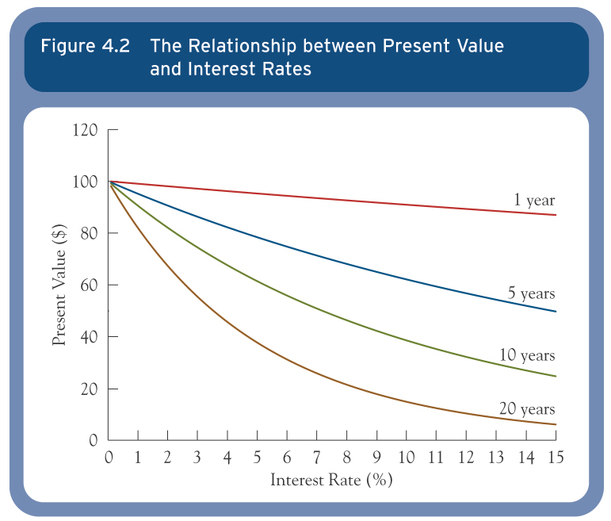
Interest Rates and Present Value
FV = PMT [((1 + i) ^n - 1) / i]

Slide 12
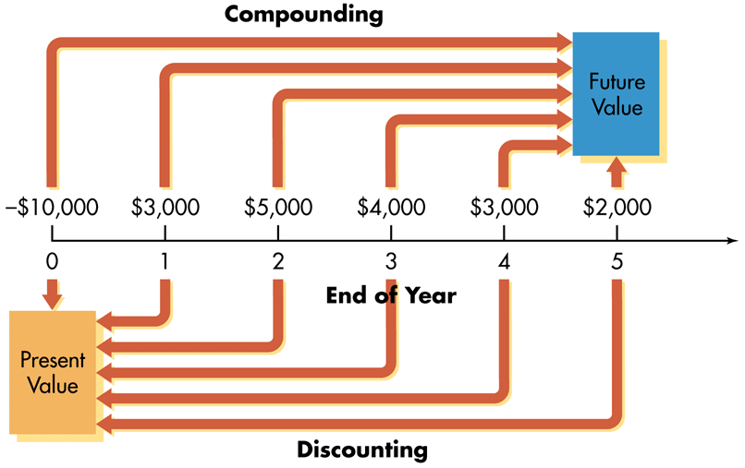
6. How is present value of a single amount calculated?
The present value of a single amount is the worth to you today of receiving that amount some time in the future. (Stern, 2006). For instance, you might be offered an opportunity to invest in a ﬁnancial instrument that would pay you $1,000 in 3 years. Before you decided whether to invest, you would want to determine the present value of the instrument.
Present value = Annuity Amount x [1 - 1/(1 + r)n] / r R= interest rate n = number of periods

Slide 13
Conclusion
This conclusion holds only when there is no friction on credit markets, and when investment projects are marginal (Stern, 2006). For non-marginal projects, their existence requires re-optimizing the consumption path, as claimed by Stern
(2006). In the case of the climate change problem, the choice of the discount rate remains dependent upon which generations will bear the mitigation and adaptation costs.

Slide 14
Reference
1. Pazner, E.A., and A. Razin, (1975), On expected present value vs. expected future value, Journal of Finance, (30), 875-877.
2. Ramsey, F.P., (1928), A mathematical theory of savings, The
Economic Journal, 38, 543-59.
3. Stern, N., (2006), The Economics of Climate Change: The Stern Review, Cambridge University Press, Cambridge.
4. Weitzman, M.L., (1998), Why the far-distant future should be discounted at its lowest possible rate?, Journal of Environmental Economics and Management, 36, 201-208.
5. Weitzman, M.L., (2001), Gamma discounting, American Economic Review, 91, 260-271.
6. Weitzman, M.L., (2007), Subjective expectations and asset-return puzzle, American Economic Review, 97, 1102-1130.

