Slide 1
On-Site Childcare
Today’s response to the Growing
need of Establishing
Good Family Environment
for Working Parents
and their Children

Slide 2
Understanding the Science Behind Childcare
While people institute on the thought that childcare comes naturally to the instincts of parents, there are three primary theories behind this element that tends to assure childcare excellence
Institutional theory
Rational Choice Approach
Resource Dependent Theory

Slide 3
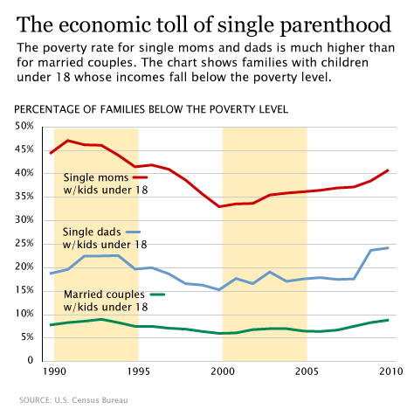
Understanding the Concept of Institutional Theory
Establishes the family type one belongs to
Development of single-parent families:
This chart shows how single-parent families tend to increase and thus imposing the need for onsite childcare programs offered in establishments they work for.

Slide 4
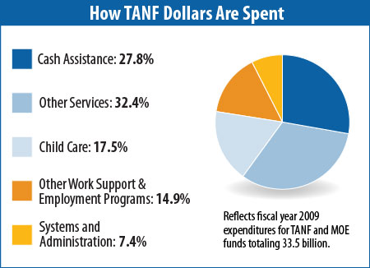
Understanding the
Rational Choice Approach
Focused on providing financial support to parents, rational Choice Approach or RCA insists on the creation of programs that would allow for subsidies dedicated to helping parents needed financial assistance.
TANF or Temporary Assistance for Needy Families is one for of Rational Choice Approach which is now used in the US.

Slide 5
Understanding the
Resource Dependent Theory
Insists on the creation of particular positions that would allow workers to bring in their children within worksite for childcare purposes.
This results to better performance since the workers know that their children are just beside them and are well cared for.

Slide 6
WHAT YOU CAN DO
Both parents and children belonging to new forms of families are in need of assistance.
Opening our minds and our hearts to the need of creating programs allowing parents to work beside their children accommodates the possibility of better performance for workers and immensely a good source of protection for the children.
REMEMBER:
Establishing good families is a social responsibility that provides the chance to establish a society with excellent foundation.

