Slide 1
The Impact of the Revolutionary War on the Institution of Slavery
Planting the Seeds of Abolition

Slide 2
Slavery in the American Colonies
As the Europeans Established Colonies in the Americas the Need for Labor was Paramount
Many Colonists Died from Disease and Starvation
The Shortage of Labor Prompted the Development of the Atlantic Slave Trade
The Atlantic Slave Trade was More than Just the Shipment of Slaves; it was the Basis for a new Global Economy
Notes:
The institution of slavery played a significant part in American history. From the time that the earliest colonies were established there was a need for labor to work the plantations and to take on the other roles that would benefit the European nations that were colonizing the Americas. Many colonists died from disease and starvation in the early years of American colonization, and the Europeans began to rely on slave labor to fill the void left by the shortage of available colonists. The development of the Atlantic Slave Trade was not just based on the one-way passage of slaves from Africa to the colonies, but was instead the foundation of a complex trade system that moved slaves and goods between the Americas, Europe, Africa, and other parts of the world. Ironically, it was the reliance on slave labor that would, in some ways, prompt the eventual revolution of the North American colonies against Great Britain.

Slide 3
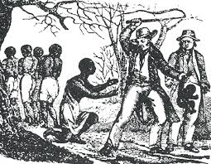
The First Stirrings of the Revolution
The Colonies Begin to Develop their Own Social, Political, and Cultural Identities
Slave Labor Forms the Basis of the Economies in the Southern Colonies
Notes:
As the colonies began to grow and to expand their economic activity, each of them also established their own social and cultural identities, and began to cultivate a sense of independence and self-reliance that would eventually underpin the revolution against British control. Although there were slave owners in the Northern colonies, it was the Southern colonies that developed agriculture—based economies that relied most heavily on slave labor. As the move towards revolution began to grow, it was the Southern colonies –whose political systems and economies were controlled almost entirely by wealthy landowners- that remained most loyal to the Crown, as they were the ones with the most to lose in a revolution. Pockets of loyalists existed in the Northern colonies as well; again, these loyalists tended to be among the wealthiest, and therefore the most interested in maintaining the status quo.

Slide 4
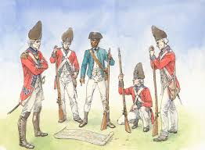
Slaves in the Revolutionary War
Although the War was Fought over Ideals about Freedom and Liberty, it Was the British Who Were Most Willing to Trade Liberty for Military Service to Slaves
Notes:
As noted, there is a measure of irony in the fact that much of the overall economic might of the colonies, which would eventually spur a revolution based on ideals about “freedom” and “liberty,” was built on the power of slave labor. Although slavery was less common in the Northern colonies than in the Southern colonies, and public discourse about the morality of slavery and the possibility of abolishing the institution of slavery were already taking place before the war began, there was still little interest among any of the colonists in treating Blacks as equals. George Washington, in fact, refused to recruit Black soldiers until the very last months of the war. The British found occasions to use the issue of slavery in the colonies to their advantage, such as when Lord Dunmore, confined to a ship in Norfolk Harbor as he awaited supplies, offered “Liberty to Slaves” who were willing to fight for the British. Hundreds of slaves responded to Dunmore’s offer, and thousands of slaves and former slaves would fight on the side of the British over the course of the Revolutionary War.

Slide 5
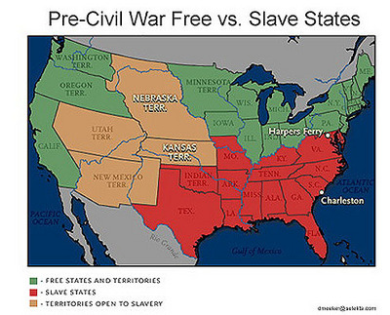
The Impact of the Revolution on the Institution of Slavery in America
The Revolutionary War Led to Freedom for Tens of Thousands of Former Slaves
The Northern Colonies Began to Abolish Slavery, Though It Would Take Another War Before Slavery Ended in the South
Notes:
The Revolutionary War had both immediate and long-term effects on the institution of slavery in America. As a war fought largely on ideas and ideals about liberty and freedom, it led to the abolition of slavery in the Northern colonies, and also exposed the deep philosophical divide between the North and the South that would lead to the Civil War in the next century. Slaves fought on both sides in the Revolutionary War, and thousands of former slaves escaped from the South or otherwise gained their freedom during the war. After the war there were tens of thousands of fewer slaves than there were before the war, and this burgeoning population of Free Blacks would eventually lead to the emancipation of all slaves in America. The ideals of liberty and freedom that underpinned the Revolutionary War were not originally considered to be applicable to slaves, but by the conclusion of the war the beginning of the end of slavery had begun.

Slide 6
References
http://africanamericansslavery.blogspot.com/2012/05/slaves-in-revolutionary-war-era.html
http://wheretwoormorearegathered.blogspot.com/2005_05_01_archive.html
http://www.ocf.berkeley.edu/~arihuang/academic/abg/slavery/history.html
Schultz, K. M. (2012). HIST2, Volume 1. Retrieved from The University of Phoenix eBook Collection
Notes:
As noted, there is a measure of irony in the fact that much of the overall economic might of the colonies, which would eventually spur a revolution based on ideals about “freedom” and “liberty,” was built on the power of slave labor. Although slavery was less common in the Northern colonies than in the Southern colonies, and public discourse about the morality of slavery and the possibility of abolishing the institution of slavery were already taking place before the war began, there was still little interest among any of the colonists in treating Blacks as equals. George Washington, in fact, refused to recruit Black soldiers until the very last months of the war. The British found occasions to use the issue of slavery in the colonies to their advantage, such as when Lord Dunmore, confined to a ship in Norfolk Harbor as he awaited supplies, offered “Liberty to Slaves” who were willing to fight for the British. Hundreds of slaves responded to Dunmore’s offer, and thousands of slaves and former slaves would fight on the side of the British over the course of the Revolutionary War.

