Slide 1
UMass Boston
Notes:
This template can be used as a starter file for a photo album.

Slide 2
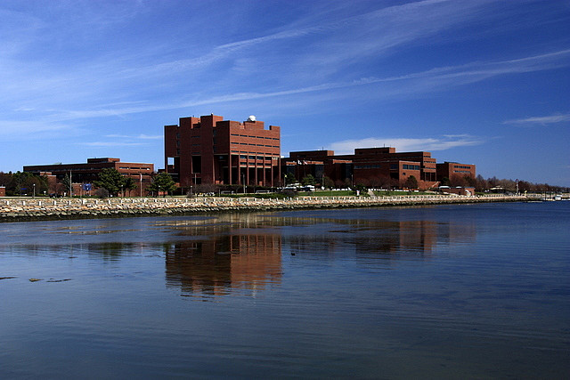
Culture of UMass Boston
The University of Massachusetts is a unique university offering a sundry blend of cultural diversity
The local culture and the conglomerate of international students works together to form a global culture that is appreciative of the diversity and differences that exist in society
Notes:
The University boasts over 25 ethnic/cultural clubs that are meant to appreciate the cultural diversity within the University.
These cultural clubs cover all the 7 continents and have a rich diversity and a cultural blend that gives UMass Boston its global culture.

Slide 3
UMass Boston’s Symbol
UMass Boston uses a symbol as opposed to a logo to represent UMass Boston and its athletic teams.
The symbol that is used is the Beacon.
The symbol of beacon has a much deeper meaning, “to Light the Way”
It represents the aim and target of the University in the Higher education sector.
Notes:
Paul Finnegan was among the first athletics administrators at UMass Boston.
He knew that the University would be built on Boston Harbour, where beacons guide ships from all over the world, he chose the Beacon as the ideal representation for UMass including its athletics teams.

Slide 4
UMass Boston’s Symbol – Shine On
The beacon that is UMass Boston, is a symbol that represents guidance and hope. It is a light that is constant and is never extinguished.
The beacon shows endurance, strength and light. Traits that are echoed through out its athletics and education programs
The university is a beacon for diversity with the rich background of international students.
Notes:
Owing to the fact that it is the city’s sole public University, it guides students to realize their dreams and hopes, pushing them to rise above.
The university is a symbol of the city and the famous “beacon” is a term that is synonymous with the heritage and history of Boston.
UMass Boston is in fact the only University with a beacon as its mascot.

