Slide 1
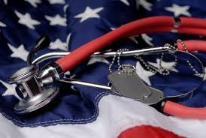
Veterans Health System
Student Name
Course Title
Professor Name
Date

Slide 2
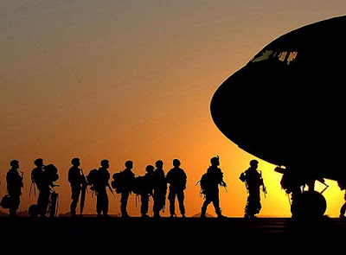
Inception: Veterans Health System
Veterans have an essential part in protecting our country and the establishment and preservers of the government.
It was and still is an importance to the government to take care of military members that served and are now needing assistance due to injury/disability or age. The purpose of the government program is to provide healthcare and benefits to those military members and their families through the redistribution of money towards the health care system.
The Veterans Healthcare System was established in
1946 through the Department of Defense and
Department of Veterans Affairs.
Notes:
Veteran’s healthcare incorporates a various range of programs and benefits that only serve to help past and present members of the military including their families. The Department of Defense and Department of Veteran Affairs works together to provide health care programs that offers coverage for all veterans, within established hospitals and clinics that are central to veterans and their families. The Veterans Heath Care System was established in 1946 by the government and has since expanded in the members covered and the responsibility of the government. The Veterans Healthcare system is one of the largest integrated healthcare systems in the US and the largest provider of graduate medical and other health professionals training. Veteran’s health system serves as the essential and largest provider of services to homeless people in America and the public healthcare system. It serves to address the market failure of merit goods including the failing healthcare and social systems aimed at helping the uninsured and low income. Not only does it benefit veterans and homeless people, but aids in natural disasters and emergencies. The rationale for the government developing the veterans’ health system is a form of redistribution while providing high quality insurance premiums and benefits to veterans and the homeless. The redistribution taken from the wealthy percentage of individuals in order to benefit the healthcare system. The government set up the program to plan for the future of members of the military and their families in the case of injury or prolonged disability later in life. The systems benefits to serves the needs of military veterans, active members of the military, and their families exclusively.

Slide 3
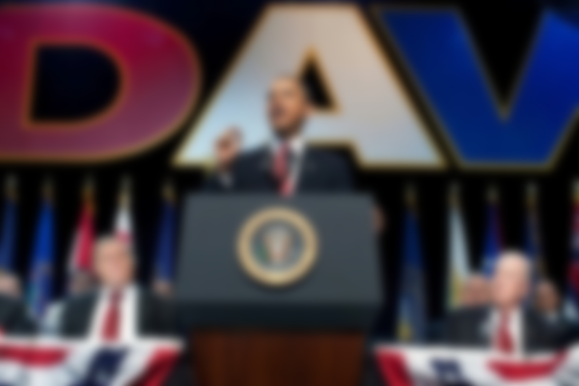
How Does the Veterans Health System Work?
To all the military personnel that are applicable the government run program provides premium benefits including insurance, assisted living and homecare, home loans, and payments to help with needs.
There have been several health reform laws including:
Emergency Medical Treatment and Active Labor Act (1986)
Health Insurance Portability and Accountability Act (1996)
Medicare Prescription Drug, Improvement, and Modernization Act (2003)
Patient Safety and Quality Improvement Act (2005)
Health Information Technology for Economic and Clinical Health Act (2009)
Patient Protection and Affordable Care Act (2010)
Current public policy has brought attention to the issue of mental illness in veterans.
Notes:
The Veterans Health System has been in the works since the 19th century but wasn’t formulated until the establishment of the Veteran’s Administration by President Hoover, which was soon followed by Department of Veteran Affairs by President Reagan which help to publicize the veteran health system. The reform from Clinton helped push for notice on the complications of eligibility for veterans along with the need for more benefits and attention paid to the homeless individuals. More reform came in the late 90’s which help to restructure the system to provide better quality care that encompasses more regions, uninsured veterans and family members, and the overall healthcare system. The current public policy was signed by Obama that has brought much needed attention to the growing number of veterans that are suffering from mental illness. This public policy significantly pinpoints suicide prevention within military personnel. Since the Reagan administration that have several laws that have benefited Veteran’s Health System not only economically but socially, Emergency Medical Treatment and Active Labor Act (1986). Health Insurance Portability and Accountability Act (1996), Medicare Prescription Drug, Improvement, and Modernization Act (2003), Patient Safety and Quality Improvement Act (2005), Health Information Technology for Economic and Clinical Health Act (2009), and Patient Protection and Affordable Care Act (2010). The eligibility for the system is based on eight criterion groups that are beneficial for present and past military members who hold either rank, medals, or been a prisoner of war. The current reforms passed have helped with easy access to healthcare benefits and services, along with access for family members, and the homeless. The passage of these laws have not only help the veteran system but the initial healthcare system that serves to benefit millions of uninsured individuals.

Slide 4
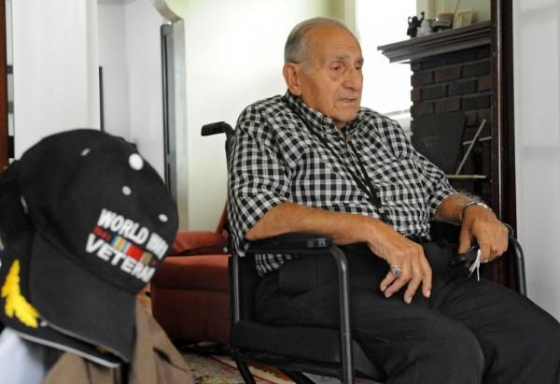
Need For Intervention?
The need for government intervention is measured by two factors of generosity which include the patient: In this instance the Veterans are the primary recipients of the health system. In this instance the plan followed is the first-dollar coverage.
The government intervention is the creation of the Veterans Health System, with the success of the millions of people served the intended affect.
Externalities. Administrative Costs, Redistribution from the healthy to the sick, and the possibility of Paternalism is a unintended effect of intervention, and the moral hazard of social insurance.
Notes:
The need for government intervention within healthcare is measured by two factors of generosity which include the patient: In this instance the Veterans are the primary recipients of the health system. According to the book, “the optimal generosity of health insurance will be determined by trading off the consumption -smoothing benefits and moral hazard costs of insurance.” (Gruber, 2011) In considering the patients, they have sacrificed their lives and bodies to the duty of protecting their government, and a majority are left with debilitating injuries such as a loss of limb, blindness, mental illness, head trauma, or other significant injuries, that they deal with throughout their lives. In some instances they lose the battle and their families are left in need of assistance. In leveraging how much should the patient have to pay versus how much the insurer does, in the case of Veteran’s health system majority of payment is placed on the government, this plan is considered “first-dollar coverage.” The provider of the insurance is the government, and is based off tax monies, grants, and government funding. The generosity posed on the provider is none, as they pay a majority of the health costs without the need of reimbursement. The overall intervention is the formation of the veterans health system which helps to not only insure low income, homeless, and veterans, but also provide benefits that they wouldn’t normally have access to without government intervention. The intended affect is success, as the program has been able to improve the care of millions of individuals including family and homeless people. With just about every intervention runs the risks of their being unintended affects that moral hazards and considered deadweight loss. In this instance the unintended affect are that the individuals that did have private insurance have dropped them and are dependent on the health system, that put more costs onto the system that might be used to help other veterans that are uninsured. The free rider problems presents a potential private where many who can afford private insurance choose to get free insurance provided from the government. The high cost of insurance that the government is paying for individuals adds more money to be taxed from others, and an increased in private insurance rates. Not including the redistribution that is unpopular is the focus is shifted to the more needy from the pockets of the most well off individuals. Also paternalism will play a role, in the which the government or its entities will have the say so in how they should be insured as the government insist it is doing it for the good of the people. The moral hazard is that, “higher social insurance improves social efficiency by fixing a market failure but reduces social efficiency by reducing production and raising taxes.”(Gruber, 2011)

Slide 5
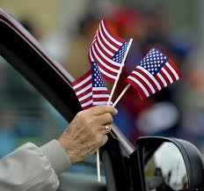
Is this the Best?
Within the scope of the government, the Veterans Health System is the optimal policy for the system. Government intervention has addressed a market failure where millions of people are left uninsured and homeless from the effects of the war. Military men serve an essential duty in protecting citizens, however, they are left with injuries that require much care.
If there was no government intervention then the problem within the market (uninsured, homelessness, etc) would fail, and the needs of individuals wouldn’t be met. The intervention is better than no intervention at all, even if some individuals do have to pay or they receive the health benefits for free.
Notes:
Within the scope of the government, the Veterans Health System is the optimum policy for the system. Government intervention has addressed a market failure where millions of people are left uninsured and homeless from the effects of the war. Military men serve an essential duty in protecting citizens, however, they are left with injuries that require much care. As the book explains that social insurance such as Veterans Health System program is weighed against the between the benefits and costs of such intervention. Veterans are insured and the government ensures that they are taken care of, thus the government fixing a market failure. However the government must raise taxes to compensate the high cost (billions) associated with providing care for individuals. “Thus, higher social insurance improves social efficiency by fixing a market failure but reduces social efficiency by reducing production and raising taxes.”(Gruber, 2011) However, although it doesn’t satisfy all the problems within the market, it does address the problems within the middle of comparing the problem and solution, which makes for the optimal policy in having government intervention versus not having it at all.

Slide 6
References
“About VA. “ US Department of Veterans Affairs. Web. 29 May 2013. http://www.va.gov/about_va/vahistory.asp
“Fact Sheet: President Obama Signs Executive Order to Improve Access to Mental Health Services for Veterans, Service Members, and Military Families.” The White House. 31 Aug. 2012. Web. 29 May 2013. http://www.whitehouse.gov/the-press-office/2012/08/31/fact-sheet-president-obama-signs-executive-order-improve-access-mental-h’
Gruber, Jonathan. Public Finance and Public Policy. Third Edition. Worth Publishers. Book. 2011.
“Health Benefits.” Department of Veterans Affairs. N.d. Web. 29 May 2013. http://www.va.gov/healthbenefits/apply/veterans.asp
Kizer KW, Fonseca ML, Long LM. “The veterans healthcare system: preparing for the twenty-first century. PubMed. 1997. Web. 29 May 2013. http://www.ncbi.nlm.nih.gov/pubmed/10169289
“Military and Veterans Healthcare.” KaiserEdu. N.d. Web. 29 May 2013 http://www.kaiseredu.org/Issue-Modules/Military-and-Veterans-Health-Care/Background-Brief.aspx
“Veterans Health Administration.” VA. 2010. Web. 29 May 2013. http://www.va.gov

