Slide 1
WALMART Inventory
Presentation and Proposal
Notes:
Wal-Mart is assessed to be one of the most successful retail store operating in the western region at present. Being as huge as its operation is, it has the need to keep an intact control of the inventory that the company embraces.

Slide 2
The Wal-Mart Inventory Issue
The company faces the need to leverage their performance for the sake of retaining competitive stance in the face of world economic failure.
In the aim of protecting how they manage the incoming number of retail products on line, the administrators there is a continuous flow of products. This further results to over inventory on the part of the company’s suppliers.
Notes:
As of now there are two primary inventory issues that the company should face as presented herein.

Slide 3
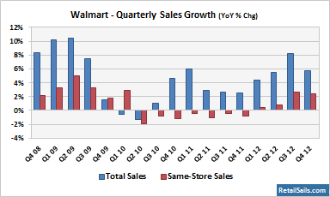
Changes and Developments
The need to solve the issue on inventory development is evidently necessary so as to protect the continuous flow of products in the different stores and branches of the business.
The above graph shows the performance of the different branches of some stores of Wal-Mart during the quarterly schedule after the implementation of better inventory management procedures by the administrators of the company.
Notes:
Solving inventory issues of the business involves the need to make sure that everything is in balance. The results of such changes could be seen the graph presented herein.

Slide 4
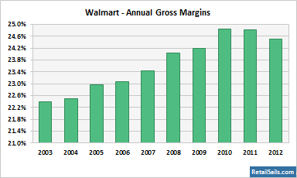
Reflection on Annual Growth on Company Sales
The annual growth sales of the company shows that the year 2010 proved to be much of its peak performance which gradually decline between the years 2011 and 2012.
This indicates that the sales inventory has been lowered due to some issues including operational cost spending. That directly affects the cash flow in the company.
Notes:
Presented herein is a reflection of the resulting factors of inventory solutions as evidently changing the pattern of company sales in an annual term.

Slide 5
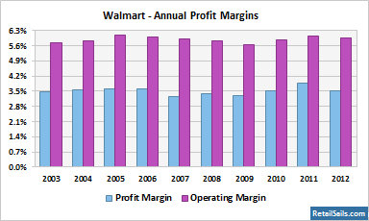
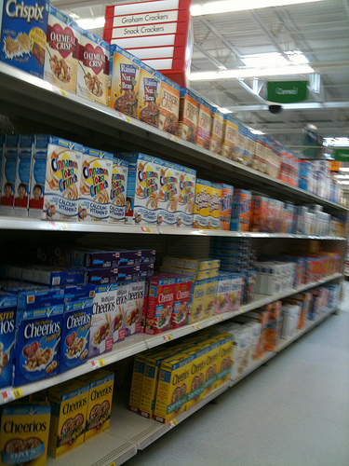
Balancing Operation and Sales
The reason behind the result on the previous slide is presented in this graph where the contrast of both profit and operation cost are supposed to be balanced.
Observe how the profit remained in tact between the years 2010 and 2012 yet operational cost spending increased by a percentage hence making it harder for profit increase to make a remarkable condition in the company’s performance in the market.
Notes:
Seen here is a comprehensive presentation on what caused the change of profit increase and decrease of the sales return from the operational cost of the business within an annual schedule.

