Slide 1
AUTISM SPECTRUM DISORDER (ASD)
BY: Tabitha

Slide 2
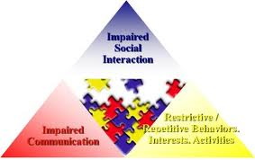
What is ASD?
Second most common serious developmental disability
Also known as Pervasive Developmental Disorder or PPD
Causes impairment in thinking, feeling, language development and relating to others
Notes:
By current standards, ASD is the second most common serious developmental disability after mental retardation or intellectual impairment (cdc.gov), but is considered to be less common than other conditions that affect children’s development, such as speech and language impairments, learning disabilities, and attention deficit/hyperactivity disorder (ADHD). Also known as Pervasive Developmental Disorder (PDD), ASD causes severe and pervasive impairment in thinking, feeling, language, and the ability to relate to others.

Slide 3
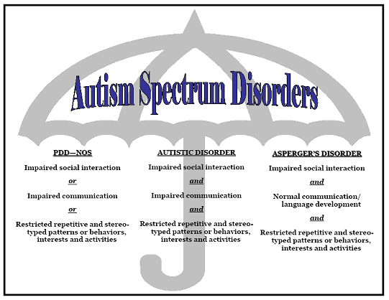
Notes:
Children with ASD demonstrate deficits in social interaction and in verbal and non-verbal communication. They commonly display repetitive behaviors or interests and often have unusual responses to sensory experiences. The disorder is usually first diagnosed in early childhood and may range from its severest form, called autistic disorder, through pervasive development disorder not otherwise specified (PDD-NOS), to a much milder form, Asperger syndrome or two other rare disorders, Rett syndrome and childhood disintegrative disorder

Slide 4
Prevalence
Rates of Autism Spectrum Disorder are increasing based on surveys
In the last 10 years, autism affects 2-7 children for every 1,000.
Notes:
In its most recent survey conducted in 2007, the Centers for Disease Control (CDC) found that the rate of autism spectrum disorder (ASD) was significantly higher than the rates found from surveys conducted during the 1980s and early 1990s. Studies conducted specifically in the United States have found rates between 2 to 7 per 1,000 children in the last 10 years (cdc.gov).

Slide 5
Year 2004
An autism alarm was issued by the CDC and the American Association of Pediatrics (AAP) in response to the rising rates of Autism
Notes:
In 2004, CDC partnered with the American Association of Pediatrics (AAP) to issue an autism alarm (cdc.gov) in cognizance of the urgency of giving attention to the increasing trend in the prevalence of the disorder as indicated by statistical data from earlier and recent studies.

Slide 6
Diagnosis
Early diagnosis equates to better outcomes.
Sadly, only 50% of children are diagnosed before entering kindergarten
Notes:
Early diagnosis is crucial because the earlier the disorder is diagnosed, the sooner the child can be helped through treatment interventions. Although early intervention has a dramatic impact on reducing symptoms and increasing a child's ability to grow and learn new skills, it is unfortunate that statistics show that only 50% are diagnosed before they enter kindergarten.

Slide 7
Role of the Community
Each person has a vital role to play
Understanding ASD is an essential
With early diagnosis and treatment, a normal life is possible to attain by children with ASD
Notes:
As part of the community, we collectively and equally have a vital role to play in helping individuals with ASD to reach their full potentials and successfully assimilate and integrate with society. It is here that we need to have a better understanding of what ASD is all about, determine whether its occurrence can still be prevented, what forms of early intervention and treatment are currently available, and the nature of support needed to help those afflicted with the disorder to lead a life of normalcy and become useful citizens of society.

Slide 8
References
American Academy of Pediatrics, The National Center of Medical Home Initiatives for Children with Special Needs. Accessed on 27-April-2012 from http://www.medicalhomeinfo.org/health/Autism%20downloads/AutismAlarm.pdf
Centers for Disease Control. Summary of Autism Prevalence Studies. Accessed 27-April-2012 from http://www.cdc.gov/ncbddd/autism/documents/tables-prevalence.pdf
Centers for Disease Control (2006). Metropolitan Atlanta Developmental Disabilities Surveillance Program. Accessed 27-April-2012 from http://www.cdc.gov/ncbddd/dd/ddsurv.htm#prev.
Dawson & Osterling (1997). The effectiveness of early intervention. Baltimore: Brookes. pp. 307–326.
Johnson, C. P.; Myers, S. M. (2007). "Identification and Evaluation of Children With Autism Spectrum Disorders". Pediatrics 120 (5): 1183–1215.

