Slide 1
Infant Sleep Related Deaths: Analysis and Plan of Action
http://upload.wikimedia.org/wikipedia/commons/thumb/4/4a/Sleeping_baby_with_arm_extended.jpg/500px-Sleeping_baby_with_arm_extended.jpg
Your Name, WHO

Slide 2
Infant Sleep Related Deaths: SUID
SUID: Sudden Unexpected Infant Death
Death of healthy infant (<365 days old); unknown cause
Three Diagnostic SUID:
SIDS
ASSB
Unspecified Causes
Notes:
SUID is the sudden unexpected infant death of a previously healthy infant less than 365 days old, in which had no immediately obvious cause of death.
There are three important diagnostic SUIDs associated with sleep. These are SIDS (sudden infant death syndrome). An infant is diagnoses with SIDS when no cause emerges even after a thorough investigation of the death scene, clinical history, and autopsy findings. ASSB (accidental suffocation or strangulation in bed and other unspecified causes. Some deaths categorized as SIDS or other unspecified causes likely are also associated with unsafe sleep environments.

Slide 3
Prevalence: Unsafe Infant Sleep Conditions
15-20 death/yr in Milwaukee
90 sleep related deaths between 2005 and 2008
Highest infant mortality rate in USA
80%=pillows, blankets
70%-shared sleep surface
70%-second-hand smoke exposure
40%- not placed on backs
(City of Milawaukee Health Department, 2010)
Notes:
Unsafe sleep has played a major factor in the deaths of infants. In fact, there is an average of 15-20 infant deaths each year in
Milwaukee. In addition, thie contributes to one of the highest infant mortality rates in the United States. There were 90 cases in which infant mortality was correlated sleep-related deaths between 2005 and 2008. Of the 90 sleep-related deaths 80% involved pillows, blankets, or other
soft items. 70% involved a shared sleep surface. 70% of the infants were exposed to second-hand smoke. 40% were not placed on their back to sleep.

Slide 4
Findings
2005-2008 infant deaths: Total 499 deaths
For ever 1000 infant born, 11 infants died
Black infants at higher risk worldwide (Rates at 15.7 for black infants vs. 6.4 for white infants)
Deaths concentrated in low poverty, unemployment and social problem areas.
(Michalski et al., 2010)
Notes:
During 2005-2008, there were 499 infant deaths in Milwaukee. For every 1,000 infants born, 11 infants died. Black infants were nearly three times more likely to die than White infants (infant mortality rates of 15.7 vs. 6.4 for this four year period.)
The Black infant mortality rate is worse than the overall rate of at least 35 countries around the world. In addition, the black infant mortality rates are higher in other large cities other than Milawaukee, such as New York and Chicago. Furthermore, the deaths that were reported in Milwaukee during 2005-2008 were concentrated in a few zip codes, where exhibited levels of poverty, unemployment and social problems. The next slide illustrates a chart comparing two zip codes in Milawaukee. One poverty ridden the other middle class.

Slide 5
Notes:
During the years 1990-2005, as seen in the Figure, black culture had the highest prevalence of deaths related to SIDS. American Indian Cultures also experienced a higher rate than whites and hispanics as well.

Slide 6
Notes:
When comparing the prevalence rates between White and Black infants and SIDS, you can clearly see the significant difference in the prevalence rates.

Slide 7
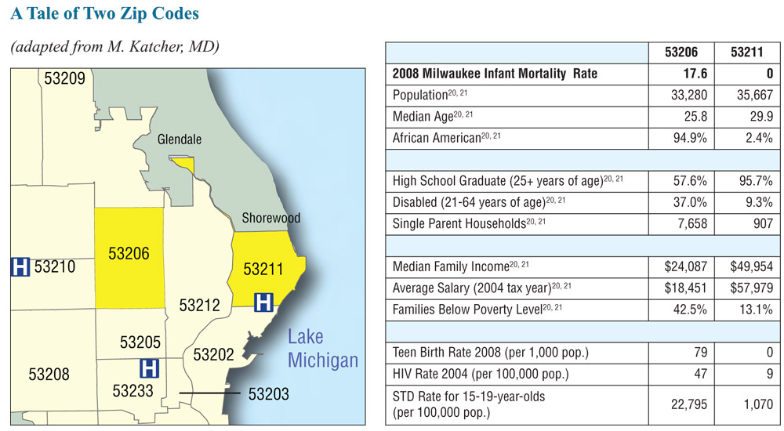
http://thirdcoastdigest.com/wp-content/uploads/2011/11/MKE_Mortality_Study_2011-26.jpg
Notes:
As you can see, the infant mortality rate is significantly higher in the African American neighborhood. In addition, other variables, such as high school educoni, disability, single parents households, income, salary, teen birth, HIV and STDs were significantly different as well. The only non-signficant variable was the population and within the populations, the infant mortality rate was 17.6 in the African American neighborhood vs. 0 for the non-African American neighborhood.

Slide 8
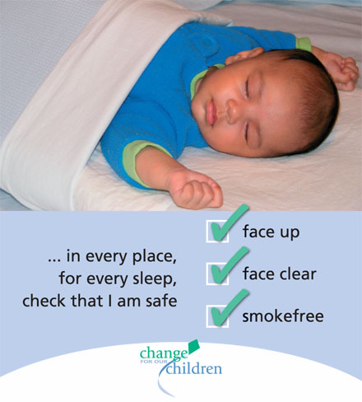
Sleep Environment
Most deaths related to unsafe sleep include a number of risk factors:
Soft objects
Bed-sharing
Second-hand smoke
Premature birth
AODA of caregiver
Sleeping on couch or swing
http://diyfather.com/files/safe-sleep.jpg
Notes:
Sleep environment major controversial issue in the deaths of many children who died at home while sleeping. The American Academy
of Pediatrics (AAP) and the City of Milwaukee ask that all parents and caregivers share a room, but not a bed with their babies. The information that is provided on Safe Sleep is abstracted from the death scene investigative reports. Most deaths related to unsafe sleep had a number of risk factors
present. The average number of risk factors was four. Common unsafe sleep risk factors are pillows, bumpers, blankets, quilts, bed-sharing, second smoke exposure, premature birth <37 weeks gestation, AODA (disabled caregivers) of caregiver, sleeping on couch, chair, bouncy seat or chair.

Slide 9
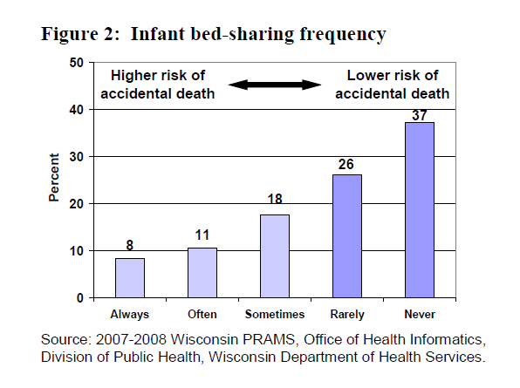
Bed-Sharing
Notes:
In 2007-2008, 37% of new mothers in Wisconsin reported that they were frequently sharing beds with their infants. 8% said always, 11% often, 18% sometimes. 37% never shared a bed. Younger mothers are mothers who are less educated are more likely to use unsafe sleep habits. Non-hispanic black mothers were more likely to report using non-supine sleep positions compared to mothers of other racial and ethnic groups.

Slide 10
Causes
Lack of crib
Encouragement of co-sleeping
Breastfeeding concerns
Fear of SIDS or “Crib Death”
Cultural Beliefs
Caregiver Exhaustion
Lack of knowledge or education
Desire to be close
Unaware of impact of alcohol or drugs
(Wisconsin PRAMS, 2012)
Notes:
There are several barriers that can have an impact of un-safe sleeping conditions for infants, such as lack of access to a crib or play pen, friends and family encouraging to not place the baby on the back or co-sleeping, concerns that separate sleep space will harm breastfeeding, worries about SIDS or crib death or violence in the home or neighborhood, personal or cultural beliefs, caregiver exhaustion, lack of knowledge of the current recommendations, the desire to be close to the baby, especially mothers with postpartum depression, lack of awareness of how alcohol or drugs can impair caregiver awareness of infant during sleep.

Slide 11
How We Can Help
Provide caregivers with information
Discuss the risks of infants sleeping on couches, chairs or adult beds
Listen to parents and understand their situation
Provide resources to families
Encourage the use of safe and awake “tummy time”
(Wisconsin PRAMS, 2012)
Notes:
In order to educate indivdiuals

Slide 12
Plan of Action: Three Recommendations
“Why didn’t
anyone tell me? This was my first
baby and no one told me anything
about the risks of sleeping with my
baby or using soft things around her.
Why don’t we hear how babies are
dying? I would give ANYTHING to
have my daughter back. All parents
need this information – make sure to
tell them.”
1)Who do we need to Reach?
High Risk Cultures
2) What do we need to Share?
3) How do we Reach and Share?
Home and Health Visits
Offer Classes
Educate Staff
Notes:
A Plan of Action needs to be implemented. I am recommending three ways in which a plan can be established. For 1) we need to establish Who we need to reach. He have to research and determine the high risk communities. According to the City of Milawaukee Safe Sleep Summit, there was a broad range of individuals that were identified in this spectrum. These included: mothers, fathers, siblings, grandparents, aunts and uncles, other family members, teachers, babysitters, teens/ high school students, school children, college students, health care providers, pediatric/Medical/Nursing students/residents, service agency staff, child care providers, foster parents, community members. Secondly, we need to offer information on safe sleep through DVDs, Posters, Pamphlets/brochures/handouts, Door hangers, Magnets, Model crib/visual displays, Birthday cards with safe sleep messages, Bed clothing with messages like go Back to sleep, tummy to play, Safest way to sleep with your baby is ABC: Alone, Back, Crib, using more pictures of (culturally-specific) safe sleep situations – babies sleeping on their backs in an empty (but inviting-looking) crib, in the same room as parents. We need to providing information that includes local statistics on unsafe sleep and infant deaths, share personal stories of infant mortality “Refer to Quote on SLIDE” . We could creating a safe sleep nursery rhyme book, eep sacks/halos that say “wrong
way” on the back prevent harm, share room not bed.
Thirdly, we need to Reach and Share to individuals during their prenatal visits or during public health programs. Even during preconception and inter-conception visits. We also need to address these issues before the infant is born.
We need to reach out to the at risk individuals through home visits. If the family is in WIC or Welfare, site visits should be established. Also, all of the above should be discussed during health visits. In addition, we need to offer classes as part as the prenatal visits.
Most importantly, we need to educate all Health Staff of the importance of educating individuals on this matter.

Slide 13
Social Influences
Infant Mortality in the African American culture is twice that of other cultures.
Sudden Infant Death Syndrome (SIDS) is one of the leading causes.
Infant Mortality in the American Indian culture is also higher than non-Hispanic white mothers.
How to implement program to this group
Eliminate risks in these groups by monitoring the trends each year.
Focus on behaviors that occur in these groups.
Lifestyles
Smoking
Poor Diets
Lack of Prenatal Care
Medical Problems
Infant Sleeping Behaviors
Partner with Health Care Providers or Agencies to improve the mortality rates in these social groups.
(CDC, 2007)
Notes:
Infant mortality among African Americans is more than twice the national average for non-hispanic white americans. The leading causes of infant death include congenital abnormalities, pre-term/low birth weight; however, Sudden Infant Death Syndrome (SIDS) is one of the leading causes as well. In addition, infant mortality occurs at a higher rate in American Indians as well. How to implement the program to this group by focusing on the behaviors that occur in these groups. For instance, the focus should be on the lifestyle, smoking habits, poor nutrition, lack of prenatal care, medical problems, how they feel about infant sleeping behaviors. In addition, the focus should be on partnerning with other Health Care Providers or Agencies in order to imporve mortality rates in these social groups that can address the situation and find the best approach. For example, posters and clothing could be given to soon to be parents at these agencies. Example is given on next slide.

Slide 14
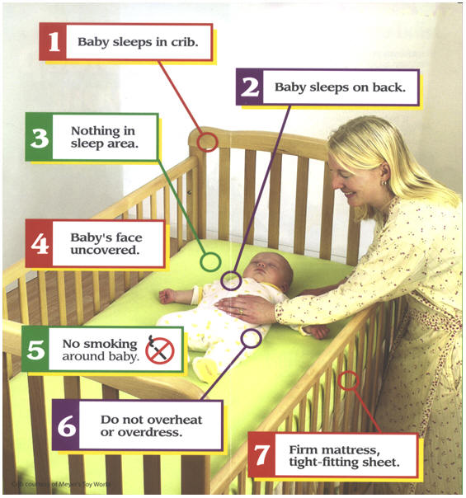
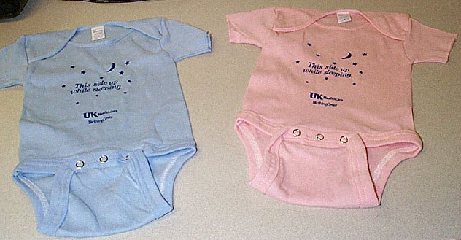
http://www.sids-pa.org/img5.jpg
http://www.uky.edu/PR/News/MCPRNews/2000/sids-onesies.JPG
Notes:
This is an example of a clothing item or poster that could be established or given to individuals in high risk areas.

Slide 15
Environmental Factors
Sleeping Position:
Increases risk of SIDS
Infants who sleep on their sides are twice as likely to dies of SIDS than those infants sleeping supine.
Current Recommendation: All infants should sleep on back.
Some nursey and daycare settings still place on side. (Hunt and Hawk, 2006)
Environmental Factors that occur with SIUD can easily be implemented into the program.
Parents and Staff must be educated on these issues.
Notes:
The prone sleeping position has consistently been shown to increase an infant's risk of SIDS. Although the rates of prone sleeping have decreased among the general population, the odds rations for SIDS among infants still sleeping prone have increased. For example, the odds in Norway for infant for SIDS was 2.0 before an education campaign and 11 after the campaign. Infants risk of SIDS is much higher when placed in another sleeping position, or on their stomachs or sides. The unaccustomed prone position is most likely to occur in a daycare setting. The current recommendation is to place all infants on their backs when sleeping. Environmental factors that influence infant mortality can be easily implemented into the educational program and all individuals will be educated on these issues.

Slide 16
Cultural Influences
Critical relationship exists between cultures and sleep practices. (McKenna, 2000)
Japan vs. USA
Japan encourges co-sleeping
USA children sleep alone
Since different cultures have different beliefs, these values must be taken into consideration as a health care provider when informing the patients, parents, or health care providers.
Information: Must be explained why it is important and all the risks involved when infants are not placed in a sleeping position that is not recommended by the WHO.
Notes:
When looking at the three recommendations for the implemention of the plan of action, the cultural influences of the risk groups should be assessed. We must be aware that a critical relationship exists between cultural ideologies and sleep practices. For example, in Japan, interdependence and group harmony are valued where parent-child co-sleeping is practices. American children are trained to be self-reliant and sleep alone. These observations related to the different attitudes in the Cultures between the Japanese and American parents and their concern with what sleeping arrangements are necessary to achieve developmental goals. In addition, since different cultures have different beliefs, these values must be taken into consideration as a health care provider when informing patients, parents or health care providers about SUIDs. The information must be explained in a way to illustrate the risks involved when infants are not placed in the proper sleeping position that is recommended by the WHO.

Slide 17
Epidemological Influences
Sleep-disordered breathing in the infant : increases infant mortality rate. (MedScape, 2003)
Apnea of Prematurity
Infant Apnea
SIDS
Infection, brainstem dysfunction, inherited disorders or fatty acid metabolism are also causes of SUDI.
Health Care Providers provide information to parents about precautions.
Notes:
Sleep-disordered breathing in infants does increase risk of mortality. The common disorders are apnea of prematurity, infant apnea, SIDS.
presents a unique threat to life. In addition, Genetic alterations in the brainstem and other disorders, such as fatty acid metabolism also increase risk of SUID. cell function,^{[16]} or cytokine profile^{[17]} may cause vulnerability in some infants. It is therefore important to stress to parents of children with these diagnoses about the proper precausations and the proper sleeping arrangements. For instance, second hand smoke should never be permitted around the children.
The prone sleeping position has consistently been shown to increase an infant's risk of SIDS.³⁹ As rates of prone sleeping have decreased in the general population, the odds ratios for SIDS among infants still sleeping prone have increased. For example, in Norway the odds ratio for SIDS among infants sleeping prone was 2.0 before an educational campaign and 11.0 after the campaign.⁴⁰ Infants at highest risk of SIDS may be those who are usually placed in another sleeping position but were placed on their stomachs for last sleep (“unaccustomed prone”) or were found in the prone position (“secondary prone”).³⁹ The unaccustomed prone position is more likely to occur in daycare or other settings outside the home and highlights the need for all infant caretakers to be educated about appropriate sleep positioning. Initial recommendations in SIDS risk-reduction campaigns considered placing an infant on his or her side to sleep to be nearly equivalent to the supine position in reducing the risk of SIDS, but subsequent studies have indicated that infants who sleep on their side are twice as likely to die of SIDS as infants sleeping supine.⁴¹ Thus, current recommendations call for placing all infants on their back for sleep except those few with specific medical conditions, for which a different position may be justified.³⁹ Some newborn nursery staff still place infants on their side, which models inappropriate infant care practice to parents. Many parents and health care providers were initially

Slide 18
Summary
The risk of SUIDS is at higher for Black communities located in Milawaukee Zip Codes and Nationwide
Communities need to be educated on the causes and risks
Healthcare Staff needs to be educated
Implementation of Programs needs to be established in high risk areas, with consideration of Social, Environmental, Cultural, Epidemilogical Influeneces.
Notes:
In Summary, the risks of SUIDS is higher in the black communities located in Milawakee as well as nationwide. These communites need to be educated on the causes and risks, as well as the Healthcare Staff. Finally, Implementation of the Plan of Action should be established in high risk areas with consideration of Social, Environmental, Cultural, and Epidemilogical Influences.

Slide 19
References
CDC. (2005). National Health Statistics.
CDC. (2007). Eliminate Racial Disparities. Web. Retrieved on July 12, 2012 from: http://www.cdc.gov/omhd/AMH/factsheets/infant.htm
City of Milwaukee Health Department. (2010). Safe Sleep Summit. Report. May 3, 2010.
Franciscan, W. (2010). Safe Sleep Summit. St. Joseph Hospital.
Filiano, J. and Kinney, H. (2004). Triple Risk Model for SIDS. Biol Neonate. 65:194-197.
Hunt, C.E. and Hauck, F.R. (2006). Sudden infant death syndrome. CMAJ. 174(13): 1861–1869
McKenna, J. (2000). Cultural Influences on Infant and Childhood Sleep Biology, and The Science that Studies It: Toward a More Inclusive Paradigm Sleep and Breathing In Children: A Developmental Approach JLoughlin, Jcarroll, CMarcus, (Eds.) Marcell Dakker 2000, pages 199-230.
MedScape. (2003). Sleep Disorders in Children: Infant Sleep Disorders. Retrived on July 12, 2012 from: http://www.medscape.com/viewarticle/463494_2.
Michalski, K., Gathirimu, J., Benton, A., Swain, G., Gass E., Ngui, E. (2010) Milwaukee Fetal Infant Mortality Review Report. City of Milwaukee Health Department, December 2010, 1-40.
Wisconsin PRAMS. (2012). What Moms Tell Us. Division of Public Health, Department of Health Services. P-00242A.

