Slide 1
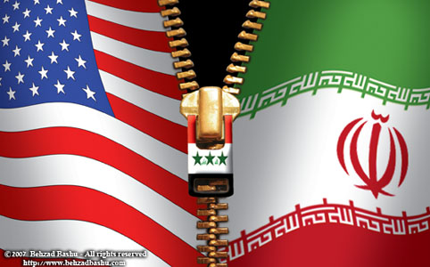
The Iran-Contra Affair
Understanding its Beginning and How it Assumes Current
Iran-American Relations

Slide 2
Iran Contra: Roots
U.S. viewed communist regimes such as Vietnam, Cuba, and Nicaragua as not sovereign countries but Russian Agents
Boland Amendment (1984) prevented CIA and Department of Defense from providing militaristic aid to Nicaragua
Nicaragua was being ruled by the leftist Sandinistas

Slide 3
Solution to Boland Amendment
President Reagan deemed Sandinistas a communist threat
Boland Amendment didn’t apply to the National Security Council (NSC)
Instead of the direct aid, a portion of the receipts from arms sales to Iran was diverted to the Contras through the NSC

Slide 4
The Beginning
1986
The Reagan Administration
The scandal between the relationship of US with the Iranian system of operations against human rights has been established.
Hoping to topple the government of Nicaragua, Contra Militants used to engage in a warfare against the said form of governance through extensive violence of torture, rape, mutilation that caused the death of hundreds if not thousands in Honduras.
THE BOLAND AMENDMENT limited US assistance to the contras after the said group were accused of strongly going against human rights administration.

Slide 5
Establishing the Purpose
Continued operation
of the Contras
Although the group was not supported anymore, it continued to thrive from which its system has been further embraced by other countries such as Israel.
In the aspect of growing terrorism, seven American hostages were aimed to be freed by Reagan hence causing him to agree to the process of arms-exchange between Israel and Iran which it would fund. In exchange, the Iranian group shall do everything to free the seven hostages.
The Growth of
Terrorism

Slide 6
An Agreement Gone Bad
Deterioration of the
Agreement
While the American Government tried to establish the worth of the cause of the agreement, the main purpose has began to deteriorate into becoming an arms-exchange scheme between the two countries involved [Iran and America].

Slide 7
The Need to Face the Truth
Accepting the Illegal
course of the Administration
Although he was not proven guilty of being directly a part of the scheme, Reagan took responsibility for all that has occurred in line with the agreement as the presiding administrator during the time when the illegal connection for arms distribution has been incurred.
In line with this, retracting the value of the agreement for hostage exchange has been processed since the Iranian party did not accomplish what they have promised to complete for the administration.

Slide 8
Breaking the Silence
Total arms sold to Iran:
August 1985: 96 TOW
anti-tank missiles
May 1986: 508 TOWs and
240 Hawk Spare Parts
September 1985: 408 TOW
August 1986: Delivery of
Hawk spare parts
November 1985: 18 Hawk
Anti-Craft Missiles
February 1986: 500 TOWs
October 1986: Delivery
of 500 more TOWs

Slide 9
A History of Arms Trade
In line with all that happened in the past, a certain question remains unanswered, was it really just the exchange of arms for hostage that occurred or was it the receipt of payment from the militants that caused the contra-agreement to be preserved?
Beyond the agreement,
continuing arms trade
between Iran and US
continue to occur

Slide 10
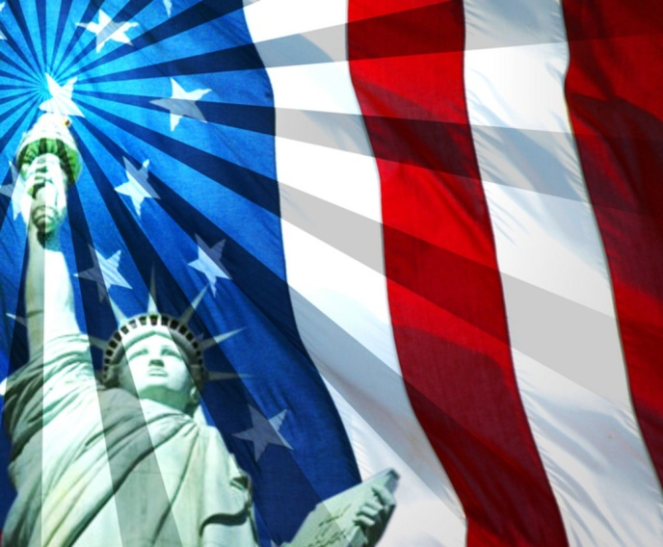
Resulting Developments from the Past
From exchange of hostages
to exchange of peace
Through the years, the American administrators have continuously embraced the process of agreeing with Israel to be able to protect its regions and its other allied countries from being attacked by perpetrators.
To do so, continuous supply and exchange of arms and payment between parties involved are established and specifically continue to thrive.

Slide 11
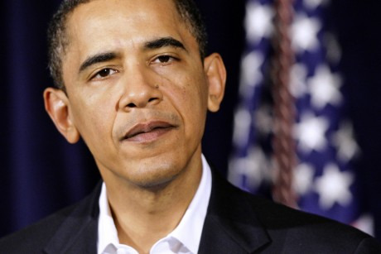
The Relationship between Then and Now
Did Obama promise Israel arms deal in exchange for delaying Iran strike after US elections?
Released in consideration with the issue of Obama offering Iran a supply of weaponry in exchange of not attacking after US elections have been presented in the headline noted above which has been posted at Hot Air online media [http://hotair.com/archives/2012/03/08/did-obama-promise-israel-arms-deal-in-exchange-for-delaying-iran-strike-after-us-elections/]
Is the American government guilty of funding the desires of possible terrorism attacks just so to protect its political agendas over the status of its national security?

Slide 12
Scaling the Current US-Iran Relationship
Continued obvious conflict
But a unified desire to strengthen armies
While there exists an obvious conflict between the two nations, it is seen that both US and Iran often bargain on values, especially in connection with the desire to strengthen their armies through improved weaponry. Whether the process is illegal or not, the advancement of weaponry in Iran and Iraq is said to be strongly supported by underground arms exchange from the US direct insiders.
-Timmerman, Kenneth R. The Death Lobby: How the West Armed Iraq. New York, Houghton Mifflin Company, 1991.

Slide 13
References:
Asleson, Vern. Nicaragua: Those Passed By. Galde Press . 2004.
Cold War Museum. Iran Contra Affair (1983-1988). 21 May 2012 <http://www.coldwar.org/articles/80s/IranContraAffair.asp>.
Moyers, Bill. The Secret Government. 21 May 2012 <http://www.youtube.com/watch?v=jiRBxDEGDqw>.
Shenon, Philip and Stephen Engelberg (July 5, 1987). "Eight Important Days in November: Unraveling the Iran-Contra Affair". The New York Times.
Timmerman, Kenneth R. The Death Lobby: How the West Armed Iraq. New York, Houghton Mifflin Company, 1991.
Webb, Gary (1998). Dark Alliance: The CIA, the Contras, and the crack cocaine explosion. Seven Stories Press.
Zinn, Howard (2003). A People's History of the United States. New York: Perennial.

