Slide 1
Literacy leadership plan
Aberdeen School District, Washington State

Slide 2
Aberdeen School District
Located in Washington State
Student population of roughly 3,400 from pre-school to 12th
450 certified staff members
Five elementary schools, one junior high, one traditional high school, and one alternative high school.
Aberdeen has a population of approximately 16,500 residents
Source: Aberdeen School District, 2012

Slide 3
Statewide Data Analysis
Statewide Report Cards measure the passing percentages of students in grades three to eight.
It also measures student success based on Measurements of Student Progress and High Proficiency Eaxam (MSP/HSPE) in the areas of math, reading, science, and writing.
Source: Aberdeen School District, 2012

Slide 4
Washington State Report Card
Statewide reading test results for the 2010-2011 school year shows scores within a six point range from 67 percent to 73 percent for grades three through six, but indicates a significant decline in seventh grade test scores to 56.5 percent.
Incremental increase from 68.7 percent for eighth grade to 82.6 percent for 10th grade students
MSP/HSPE math test scores were significantly lower than reading scores and ranged between 50 percent and 64.3 percent for all grades.
Based on the MSP/HSPE assessments, eighth grade scored the lowest at 50.4 percent and 10th grade scored the highest at 64.3 percent
Source: (OSPI, 2012)

Slide 5
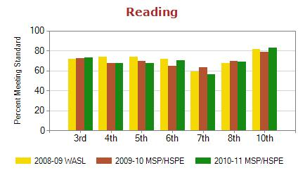
Statewide Reading

Slide 6
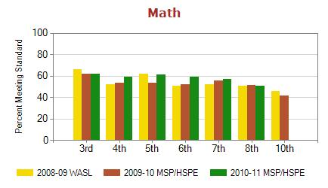
Statewide Math

Slide 7
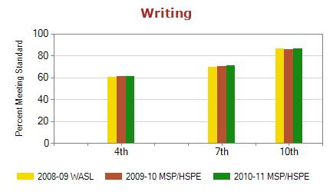
Statewide Writing

Slide 8
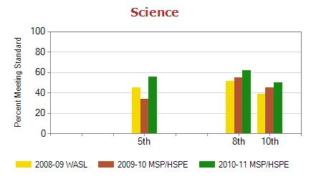
Statewide Science

Slide 9
District-Wide Data Analysis
Third-graders read at a 59.1 percent proficiency level and delivered math scores at a 55.6 percent proficiency level
Fourth-graders scored 65.7 percent in reading, 51 percent in math, and 49 percent in writing
Fifth-graders scored 68.1 percent in reading, 48.5 in math, and 17.3 in science
Sixth-graders scored 62.8 percent in reading, and 41.2 percent in reading
Seventh-graders scored 47.7 percent in reading, 47.1 percent in math, and 55 percent in writing
Eighth-graders scored 53.2 percent in reading, 40.3 percent in math, and 34.1 percent in science
Tenth-graders scored 66.7 percent in reading, 25.9 percent in math, 64.3 percent in writing, and 18.1 percent in science
Source: OSPI, 2012

Slide 10
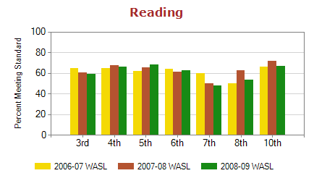
District-Wide Reading

Slide 11
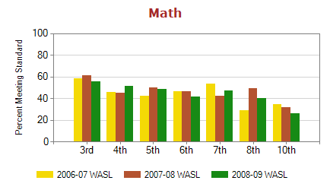
District-Wide Math

Slide 12
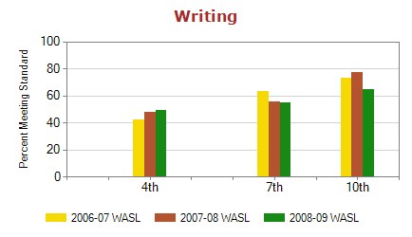
District-Wide Writing

Slide 13
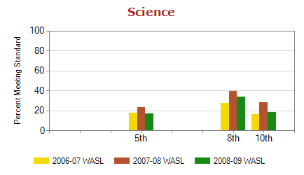
District-Wide Science

Slide 14
Aberdeen District Deficiencies
Aberdeen School District is performing well below state standards.
This evidence will help educators to implement curricula that will strengthen the areas that show the most weaknesses, such as science and math.

Slide 15
Literacy Leadership Plan
Primary areas of concern are reading and math for seventh-graders
Transition from primary school to middle school is difficult
Since the district only has one middle school, class sizes are larger than what students are accustomed to

Slide 16
Recommendations
Implement Small Learning Communities
Use Team Approach
Co-enrolling students in two or more courses will result in regular peer-to-peer interaction, while they are engaged in shared scholarly activities
Will improve learning outcomes for students, while teachers can design lesson plans to incorporate different courses.
The result is that students have a more comprehensive idea of course material.

Slide 17
Team Approach
Propagates the implementation of small learning communities within large schools to transform the lives of teachers and students alike
In addition to teaching civility and equality, the implementation of small learning communities is the most viable means to design a responsive and integrated curriculum
Source: Dickinson & Erb, 1997, p. 55

Slide 18
Team Approach
Curriculum within middle schools that use the team approach is based on nationally recognized standards
Offers extra help to students who struggle in math or reading
With the team approach model, teachers group between 80 and 100 students into teams and instruct that group of students as a team
Teachers are responsible for class scheduling and for the implementation of universal lessons into each class.
Teachers also integrate subjects and material to determine the best method to teach a certain lesson
The result of the team model is a comprehensive approach to education, which results in more attention to students’ needs and abilities.
Promotes educational continuation and flexibility.
Source: Herlihy & Kemple, 2004; Dickinson & Erb, 1997, p. 26.

Slide 19
Leadership Roles
Educational leaders will identify and implement guiding principles for all funds allocated to support the aforementioned recommendations.
Through the appropriate allocation of resources, the leadership team will develop a statewide capacity in student literacy, as well as design district-wide literacy self-assessments.

Slide 20
Leadership Roles continued…
Director: Will collaborate with the Superintend to gain approval for establishing literacy as a primary goal for the district;
Principals: All eight school principals in the district will work with the director to implement an effective and feasible vision to improve district-wide literacy;
Literacy Leadership Team: Will collaborate to refine the District-wide literacy plan;
Literacy Leaders: Will be responsible for conducting ongoing assessments to determine the effectiveness of the program and to recommended changes in the areas that prove ineffective.

Slide 21
Conclusion
This method of instruction promotes interdisciplinary collaborations between teachers with regards to instructional leadership and program coordination
Research has indicated that smaller schools are associated with increased academic achievement, despite having a more restricted curriculum.
As a result, the achievement gap usually found in larger schools is minimized in a smaller school setting because different ethnicities are reduced in smaller schools (Oxley,
Source: Small Learning Communities: Implementing and Deepening Practice, 2007, p. 22

