Slide 1
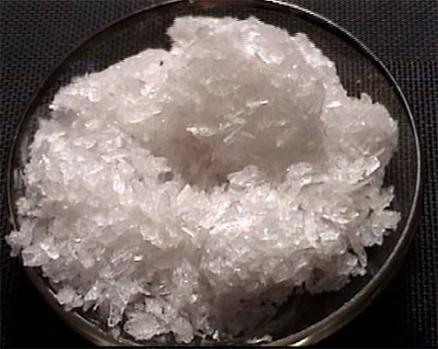
Methamphetamine Effects On Dopamine
April 30, 2012
Presented by:

Slide 2
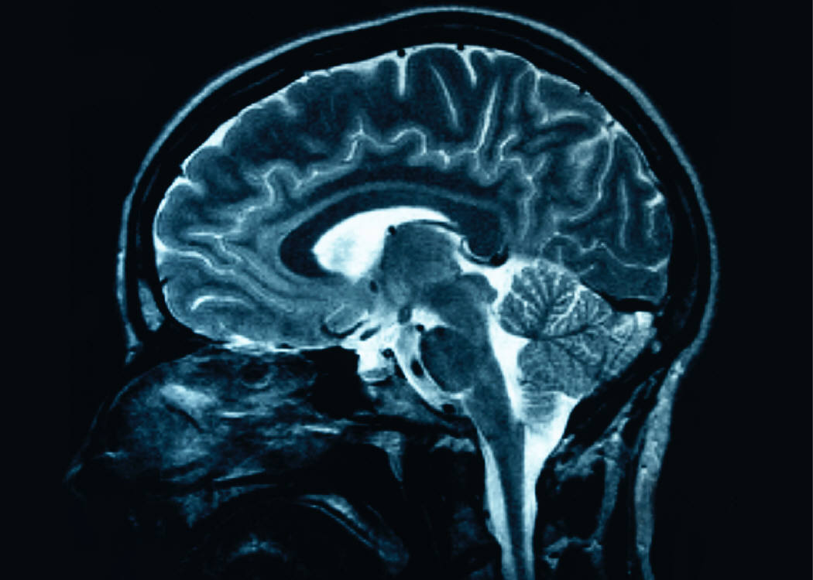
The Epidemic Of Meth
Methamphetamine Changes The Brains Structure
Dopamine is a Neurotransmitter
Meth Increases Production Of Dopamine
30 Million Use Yearly
16,184 Deaths 1995 In The United States
Image of Brain
Notes:
Slide: What is Dopamine
Problem: Dopamine is an organic chemical that functions as a neurotransmitter, carrying messages within the brain.
Incidence: When methamphetamine is introduced it causes mass release of dopamine and thereby changes the structure and functioning of the brain.
Prevalence: There are about 30 million users in the United States.
Mortality: 16, 184 deaths due to meth in the United States that was documented in 1996, however it is estimated that the numbers have increased greatly.

Slide 3
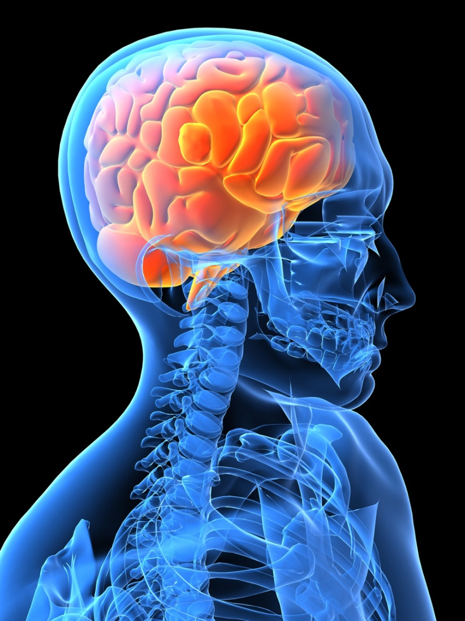
Long Term Effects
Dopamine Controls Movement
Destroys Dopamine Receptors
Meth Used For It’s Euphoric Effects
Users Are Not Aware Of The Internal Brain Damage
Notes:
Effects: Dopamine controls body movements, information flow, feelings of enjoyment, motivation and much more. When meth is introduced for long periods of time it interferes with all of these bodily functions. Individuals may experience the same symptoms of Parkinson’s disease or other movement related disorders as well as psychiatric disorders such as Schizophrenia.
Teratogenic: Meth has a poison effect that actually destroys dopamine receptors, which creates an inability to produce dopamine over time. The individual may have a flat affect and have an inability to feel euphoria other than when they are using meth.
Recreational Use: Meth is used to fill quick levels of euphoria, which occurs when the rush of dopamine is released into the brain. While the “high” is short lived, individuals suggest that they feel extreme happiness, pleasure and over all euphoria.
Ignorance of Effects: Most users do not realize the meth is depleting their brains ability to function normally. While they may know it is harmful, they do not fully understand the scientific phenomenon that neurotransmitters are being destroyed and pathways are being destroyed and rebuilt that is dependent on meth.

Slide 4
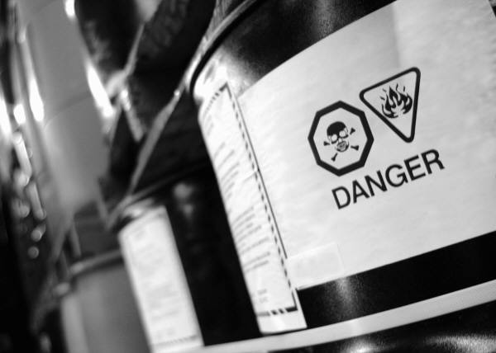
About The Law
Meth Is A Schedule II Class Of Drugs
  Addictive Physically & Physiologically
Low Cost – High Reward
  Easy To Obtain
Current State & Federal Laws
  Sufficient Laws
  Difficulty Enforcing
Notes:
Schedule II Classification – Which is defined as substances in this schedule have a high potential for abuse which may lead to severe psychological or physical dependence.
Barriers – with the low cost of use and quick reward to the user, it is commonly used. The high prevalence it is difficult to find and prosecute users. Another problem is the fact that the effect of meth happens so quickly, that by the time the law becomes involved the negative effects have already begun.
Laws In Place – each and every state has laws regarding Schedule II drugs. While the laws are sufficient, the punishment and enforcement phase is often too lax. Because there is such crowding in jails, offenders are often given second, third and fourth chances before they are required to seek substance abuse treatment.

Slide 5
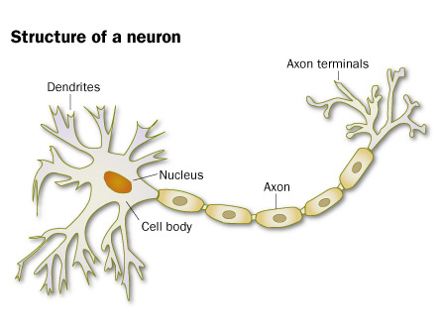
Alteration Of Dopamine
Stimulates Release Of Neurotransmitter
  Enters Axon
  Interferes With Dopamine Vesicles
Blocks Pumping Back To Neuron
  Dopamine Transporters Are Blocked
  Unable To Remove Dopamine From Synapse
Notes:
Slide: Alteration of Dopamine
Issues that define– methamphetamine can enter the axon and actually causes the release of dopamine from vesicles. It then causes the vesicles to release dopamine in larger quantities.
Blocks pumping back to neuron – because the dopamine transporters are blocked it inhibits the ability to remove excess from the synapse and return to a normal state.

Slide 6
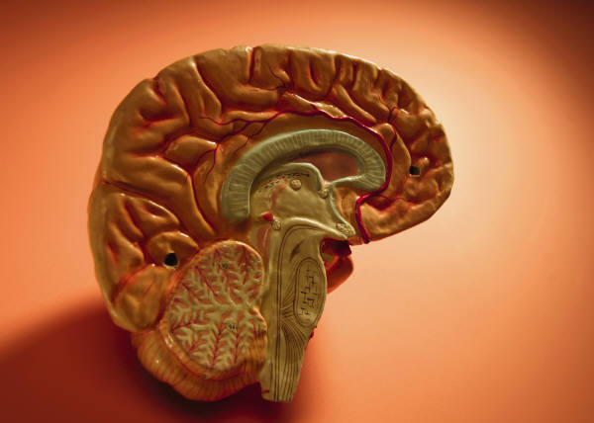
Critical Findings
Meth Has Similar Properties To Dopamine
Increases The Levels Of Dopamine Produced
Changes Brain Structure & Pathways
Changes In The Chemical Makeup Of The Brain
Serious Health Concerns & Death Are Prevalent
Notes:
Slide: Meth Effect
Meth has similar properties to the neurotransmitter dopamine and is the reason that the difficulty arises.
Because it has similar properties it causes an increased in dopamine, which leads to serious concerns for the user’s health.
These dopamine float in the synapse and essential have nowhere to go because there are only so many dopamine receptors, which are already full with all other dopamine.
Meth also blocks the reuptake pumps and therefore is not able to get rid of or recycle the extra dopamine.

Slide 7

Conclusion
Meth Destroys 50% Of Dopamine
Damages Neuron
Permanently Changes Brain Pathways
Research Suggest Brain Changes Occur That Are Not Likely Repairable
I Conclude That Long Term Meth Use Decreases Health, Deteriorates Brain Functions, Structure & Depletes The Ability To Properly Operate.
Notes:
Issues - Meth Destroys 50% Of Dopamine, because of the depletion of dopamine receptors.
Neurons are permanently damaged because of changes in chemical structures.
Permanently Changes Occur To Brain Pathways
Research Suggest Brain Changes Occur That Are Not Likely Repairable
I Conclude That Long Term Meth Use Decreases Health, Deteriorates Brain Functions, Structure & Depletes The Ability To Properly Operate.

Slide 8
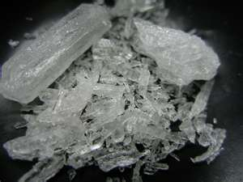
Recommendations
Increased Public Awareness
Imposed Harsh Sentences
Mandatory Treatment For Convictions
Prevention Through Increased Media Attention
Methamphetamine
Notes:
Increased Public Awareness – public entities, governmental agencies and schools should strive to inform the public about the dangers and prevalence of meth use and potential deathly affects.
Impose Harsher Sentences – for those that are caught with drugs.
Mandatory education and treatment imposed in those that have drug charges.
Prevention – Increased literature, media and articles that inform the public about the dangers and also harmful effects.

Slide 9
Recommendations
Increased Public Funding For Research
Easier Admission To Treatment Facilities
Educate Against Common “Addict” Stigma
Human Brain
Notes:
Increased Public Funding For Research – additional State and Federal funding would assist in finding improved ways of treating methamphetamine addiction and how to improve outcomes for users.
Easier Admission – in many cases addicts have difficulty getting into treatment, which further facilitates the addictive cycle. Increasing funding and additional treatment facilities would assist the addict, as well as create a safer society.
Educate against stigma – there is a definite stigma associated with addiction. This oftentimes hinders users from getting help because families have difficulty admitting that their family member is an addict. This can be done through education.

Slide 10
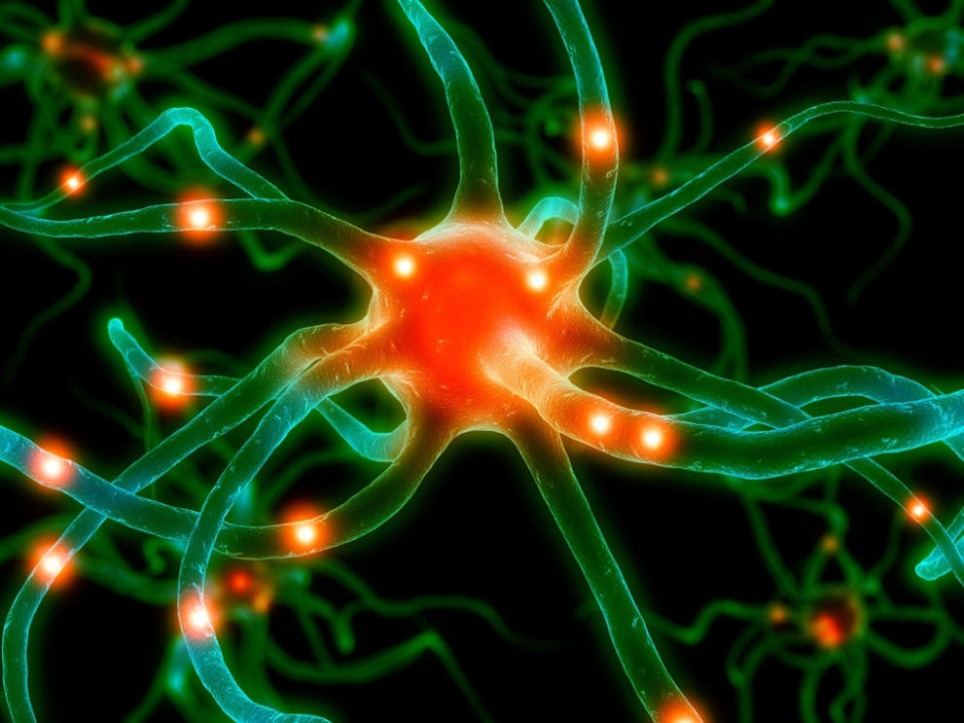
Research
Improved Understanding Of Dopamine
Increased Implementation In Technology
How Can Dopamine Receptors Be Repaired
Notes:
Research
Develop an improve understanding of dopamine through laboratory studies and use that information to assist with medical intervention.
Developing new technology and an understanding of how dopamine receptors can be stimulated after damage from meth usage.
Continue research into medications and medical interventions can repair dopamine receptors and restore brain functions.

Slide 11
Treatment
Decrease Cytokine Chemicals
Stimulate New Pathways Within The Brain
Address Changed Brain Structure
Treat Addiction Through Counseling
Notes:
Slide: Reward Center of the Brain
Because Cytokine chemicals are increased and create the new pathways, thereby destroying the old ones, treating the cytokine levels may assist in improved outlook for meth abusers.
Research and implement how new pathways can created and reducing the damage from destroyed pathways, can facilitate treatment for therapy.
Ex: new pathways are created as new expressways replace old highways
These changes tell the person’s body and brain that they need the meth to survive and function normally, which sets them up for further relapse.
Counseling and treatment can assist in recovering from addiction and stopping the relapse cycle that facilitates damage to the brain and overall health.

Slide 12
Cheng, J., & Feenstra, M. P. (2006). Individual Differences in Dopamine Efflux in Nucleus Accumbens Shell and
Core during Instrumental Learning. Learning & Memory, 13(2), 168-177.
"Dopamine." Biochemistry. (2008). Web. 29 Apr. 2012.
<http://www.macalester.edu/psychology/whathap/UBNRP/meth08/biochemistry/dopamine. htm>.
Fleckenstein, A.E., Metzger, R.R., Wilkins, D.G., Gibb, J.W., Hanson, G.R. (1997). Rapid and Reversible
Effects of Methamphetamine on Dopamine Transporters. Journal of Pharmacology and
Experimental Therapeutics, 282(2). 834-838.
Goldman-Rakic, P.S,. Castner, S.A., Svensson, T.H., Siever, L.J., Williams, G.V., (2004). Targeting the dopamine D1 receptor in schizophrenia: insights for cognitive dysfunction.
Psychopharmacology,174: 3–16
"Methamphetamines:." Montana State University. Winter 2008. Web. 29 Apr. 2012.
<http://www.montana.edu/wwwai/imsd/rezmeth/transmit.htm>.
Moszczynska, A., Fitzmaurice, P., Ang, L., Kalasinsky, K. S., Schmunk, G. A., Peretti, F. J., & ... Kish, S. J.
(2004). Why Is Parkinsonism Not a Feature of Human Methamphetamine Users?. Brain,
127(2), 363-370.
Newbury, J., & Hoskins, M. L. (2008). A Meaningful Method: Research with Adolescent Girls Who Use
Crystal Methamphetamine. Child & Youth Care Forum, 37(5-6), 227-240.
Qi, Z., & Gold, P. E. (2009). Intrahippocampal Infusions of Anisomycin Produce Amnesia: Contribution of
Increased Release of Norepinephrine, Dopamine, and Acetylcholine. Learning & Memory,
16(5), 308-314.
Sarkar, C; Basu, B; Chakroborty, D; Dasgupta, PS; Basu, S (2010). "The immunoregulatory role of dopamine: an update". Brain, behavior, and immunity 24 (4): 525–8.
Schmidt, C.J., Ritter, J.K., Sonsalla, P.K., Hanson, G.R. & Gibb, J.W. (June 1985). Journal of
Pharmacology and Experimental Therapeutics. 233(3). 539-544.
References

