Slide 1
title
Presenter Name
Presentation Date

Slide 2
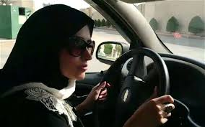
Conveniences of Driving
Notes:
Women in America and many other parts of the world can’t imagine their lives without the convenience of a car. Women take their children to school, run errands, meet friends for lunch, make play dates with other parents, and sometimes they just take a drive to relax. They do all of these things without thinking about them. Imagine now that you are a woman living in Saudi Arabia. You are not allowed to drive. If you want to go somewhere you must have your husband to carry you. If you are unmarried you must have another male relative carry you or you must catch a cab. Imagine how inconvenient your life would be without a car. This is not very hard for me to imagine because I am from Saudi Arabia. I have lived this life and know first hand how utterly ridiculous it is to have such laws placed upon women. This topic is very important to me; therefore this picture is very liberating to me.

Slide 3
Women’s Rights?
Women and girls are forbidden to leave home, travel outside the country, work, study , marry, file a court case, or seek medical attention without the permission of a male guardian-husband, father, brother, or son.
Women can’t open bank accounts
Women can’t enroll their children in school.
Girls are taught that their primary role in life is to raise children and take care of the home
Notes:
Essentially, women have no rights in Saudi Arabia. Recent news reports have shed light on the struggles that Saudi women are facing, but light needs to be shed on so many other issues women are having in Saudi. On June 17th about 40 women with international drivers’ licenses participated in the “women2drive” campaign. There are no laws forbid women from driving in Saudi, but government officials forbid the practice. Saudi Arabia is the only country in the world that prohibits women from driving.

Slide 4
Women Rights?
Saudi women constitute 17% of the native workforce
women may work only in capacities in which they can serve women exclusively: women can work as doctors, nurses, teachers, or in a few other special situations where there is no contact or interaction with the opposite gender.
Driving would be the first step in an erosion of traditional values, such as gender segregation.
Notes:
Saudi Arabia follows very strict interpretation of the Islam Wahhabis. Punishments are harsh. For example, a court sentenced a 75 year old woman to 40 lashes, four months imprisonment and deportation from the kingdom for having two unrelated men in her house. So, women who are brave enough to fight for equal rights in Saudi could be severely punished or killed. These women are willing to sacrifice their lives for freedoms that so many take for granted.

Slide 5
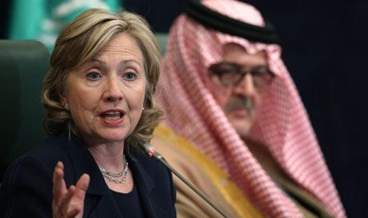
Support is Needed
She added that the ban is "hard to even rationalize" in today's world.- Hillary Clinton
Notes:
Hillary Clinton has publicly supported Saudi women who have defied their kingdom’s ban on female drivers. Clinton said that Saudi Arabia is one of the strongest and longest standing US allies in the Middle East, yet it is also the only country on earth where women are not allowed to drive, or even ride a bicycle, For that reason it is often called ‘the world's largest women's prison’. Saudi women lack of freedom to move from place to place causes an extreme burden on their lives. The lack a public transportation systems causes even the most basic errands and medical appointments to be missed due to the difficulty and expenses of arranging transportation. Many establishments openly state that the reason they prohibit women from driving is to keep women at home and in need of men. The lack of the basic right to drive cars has caused women to be repeatedly exploited by abusive fathers, brothers, husbands and even hired drivers. Just this week a Saudi woman reported she was raped by her driver.

Slide 6
Call to Action
Advocate
Petition
Publicity
Notes:
Saudi Arabia’s prohibition against women behind the wheel must end–and Saudi women have made great strides toward changing public opinion through activism. From a human rights standpoint, it is disgraceful that adult citizens in the year 2013 would have their ability to operate a motor vehicle restricted by something as arbitrary and irrelevant as their sex. Furthermore, it makes little sense from an economic standpoint, as it renders roughly half of the adult population completely reliant on others for transportation. Women’s driving rights appear to have a wider support base in the country than several other concerns that have compelled Saudis to take to the streets since 2011. In a Gallup survey from 2007 – several years before the Arab uprisings inspired new ways of approaching basic rights – 66 percent of Saudi women and 55 percent of Saudi men expressed the belief that women should be allowed to drive

