Slide 1
Self-Differentiation, Nation of Origin, Religious Affiliation, and Bicultural Identity Development in Former Soviet Union and Arab immigrants
Anastasia Zyuban, M.A.
Doctoral Dissertation
Richard L. Conolly College - Long Island University

Slide 2
Introduction
U.S. – A Mecca for Immigrants
Economic opportunities
Racial, ethnic, and cultural diversity
Foreign-born residents – 12 % of total population
Speakers of non-English language – 19 % of total population

Slide 3
Moving to a new country …
Adapting to a new culture
Emotional Impacts
Stress
Uncertainty
Reformulation of identity
Empirical studies
Numerous studies have examined the psychological impact of settling down in a new culture
Hermans & Kempen, 1998
LaFromboise, Coleman, & Gerton, 1993

Slide 4
Bicultural Integration
Research interest in bicultural integration of immigrants is relatively recent
Benet-Martínez & Haritatos, 2005
Trimble, 2003
Literature’s implications regarding acculturation
Assimilation into dominant culture is the most useful strategy
It is only one among several strategies employed by immigrants

Slide 5
Acculturation
Much more than mere assimilation
Includes but not limited to
Reorganization of values and beliefs
Transformation of self-concept
Acculturation options
Adopt host culture
Identify with both host culture and culture of origin
Identify with culture of origin only
Associate with neither

Slide 6
Acculturation (Cont.)
Literature suggests identifying with both host culture and culture of origin
Allows preservation of cultural heritage
Enables engagement with the host culture
Additional benefits include
Healthy self esteem
Positive relationships
Sense of well-being
The literature suggestion not without limitations
Individuals from certain countries adjust more easily into host culture as compared to others

Slide 7
Factors behind acculturation
Successful acculturation is influenced by several factors
Self-differentiation
Independent cognitive style
Self-awareness
Secure sense of self
Environmental factors
Similarity between host culture and culture of origin (Positive relationship)
Language
Religion
Values
Status of women
Individualism vs. Collectivism
Attitudes towards authority
Forms of government
Legal systems

Slide 8
Factors behind acculturation (Cont.)
Attitude of natives towards particular immigrant groups
European natives generally hostile to non-European immigrants
Studies found that non-European immigrants often reported
Lower levels of adaptation
Greater identification with cultures of origin
Lower sense of mastery
Lower life satisfaction

Slide 9
Limitations of existing literature
Most studies have examined acculturation from assimilation perspective
Studies have usually focused on personal characteristics of immigrants or the external context of immigrants
To date, no study has investigated the role of contextual factors in the relationship between personal qualities and bicultural identity formation

Slide 10
Research Study - Introduction
Purpose
Investigate the potential influence of national origin and religious identification on the relationship between self-differentiation and bicultural identity formation
Study Sample
First generation immigrants from former U.S.S.R
First generation immigrants from Arab countries

Slide 11
Sample
Sample Size – 155 first-generation immigrants
 | Men | Women | Total | %
Former U.S.S.R (FSU) | 39 | 24 | 63 | 40.65%
Arab countries (Arabs) | 67 | 25 | 92 | 59.35%

Slide 12
Sample (Cont.)
Sample Characteristics
 | FSU | Arabs
Mean Age | 31.37 | 30.56
Years in the U.S. | 14.58 | 13.39
Immigration with family/relatives | 59.40% | 76%
Married | 42.20% | 61.50%
Religious Identification | Orthodox Christian (39.7%) | Muslim (45%)
 | Muslim (17.5%) | Christian (34.7%)

Slide 13
Hypothesis 1
Immigrants from FSU have higher levels of bicultural identity than those from Arab countries

Slide 14
Hypothesis 2
Immigrants who identify themselves as Muslims would show higher levels of bicultural identity than those with other religious affiliations or no affiliations at all

Slide 15
Hypothesis 3
Nation of origin (FSU vs. Arabs) would moderate relationship between self-differentiation and bicultural identity

Slide 16
Hypothesis 4
Religious identification would moderate association between self-differentiation and bicultural identity development. Muslim participants would demonstrate weaker relationship between self-differentiation and bicultural identity development for both Arab and FSU immigrants while those with other religious affiliations or no affiliation at all would demonstrate a positive relationship between level of self-differentiation and bicultural identity development

Slide 17
Hypothesis 5
Religious identification would moderate association between nation of origin and bicultural identity development. FSU and Arab immigrants who are non-Muslim would show higher levels of bicultural identity development than Arab and FSU immigrants who are Muslim

Slide 18
Measures
1. Cloze Procedure
Efficient predictor of English language proficiency
For the purpose of the study
Test employed – Bachman (1982) 365-word passage
Results interpreted – Bormouth’s (1971) criteria
Passing mark set at 60% (12 correct responses)

Slide 19
Measures
2. Demographic Questionnaire
Descriptive data on participants including but not limited to:
Gender | Education level
Age | Occupation
Marital Status | Living status (with parents or alone)
Age at arrival in the U.S. | Parents' occupation
Reason for arrival | Household Income
Number of years in the U.S. | Religious Orientation

Slide 20
Measures
3. Differentiation of Self Inventory (DSI-R)
A 46-item, self-reported scale consisting of four subscales:
Emotional Reactivity (ER)
I-position (IP)
Emotional Cutoff (EC)
Fusion with Others (FO)
Study Sample Score
Overall Sample | 0.89
FSU | 0.91
Arabs | 0.81

Slide 21
Measures
4. Bicultural Identity Integration Scale, Ver. 1 (BIIS)
Benet-Martinez’s (2003) BIIS measures nine items in two factorial categories which are:
Cultural Conflict
Cultural Distance

Slide 22
Measures
5. The Social, Attitudinal, Familial, and Environmental Acculturative Stress Scale (SAFE)
Mena, Padilla, and Maldonado’s (1987) SAFE scale measures acculturative stress in four contexts:
Social
Attitudinal
Familial
Environmental
Study Sample
 | Internal Consistency
Overall Sample | 0.88
FSU | 0.90
Arabs | 0.84

Slide 23
Measures
6. Cultural Distance Questionnaire (CDQ)
Mumford and Babiker’s (1998) CDQ measures the differences in social life between the countries
Participants were asked to respond on ten items
CDQ Final Scores
Climate | Clothes | Language | Education | Food
Religion | Material Comfort | Leisure | Family Structure | Courtship & Marriage
 | Cronbach’s Alphas
Overall Sample | 0.77
FSU | 0.74
Arabs | 0.70

Slide 24
Measures
7. Religious Identification
The survey asked the participants to report their religious orientation among the following choices:
Denominational approach to measuring religious identification has been recognized as a valid measure in the field of Sociology
Christian | Jewish | Muslim | Buddhist
Hindu | Atheist | Agnostic | Other (Specify)

Slide 25
Measures
8. Scale of Intensity of Religiousness (SIR)
Saroglou and Mathijsen’s (2007) SIR scale measures participants’ responses on seven items:
Classic religiosity
Importance of God in life, Importance of religion in life, and Frequency of prayer
Emotional religiosity
Emotional-relational aspect, Community aspect, Meaning-values aspect, and Personal religious experience
Survey Responses
Classic religiosity Emotional religiosity
 | Internal Consistency Reliabilities
Overall | 0.87
FSU | 0.88
Arabs | 0.70
 | Internal Consistency Reliabilities
Overall | 0.81
FSU | 0.91
Arabs | 0.79

Slide 26
Measures
9. Schedule of Racist Events (SRE)
A modified version of Landrine & Klonoff’s (1996) SRE was used to assess perceived discrimination
Unlike the original version which also included SRE-Lifetime and SRE-Appraisal, this study only utilized SRE-Recent
Survey Responses
 | Internal Consistency Reliabilities
Overall | 0.97
FSU | 0.97
Arabs | 0.95

Slide 27
Measures
10. Marlowe-Crowne Social Desirability Scale (MCSDS)
Reynolds’ (1992) MCSDS scale measures the social desirability factors
Respondents were asked about instances of social discrimination
Survey Response
 | Internal Consistency Reliabilities
Overall | 0.91
FSU | 0.91
Arabs | 0.91

Slide 28
Procedures
Search for potential participants
Website ads
Flyer distribution at a large, urban university
Shortlisting
Several measures were taken to obtain a suitable sample population:
Consent forms
Country of origin question
English language proficiency test

Slide 29
Result: Hypothesis 1
T-Test
BIIS Scale - (t(107.266) = -0.49, p = 0.62)
No significant difference between FSU and Arabs
Hypothesis 1 (Disapproved)
Conclusion:
Immigrants from FSU do not have significantly higher levels of bicultural identity than those from Arab countries

Slide 30
Result: Hypothesis 2
T-Test
BIIS Scale - (t(154)= 1.25, p= 0.21, d= 0.20)
No significant difference between FSU and Arabs
Hypothesis 2 (Disapproved)
Conclusion:
Immigrants who identify themselves as Muslims show almost same levels of bicultural identity as those with other religious affiliations or no affiliations at all

Slide 31
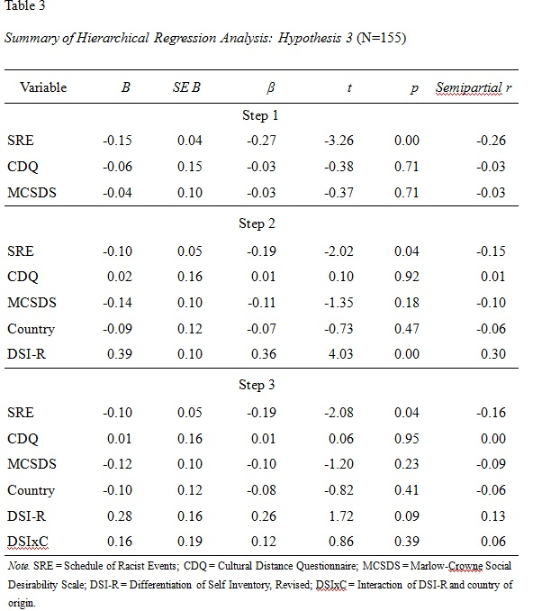
Result: Hypothesis 3
Hypothesis 3 (Disapproved)
Conclusion:
Nation of origin (FSU vs. Arabs) doesn’t have any significant impact on the relationship between self-differentiation and bicultural identity

Slide 32
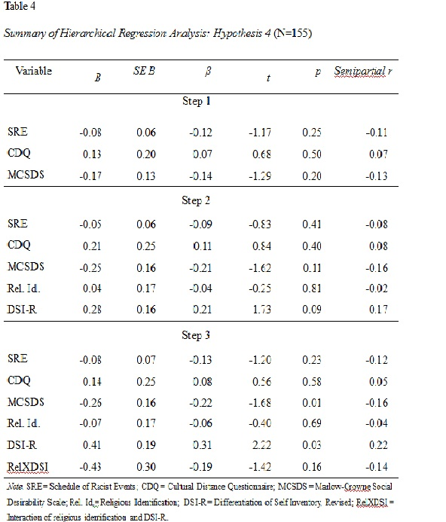
Result: Hypothesis 4
Hypothesis 4 (Disapproved)
Conclusion:
Immigrants who are Muslims do not show significantly weaker relationship between self-differentiation and bicultural identity development than non-Muslims

Slide 33
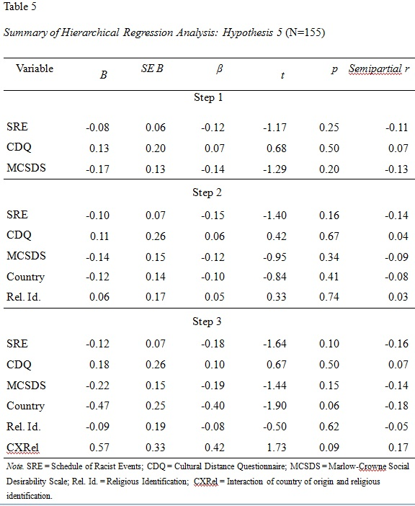
Result: Hypothesis 5
Hypothesis 5 (Disapproved)
Conclusion:
Participants who are non-Muslims would not show any stronger relationship between self- differentiation and bicultural identity than those who are Muslims

Slide 34
Post-hoc Analysis
Level of religiosity found to be correlated with bicultural identity development
Post-hoc analysis
Does level of religiosity significantly influence the relationship between country of origin and bicultural identity development as per hypothesis 4?
Result
Influence of level of religiosity on the relationship between country of origin and bicultural identity development varies among immigrant groups
FSU = Yes
Arabs = No

Slide 35
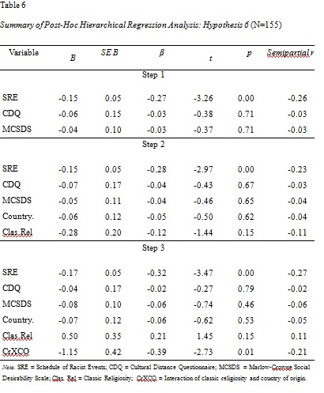
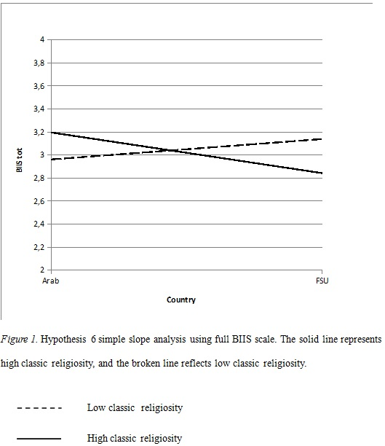
Post-hoc Analysis - Religiosity
Low classic religiosity
FSU individuals scored significantly higher on the BIIS than Arab individuals
High emotional religiosity
FSU individuals scored significantly lower on the BIIS than Arab individuals

Slide 36
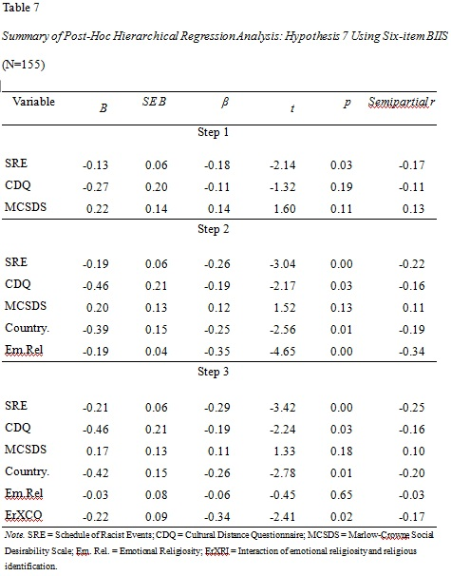
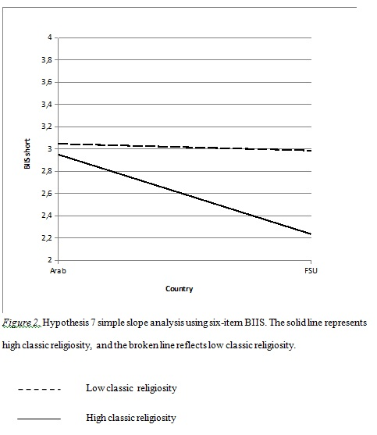
Post-hoc Analysis - Religiosity
FSU
Less religious (classic and emotional religiosity) individuals scored significantly higher on the BIIS than more religious individuals

Slide 37
Conclusions
The study confirms that immigrants from FSU who are better at developing a bicultural identity are also more likely to display higher levels of self-differentiation
The findings seem to be universal in nature, i.e. they apply to Arab immigrants also
The roles played by different dimensions of self-differentiation seem to be influenced by cultural context
Religious affiliation doesn’t have a significant impact on cultural identity
Degree of religiosity may have varying influence on bicultural identity in different cultures
Unlike religious affiliation, level of religiosity may influence the relationship between country of origin and bicultural identity development
The influence varies among immigrant groups
Arab respondents did report higher levels of perceived discrimination and acculturative stress
The trend could have significant long-term consequences including depression and high risk of suicide

Slide 38
Study Limitations
Low Cronbach Alpha Reliability Coefficient of BIIS
Inaccurate data by respondents
Sample population came from a limited geographical area
May not be a good representative of the overall immigrants’ populations from FSU and Arab countries
Language Limitation
All respondents spoke proficient English. The experiences may be may be quite different for those not proficient in English
Even within FSU and Arab world, significant cultural differences exist among ethnic groups

Slide 39
Recommendation for future studies
Greater number of research variables may help overcome the hurdle of low Cronbach Alpha Reliability Coefficient
Sample size could be chosen from larger geographical area
Multi-language options may help gather more effective and accurate responses
Future research studies may also focus upon the long-term impact of acculturation differences among immigrants from different countries

