Slide 1
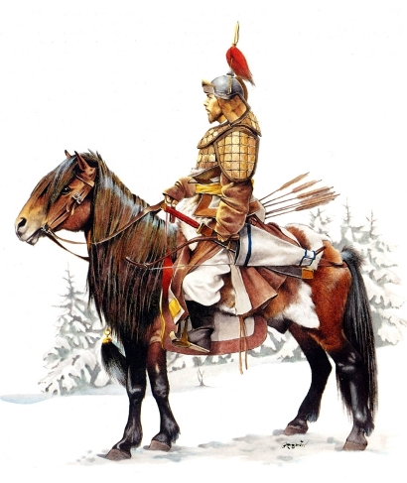
ELEMENTS OF HISTORY
The Ideals of Mongol Rule in Russia and China:
A Comparative Presentation

Slide 2
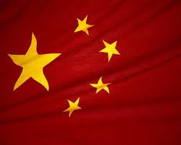
MONGOLS in CHINA
Cultural Changes:
Arts and theatre Presentations were enhanced as part of international relations that China has been introduced to.
Infrastructures and Transportation:
To improve trade and international connections, Mongols improved the road constructions and irrigations in the country
Introduction of New Religious Beliefs:
Some Chinese converted to Islam but Chinese Taoism remained strong including the implication of the principles of Confucianism

Slide 3
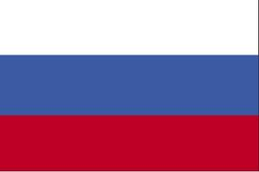
MONGOLS in RUSSIA
ARTS AND CUTURE
Russian Iconography and Fresco painting flourished again
Church art flourished in line with the development of orthodox belief
Governance and Institution
Development of dual implementation of regional administration headed by military governors.
Religious
Reestablishment of the Orthodox church
A better definition of a community-wide belief
Loss of centralized system of governance

