Slide 1
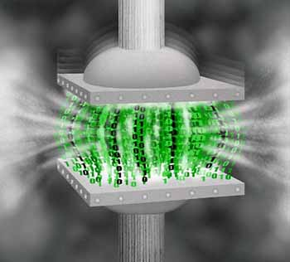
The Impact of Cloud Computing on Private Data Centers
A Research Paper

Slide 2
Introduction and Problem Statement
This research shall depend on the following questions for effective pattern of development:
What is a data center and how does it function for modern companies today?
What is cloud computing and how much would it affect modern information processing operation?
Will companies that have their own data centers transform to virtual operation through cloud computing?
Is the cloud computing the data center of the future that becomes a utility to all of the business in the world with inherent IT needs?
Is it safer and more cost effective for companies to adapt cloud computing as part of their IS operations?
Notes:
Expansion and reliability are among the many functions of private datacenters at present. However, with the immense increase of information, how are datacenters supposed to sustain the need for extended developments?

Slide 3
Motivation for Research
Being a datacenter employee, handling information services is a main concern for the author.
Hearing much about cloud computing raises the interest of the author in finding out whether or not this system would indeed affect the function of the datacenter industry in the future. Focus of discussion would be:
Functionality of cloud computing
Benefits and cost of the cloud
Future implications of the cloud system

Slide 4
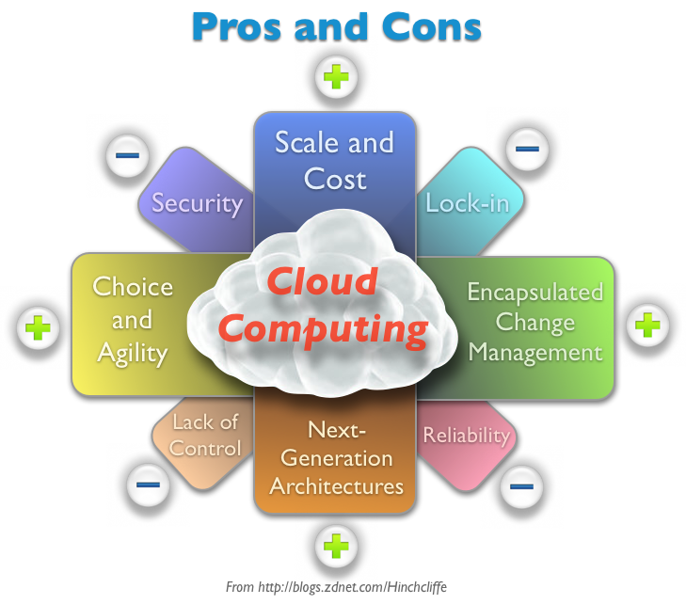
Major Findings
CLOUD COMPUTING is the face of new data management in the future making it possible for the virtualization of datacenters to take place. Some major findings include the pros and cons of the system

Slide 5
Conclusion
Future datacenter operations would be greatly affected by cloud computing
Cloud computing does provide effective platforms of information management that is efficient for organizational utilization
Cost effectiveness and functional efficiency are among the most inviting and useful aspects of cloud computing

