Slide 1
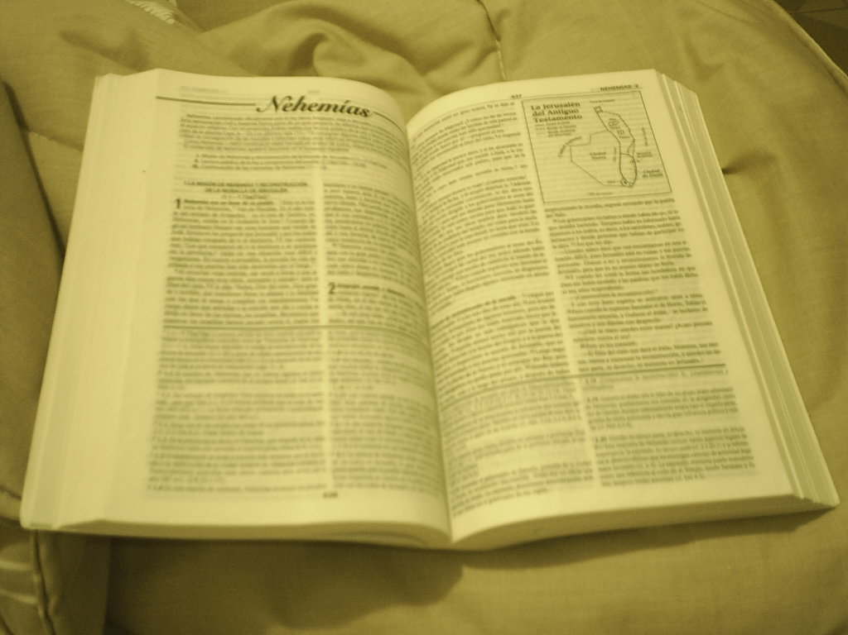
Comunicación y Gerencia
Importance of Religion
An important role in human society
A personal perspective
Notes:
This is the title page

Slide 2
Importance in my life
The need for spiritual guidance
Personal code of conduct and ethical values
Intellectual development as a human being
Perspective – tolerance of other viewpoints
Creates a sense of order in society
Notes:
Spiritual guidance is an essential navigational aid for all humans. We all need to define our role and purpose in life. Parents start you off on the path but we all have an individual journey to chart. We find this help by seeking spiritual guidance that helps to develop us as human beings. It is this spirituality that helps to define our humanity and who we are as individuals. Most people strive towards goodness and we develop our own barometer or personal code of conduct and ethical values.
Our spiritual essence is that of our mind and soul. We educate ourselves in order that we may socialise and live in a community in order to make a worthwhile contribution to society. In following this journey we recognise a higher sense of purpose and the path towards enlightenment. In this regards developing our humanity is a means of developing tolerance and respect for others viewpoints, regardless of creed or nationality. At the same time refining our education and understanding towards enrichment of our soul by attaining a sense of goodness towards others.
In a sense it is the rejection or dispensation of sin / evil towards a state of purity attained through goodness and self-discipline. It is to recognise our place in the universe and a sense of order of things. To understand our own limitations but to strive towards self-fulfilment of being all that we can be in terms of our humanity (Collins)

Slide 3
Examples of my position
Spiritual guidance comes from inner strength and the ability to lead and develop a good life
Being a kind and charitable person makes you feel good and gains the respect of others
Helps to develop our morality and humanity with a sense of purpose in life
Notes:
There are many different types of religious beliefs. In general terms religion is a personal journey and comes from determination of your own spiritual beliefs regardless of the type of religion. This is attained by self-analysis and finding the inner strength to lead a good life. Religion is often influenced by the primary care givers at an early age (parents) and they set you off on your journey in life. Ultimately it is our own journey and self-determination that makes us follow the route of goodness or evil. Society looks to promote goodness through law and order and individuals are free to chose their own path in life.
Most individuals desire to develop their humanity by building their own code of personal conduct and ethics ( sense of values) that they can endorse and live by. It is this sense of morality development that helps to define who we are as human beings and distinguishes us from that of animals. The path towards goodness is to develop our enlightenment towards understanding and practicing such items as compassion, understanding, tolerance of others and a sense of equity in our dealings with others. Our reflection of our own personal values defines who we are and acts as an example to others in society who wish to adopt a similar route in life.
Religion is therefore important in helping to define who we are as a person and our sense of purpose in life. (McFadden)

Slide 4
Reasons for others
Personal self-development
Morality and code of conduct
Sense of perspective in the universe
Humanity and tolerance of others
A basis for reason and understanding
Development of the soul and mind
Following the path of “goodness”
Notes:
There are a number of reasons for others to adopt a position similar to my own position:-
Personal Self Development – the importance of developing your social skills to contribute to society in a good and purposeful manner;
Morality and code of conduct – we all require personal standards and a moral code to live by, we need to determine the values that we can endorse and live by;
Perspective – We need to understand our role in the universe and the limitations imposed upon us. To strive towards enlightenment by a path of goodness enriches our spirituality and soul;
Humanity – the determination of who we are as human beings and a sense of purpose in all things. To develop dignity, humility, tolerance and understanding in our dealings with others;
Spiritual development - We exist in our mortal form for a relatively short period of time, during this period we define our own destiny in terms of being a good or bad person. It is to follow a path of enlightenment towards goodness that ultimately leads to the development of the mind and the cleansing of the soul.
Science does not have all of the answers. (Radcliffe-Brown)

Slide 5
References
Collins, T. The Contribution of Religion to Society, May 31st 2007, White paper speech delivered by the Archbishop of Toronto
McFadden, S.H. Religion and Well-Being in Aging persons in an aging society, 1995, Journal of Social Issues Vol 51, Iss 2 pp 161-175
Radcliffe-Brown, A.R. Religion and Society, 1945, Journal of the Royal Anthropological Institute of Great Britain, Vol 75 Iss 1 pp 33-43
Notes:
References Page

