Slide 1
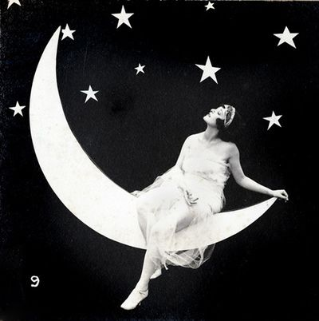
Presentation of Draft for Final Research
Defining the parts
and Focus of Discussion

Slide 2
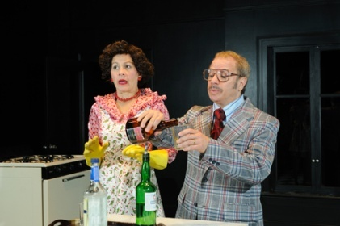
Topic and Title Choice
Title: Examining the Windows of the Absurd Theatre through Ages and through Cultures
This title intends to define a specific attention on the course of discussion that the research is going to take helping the readers understand what they should expect from the said material of writing
Notes:
Divided into two particular sections, the title basically introduces what the research is going to be about.
The two divisions include the terms “through the ages” which suggests a discussion focused on the developmental pattern of the absurd theatre
And the term “through cultures” suggesting a sense of definition of the said type of theatre based on cultural differences in the world.

Slide 3
Purpose and Objectives
It is the purpose of this research to define absurd theatre based on development and cultural differences of presentation around the globe.
This research is defined under the core patters of the following objectives:
To clearly define what absurd theatre is
To make an assumptive presentation on the developments of the said type of performing arts
To research and know how other cultures aside from the European regions utilize absurd theatre as a form of performing excellence
To give the readers a clear understanding on the real value that the absurd theatre carries
Notes:
As presented herein, it is the aim of this research to instil among the readers the need to know what absurd theatre is through defining its history and the way it is being viewed across the nations around the globe.

Slide 4
First Sections of Discussion
Introduction
This section hopes to introduce the reader to the contextual direction that the research is to adapt to be able to present important details about the topic being discussed.
Understanding the Absurd Theatre
This section provides the readers with a specific primary understanding of what absurd theatre is.
Notes:
These first sections of the discussion aims to clarify and present the primary information that must be known by the readers with regards the topic of the absurd theatre.

Slide 5
Central Sections of Discussion
The Absurd Theatre as a form of Avant-garde art
For this part of the discussion, defining the value of absurd theatre is to be presented
Noting the Real Worth of the Absurd Theatre
This section shall further define the real meaning of the absurd theatre based on how it was developed not only to entertain but to influence the mind of the audiences.
An Absurd Mirror of Real Life
For this part of the discussion, an explanation on how absurdism is used to define real living in the absurd theatre shall be tackled with deeper definition of the said art in relation to social issues.
Understanding the Deeper Meaning of the Absurd in Different Cultures
Seeing through how cultures respond to the said form of performing arts, this presentation shall intend to make a definite indication on how absurd theatre is accepted as a form of complex art in other nations
Notes:
The central sections of the discussion are supposed to be the gist of the research whcih will present the readers with the most important issues that the context of the research is practically based upon.

Slide 6
Finale and Conclusions
Reflections and Learning
Giving an indicative presentation on how the author of the research specifically gained knowledge from the research, this part shall provide a chance for the author to present what he learned and what he was able to see through himself through understanding points of reality regarding the absurd theatre.
Conclusion
Serving as the finale of the discussion, this section hopes to present an overall scope that the research has been about hence concluding the finale indication on how absurd theatre developed through the years and how it was accepted through different cultures.
Notes:
The last sections of the research hopes to finalize what has been learned and provide a reflective indication on how the author of the research gained knowledge from the study itself.

Slide 7
Research Expectations
The research is hoped to impose the possibility of gaining these final points after its completion:
A well constructed understanding of the absurd theatre
A better vision of its [absurd theatre’s] real worth to the performing arts
A better understanding on the difference of cultural acceptance regarding the application of absurd theatre as a form of entertainment and influence
An establishment of good knowledge as to how absurd theatre is being presented today.
Notes:
Read through slide

Slide 8
References to Use
Gabrielle H. Cody, Evert Sprinchorn. The Columbia encyclopedia of modern drama. Columbia University Press, 2007.
Marshall Cavendish. World and Its Peoples: Eastern and Southern Asia. Marshall Cavendish, 2007.
Kalina Stefanova, Ann Waugh. Eastern European Theater After the Iron Curtain.Routledge, 2000.
Les Essif. Empty figure on an empty stage: the theatre of Samuel Beckett and his generation. Indiana University Press, 2001.
Notes:
Read through slide

