Slide 1
What are the health knowledge needs of pregnant teenage mothers?
Your Name and Credentials
Regis College

Slide 2
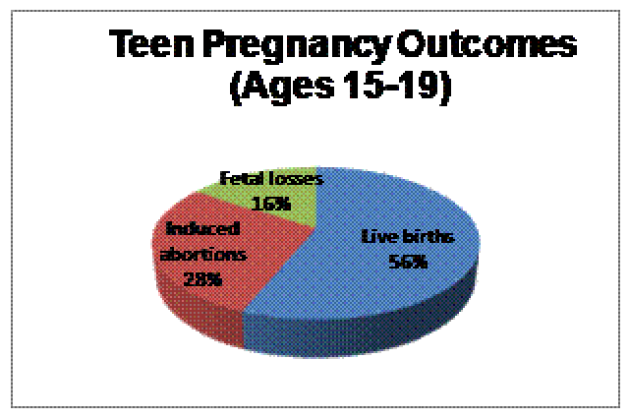
Introduction
This data is important to nursing practice as it provides a clear definition on how nursing intervention could make a difference on how teenage pregnancy rates could be lowered and its risks be given solution to in line with the mother and the child’s future welfare.
At present, there are different risks that are involved in the rising number of teenage women getting pregnant.
The graph above presents how many abortions and fatal loses are incurred between girls ages 15 to 19 who get pregnant.

Slide 3
Background
Teenage pregnancy is most often as the state of motherhood incurred by a teenage girl often outside of marriage.
Teenage pregnancy is considered to be one of today’s most prevalent dilemmas among young girls as they face their ages of puberty and the challenges that comes along with it.
Notes:
For this study, an assessment of what teenage pregnancy is and how it is becoming a dilemma among teens at present is discussed. Through a research process, the measure of the teenage pregnancy births in the United States have been accounted for and was utilized to define the procedures that nurses could take so as to make sure solutions could be provided for the emergence of such problems.

Slide 4
Methodology and Procedures
Getting Reliable Sources
Analysis of Data Collected
Interpretations and conclusions
Notes:
To complete this study, the researcher decided to complete a literature investigation on CINAHL, Medline and ENSCOhost article sources so as to find out the real issues behind teenage pregnancy and how they are currently being resolved.

Slide 5
Purpose
To define what teenage pregnancy is and define the problems behind it
To make an assumptive position based on research on defining what nursing intervention could do to resolve the issues
To improve the process by which teenage pregnancy and motherhood is to be handled carefully hence avoiding further healthcare problems in the future.
Notes:
The main questions responded to in this research are include:
1) What are the learning needs of teenage mothers?
2) How can nurses design better interventions to meet teenage mothers’ learning needs? 3) How can nurses facilitate the social and interpersonal needs of teen mothers, particularly with respect to their own mothers?
4) How can nurses help to strengthen the mother-infant bond?

Slide 6
Literature Search
Collection of Sources:
CINAHL, Medline
EBSCOHost
Creation of Claims and interpretation of Information through given data
Collection of definitions and implicative points between teenage pregnancy and nursing
Creating a bridge of connection that depicts nursing practice impact in considering teenage motherhood development issues
1
2
3
4
Notes:
For this research, five particular articles were used. These articles were examined and explored as to how much they relate to the issue in concern thus using the information they have to define what teenage pregnancy is and how nursing practices could make a difference about it.

Slide 7
Levels of Hierarchy
MAIN PROBLEM:
Teenage Pregnancy
Underlying Causes
Effects of teenage Pregnancy
Resulting problems to the issue of birth and motherhood
Results of the Causes
Defining the future of the young mothers and their children
Notes:
To consider the development of the research, this study thrives on the point-by-point definition of the problem towards the creation of connection it has with the resolutions proposed as connected to nursing practice and how the lives of both the young mothers and their children are being further improved.

Slide 8
Review of the Literature
Papamicheal, Pillai, and Yoong (2009)
Bowman and Ruchala (2005)
Hunter (2008)
dealt with obstetric and fetal outcomes
postpartum learning needs
postnatal care and breastfeeding
McDonald et al. (2008)
socially-inclusive strategy designed to be applied not only to teenage mothers, but also to their families
Mayers, Hager-Budny, and Buckner (2008)
mother-infant intervention
Notes:
From these five articles and the key points that they represent, they were utilized accordingly to support the research being completed for this study therefore yielding a considerable definition that bridges nursing intervention towards the creation of resolutions for teenage pregnancy issues.

Slide 9
Discussion
Through the investigation of data, it has been realized that the average age of young teenage mothers is 17 and is still being constantly monitored at present.
Given such age-range, they are really in need of assistance as to how they should deal with the problem that they are facing especially in relation to motherhood responsibilities given that they themselves still need personal assistance.
Overall, the articles supported one another especially in pointing out the nursing intervention could provide so much change in the process of defining what could be done for these young individuals as they face the early challenges of motherhood.

Slide 10
Limitations
The articles somewhat were limited on the holistic approach of looking at the problems that teenage pregnant mothers face which could have strongly helped in defining the nursing intervention notes that should be followed enabling healthcare developers to support whatever is needed by these young mothers and that of their children as well.
Financial and governmental assistance to nurses as they deal with the said dilemma has also been given lesser concern.
These matters could be further improved in the future.
Notes:
Read slide as it is

Slide 11
Conclusions
Problems of teenage pregnancy start during the process of pregnancy and after birth
Depression and panic from these problems could be avoided through the application of proper assistance from family, friends and healthcare workers as well.
Resolving the issues involve community support
The cooperation of the whole community and not only of the families of the young mothers could help eliminate further problems brought about by teenage pregnancies.
Giving mothers ample knowledge [through nursing] on how to care for their children provide extensive support that could resolve further underlying issues of young motherhood

Slide 12
Implications for Nursing Practice
Nursing practice application yields good results in allowing young mothers gain back their confidence
Nursing practice provides ample support to the healthcare knowledge mothers need for their children
Young mothers are given the chance to see their better worth through being able to care for their children on their own as guided with proper healthcare assistance
Knowing what to do and how to do it could help young mothers avoid future health problems that could jeopardize their desire to support the needs of their newly born babies

Slide 13
Future Research Considerations
Better presentation of holistic approach to the problem involved
More actual studies through involved participants should be imposed
Extensive consideration on actual interviews should be added to add in accuracy and information reliability of the research

Slide 14
References
Bowman, K. G., & Ruchala, P. L. (2006). A comparison of the postpartum learning needs of adolescent mothers and their mothers. The Association of Women’s Health, Obstetric and Neonatal Nurses, 35(2), pp. 250-256. DOI: 10.1111/J.1552-6909.2006.00032.x
Center for Disease Control (CDC). (2011). Teen pregnancy: Improving the lives of young people and strengthening communities by reducing teen pregnancy. Retrieved from http://www.cdc.gov/chronicdisease/resources/publications/aag/pdf/2011/Teen-Pregnancy-AAG-2011_508.pdf
Hunter, L. (2008). Teenagers’ experiences of postnatal care and breastfeeding. British Journal of Midwifery, 16(12), pp. 785-790.
Retrieved from http://www.britishjournalofmidwifery.com/
Mayers, H. A., Hager-Budny, M., & Buckner, E. B. (2008). The Chances for Children Teen Parent-Infant Project: Results of a pilot intervention for teen mothers and their infants in inner city high schools. Infant Mental Health Journal, 29(4), pp. 320-342. DOI: 10.1002/imhj.20182
McDonald, L., et al. (2008). An evaluation of a groupwork intervention for teenage mothers and their families. Child and Family Social Work, 14, pp. 45-57. DOI: 10.1111/j.1365-2206.2008.00580.x
Papamicheal, E., Pillai, R., & Yoong, W. (2009). Children having children: Outcome of extreme teenage pregnancies (13-15 years). Acta Obstetricia et Gynecologica, 88, pp. 1284-1287. DOI: 10.3109/00016340903229427
Ventura, S. J., & Hamilton, B. E. (2011). U.S. teenage birth rate resumes decline. NCHS Data Brief, (58), pp. 1-8. Retrieved from http://www.cdc.gov/nchs/data/databriefs/db58.pdf

