Slide 1
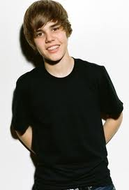
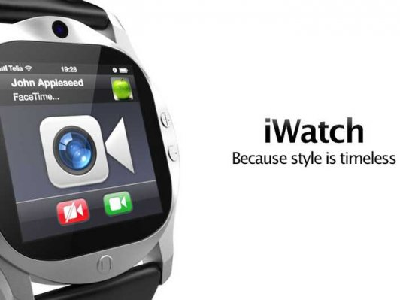
MY TIME….
My iWATCH
It’s What I NEED
MY MUSIC….
It’s What I WANT
It’s What
I DESERVE
IT COULD BE YOURS TOO…
MY CONNECTION….
Buy your very own iWATCH
Online TODAY!!!
Notes:
This first slide represents the primary advertisement that shall be used to introduce iWatch in the market. Artists Ashley Tisdale, Justin Bieber and Selena Gomez were chosen as they were among the top choices of teens who were surveyed during a market research that was performed in line with the launching of the product.
Considering that the target market involves dealing with the young ages, this advertisement tries to create an appeal to the said age-range through utilizing artists who would most likely appeal to their taste. Not only do these artists represent the genre of the market that the product hopes to serve, they are also the ones who likely represent what the product aims to give. Music is one of the most important features of the watch and these individuals do create good music that most likely define the younger generation of this time. When it comes to time management functions, these individuals are also known for their need to deal with time management properly in style. All these considerations were given attention to in making this advertisement alongside the choice of the artists to represent iWatch.

Slide 2
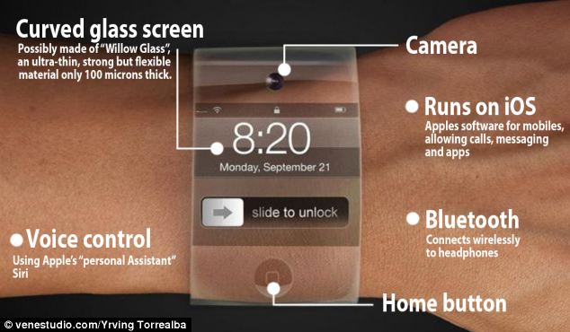
2
Get Your Hands on Your
Very Personal iWatch Today
1
3
Link to order cart
Online
Ad Space
4
5
Testimonials
Explanation of
iWATCH Specs
7
6
Press Release
Articles
Notes:
This is the iWatch Online Website.
The first box which is the online ad space shall be the place for the advertisement that was posted in the first slide of this presentation
The second box is a call out on the promotion of the iWatch online sales presentation
The third box is a link that would connect the visitors who hope to buy an iWatch to the order cart which would directly be sent to the administration for order processing
The fourth box is the place where the specification of the iWatch is to be posted
The fifth box would be a presentation of testimonials from those who already bought their iWatches from the site
The sixth box would be the press release articles which are supposed to get traffic into the website hence promoting the product further
The seventh box shall be a java-scripted presentation on the most important features of the iWatch which is more interactive compared to the presentation and discussion shown in the fourth box.

