Slide 1
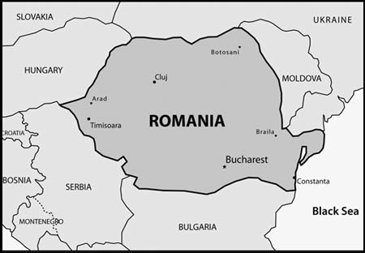
AIDS in Romania

Slide 2
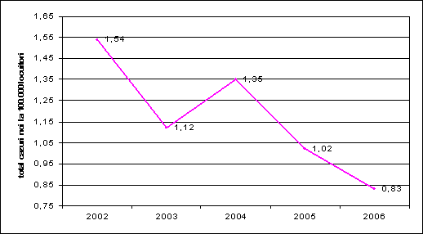
The number of the new cases recorded in 2006 was lower than the number recorded in 2002. This target (Maintain, by 2007, the incidence of HIV/ AIDS at the level of 2002) has been exceeded.
Incidents of AIDS in Romania 2006 vs. 2002
Source: Department of Monitoring and Evaluating of IBI Matei Bals / Romanian Centre HIV/AIDS

Slide 3
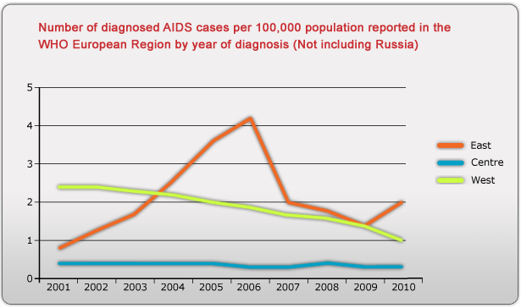
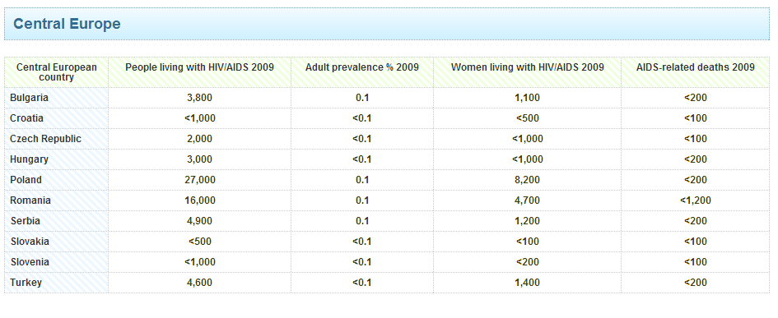
("European hiv and," 2010)

Slide 4
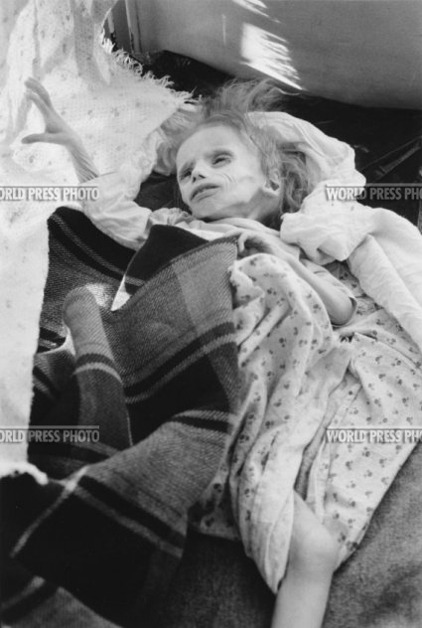
The Economist: AIDs in Romania When Ignorance is Lethal
HIV/AIDS wrought devastation in Romania in the 1980s and 1990s. The HIV problem was exposed after the 1989 revolution that brought communism crashing down. Romanians, who had been shielded from the truth by a tightly controlled media, were as shocked by the extent of the disease in their country as the outside world was (C.M., 2012).

Slide 5
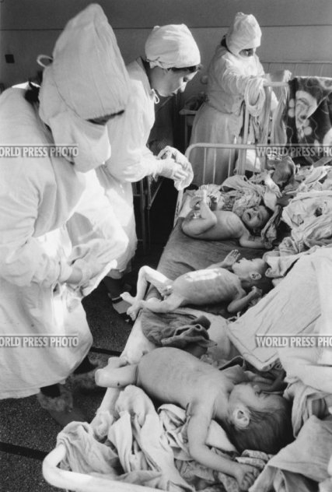
The Economist: AIDs in Romania When Ignorance is Lethal prt2
The sex industry has flourished in Romania, just as it has across the ex-communist world. Yet health workers say prostitutes are probably not the greatest risk. After all, they have a professional interest in knowing how to avoid infection. A bigger problem is a silent pool of HIV-positive people who do not realize that they and their sexual contacts are at risk. (C.M., 2012)

Slide 6
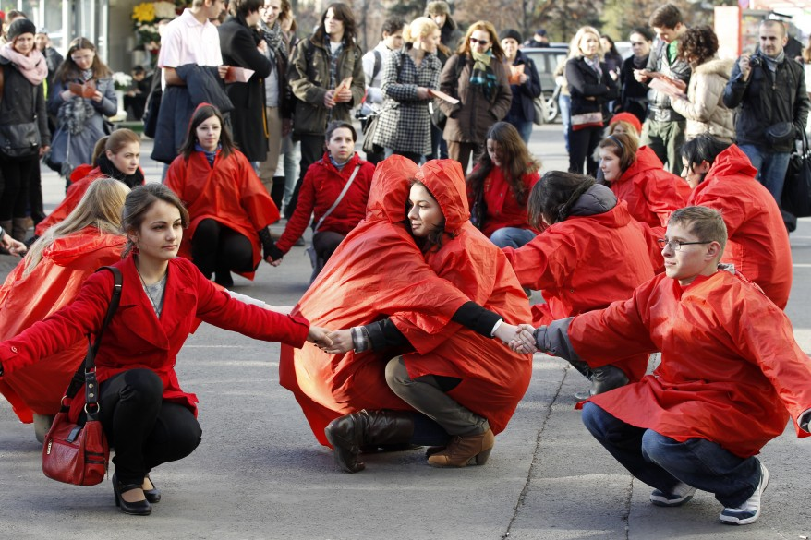
Romania Declares Victory in Fight Against AIDS
Romanian volunteers hold hands forming a red ribbon, the anti-AIDS symbol, during an awareness rally in central Bucharest, two days before World AIDS Day. (Reuters, 2011)
''Yes -- at this moment, we have a victory,'' said Dr. Adrian Streinu-Cercel, president of the National AIDS Committee. ''Everyone who needs triple therapy is getting triple therapy (Donald, 2004).'‘
The country has only about 10,000 infected people, compared with South Africa's 5 million or India's 4.6 million. Ukraine, just to the east, is believed to have more than 300,000 infected (Donald, 2004).

Slide 7
Romanian Trading
Romania's predominantly trades with Italy. These two-way trade totaled some $22.6 billion in 2007. The principal Italian export to Romania is the computer. Italy is also known to import integrated circuits, aircraft parts, other defense equipment, wheat, and automobiles. Romania's chief exports to Italy are cut diamonds, jewelry, integrated circuits, printing machinery, and telecommunications equipment (Global Edge (2012). A little over 2.8% of the country's GDP comes from the Agricultural market. The country also imports a large quantity of grain, but it’s mostly self-sufficient. In 2006 the country imported over 2.4 billion Euros of food. These number were up almost 20% versus 2005, when the imports were worth slightly more than 2 billion euros. The EU is Romania's main partner in the trade when it comes to with agricultural food products. The exports to this destination represent 64%, and the imports from the EU countries represent 54% (Global Edge (2012).

Slide 8
Work Cited
C, M. (2012). Aids in romania: When ignorance is lethal.The Economist. Retrieved from http://www.economist.com/blogs/easternapproaches/2012/04/aids-romania
Donald G. (2004). Romania Declares Victory in Fight Against AIDS New York Times
European hiv and aids statistics. (2010). Retrieved from http://www.avert.org/hiv-aids-europe.htm
Global Edge (2012). Retrieved from https://globaledge.msu.edu/countries/romania/tradestats
Reuters (2011). Healthcare. SRNNews.com

