Slide 1
AMIODARONE CLINIC DESIGN, IMPLEMENTATION and EVALUATION by a
NURSE PRACTITIONER (NP)
Victoria Ann Ainsworth
B.B.A., Averrett University, 1994
M.B.A., University of Phoenix, 1998
M.S.N., F.N.P.. University of Phoenix, 2003
PRACTICE-BASED DISSERTATION
Submitted in partial satisfaction of
the requirements for the degree of
DOCTOR OF NURSING PRACTICE
at
TOURO UNIVERSITY NEVADA

Slide 2
Background
Arizona Young Hearts of Yuma- location of the cardiology based practice
Yuma population is 195,751 with an expected growth increase of 10.79% by 2013 (Claritas, 2008)
Cause of death by heart disease in 2010 was 7,852 (Gilbert, 2008)
Many of the patients who present with emergent needs have cardiac arrhythmias

Slide 3
Atrial Fibrillation
Major cause of morbidity and mortality
Irregular arrhythmia in the heart often occurring in the atrial myocardium
Goals for treatment are regaining normal rhythm, controlling heart rate, prevention of blood clots and strokes (Goldschlager, Epstein, Niccarelli, Olshansky, & Singh, 2000)
AF initially treated with medication
Amiodarone is frequently prescribed as a treatment for AF (Calkins, Brudaga, Packer, Cappato, Chen, et. al., 2007, June)

Slide 4
Background of Amiodarone
Anti-arrhythmic used to maintain sinus rhythm in patients with AF and ventricular tachycardia (Stewart, Hart, Hole, & McMurray, 2002)
Benzofuran derivative with potent side effects that requires close monitoring
Unpredictable half-life, averaging 58 days (Siddoway, 2003)
Lipophilic effect in the body which inhibits effectiveness

Slide 5
Previous Studies
European Myocardial Infarct Amiodarone Trial and Canadian Amiodarone Myocardial Infarction Arrhythmia Trial patients with structural heart disease who are not candidates for implantable cardiac defibrillators demonstrated a 60% reduction in sustained tachyarrhythmias with Amiodarone (Julian, Camm, Frangin, Janse, Munoz, Schwartz, & Simon, 1997; Cairns, Connolly, Roberts, & Gent, 1997)

Slide 6
Previous Studies
Bickford and Spencer (2006) conducted a retrospective review of electronic medical records (EMR) at the Medical University of South Carolina. The results of the study demonstrated the need for developing protocols to ensure patients on Amiodarone are continuously monitored.

Slide 7
Adverse Effects
Corneal micro deposits, visual halos, blurred vision (> 90%)
Optic neuropathy/neuritis (≤ 1%-2 %)
Blue-grey skin discoloration (4%-9%)
Photosensitivity (25% – 75%)
Hypothyroidism (6%)
Hyperthyroidism (0. 9% – 2%)
Pulmonary toxicity (1% - 17%)
Hepatotoxicity (15% - 30%)
Hepatitis and cirrhosis (3%)
(Babatin, Lee, & Pollak, 2008, Rigas, Rosenfeld, Barwick, Enriquez, Helzberg, et al., 1986, Darmanata, Van Zandwijk, Van Royen, Mooi, Plomp Jansem, & Furrer 1983, Jessurun, Boersma, & Crijns, 1998, Machenzie, Syed, Pollak, Koren, 2011)

Slide 8
Purpose of Project
The purpose of this practice-based dissertation is to assess current practice with patients taking Amiodarone to justify the development of an Amiodarone clinic
The Amiodarone Clinic will apply evidence based practices, according to HRS guidelines (Siddoway, 2003, Bickford & Spencer, 2006)

Slide 9
Purpose of Project
Applying evidence-based practice (EBP) protocols is necessary to screen for contraindications prior to enrolling patients and identifying early adverse reactions (Bickford & Spencer, 2006)
Translating research into evidence-based practice will be vital in the success of changing practice
Applying a framework describing the process of taking research findings and implementing into practice using the diffusion of theory of innovations provides a systematic approach to change practice (DiCenso, Guyatt, & Cilska, 2005).

Slide 10
HRS Guidelines
Baseline testing of thyroid, liver, renal function, pulmonary function, and chest x-rays (CXR) should be done prior to starting Amiodarone
Liver and thyroid function needs to be followed every six-months after baseline
Pulmonary function tests and CXR’s should be done if they develop shortness of breath or symptoms of pulmonary toxicity, otherwise every 12—months
(Bickford, 2006)

Slide 11
Description of Project
This project describes the design, implementation and evaluation of an Amiodarone Clinic in a rural cardiology practice in Arizona with a patient population of approximately 5000 patients.
There is no current protocol to monitor these patients.

Slide 12
Description of Project
Developing a nurse managed Amiodarone Clinic (AC) will take evidence-based research to practice improving patient outcomes by identifying potential serious reactions to this medication.
Establishing protocols for admission of patients to monitor symptoms, laboratory evaluations, and diagnostic tests will assist the practice to identify early diagnosis of toxicity.

Slide 13
Amiodarone Clinic Implementation
Establishing an Amiodarone Clinic in this cardiology practice can reduce adverse reactions to Amiodarone
Protocols include admission criteria, baseline tests, diagnostic procedures, and regular follow-up appointments
Patients’ initial visit includes basic history and physical

Slide 14
Amiodarone Clinic Implementation
Baseline testing performed: CXR, EKG, PFT, and ophthalmologic examination. Baseline lab tests includes: CMP, TFT’s, PT, international normalized ratio (INR) (if taking Warfarin), and Digoxin level (if taking Digoxin).
Patients return at one-month for follow-up evaluation
The one-month follow-up includes: basic history and physical (H&P), patients are informed about test results
Abnormal tests results and physical changes found during the exam are discussed with the patient

Slide 15
Amiodarone Clinic Implementation
Patient’s who lack the ability to grasp the information are seen at one and three months
Patients have a six-month follow-up which includes: CMP, TFT’s, PT/INR (if on Coumadin), and digoxin level (if currently taking Digoxin)
Annually patients repeat all tests done at baseline
(Frontline Pharmacist, 2009)

Slide 16
Theoretical Framework
Based on the Iowa Model
Focuses on promoting quality of care in the day to day practices that affect patient care outcomes (Titler, 2003)
The process of implementing evidence-based practice outlined in the model assisted in the process of developing the Yuma Amiodarone clinic (DiCenso, Guyatt, & Ciliska, 2005)

Slide 17
Planning, Implementation and Evaluation of the Amiodarone Clinic
Planning Assessment of Need
Structure and Processes of the Clinic
Implementation
Evaluation Results

Slide 18
Planning Assessment of Need
NP conducted a chart review to justify the development an Amiodarone clinic within a small cardiology clinic to insure that current practice standards established by HRS
NP designed an electronic form based on HRS guidelines to be used to review patients in the EMR
Data was collected and was compared to HRS recommendation testing baselines and continued follow-up

Slide 19
Planning: Assessment of Need
Yuma clinic has 5000 patients and 40 were identified as taking this medication between the stated times. The medical records during this timeline evaluated baseline measurements of blood test, EKG, PFT’s, CXR, and adverse reactions to patients
To evaluate the need for an Amiodarone clinic 40-Patients seen between April 2011 and April 2012 on Amiodarone were assessed baseline measurements of blood test, EKG, PFT’s, CXR, and adverse reactions to patients
Frequencies of Testing and Patient followup were also evaluated with Appendix A
See Chart One

Slide 20
Planning: Assessment of Need (Appendix A)
 | Baseline | Loading | 1 Month | 3 Month | 6 Month | 12 Month
Date
EKG
PFT
DLCO
ALT
AST
TSH
T4
T3
PT
1NR
CXR
EYE EXAM

Slide 21
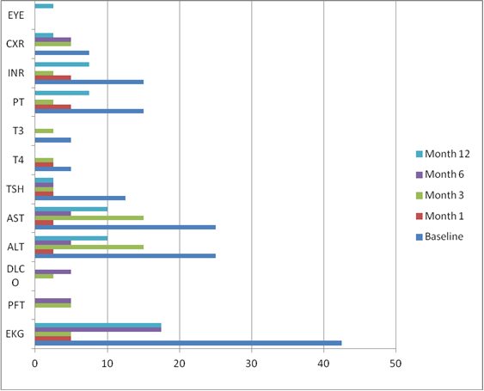
Planning: Assessment of Need Results (Chart One)

Slide 22
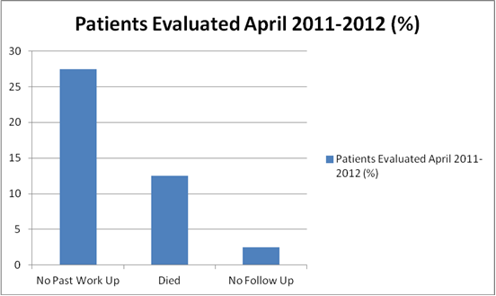
Evaluation Results (Chart Two)

Slide 23
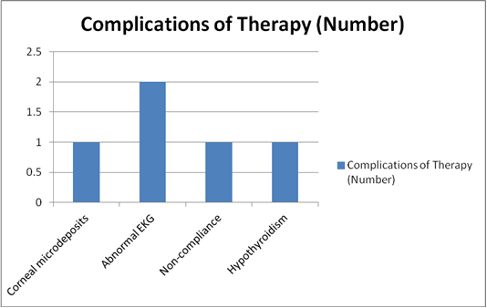
Evaluation Results (Chart Three)

Slide 24
Structure and Processes of the Clinic
The first step in this establishment was describing the best practices
The second step was to identify the key personnel needed as far as the involvement in the planning process
Third, identifying the patients was established through a chart review of all patients attending the chosen clinic
Fourth, the plan design was chosen to integrate best practices at this clinic by ensuring the patient’s quality of care would not be compromised

Slide 25
Structure and Processes of the Clinic
Yuma practice Amiodarone Clinic was established on August 23, 2012
The protocols were designed to follow current HRS guidelines
The clinic utilizes current office space during regular business hours to follow Amiodarone patients
The Nurse Practitioner (NP) evaluates the patients, monitors adverse reactions, and medication adherence using the guidelines established by HRS (Appendix B)
A medication guide about the risks and benefits of taking Amiodarone according to the Food and Drug Administration was developed and adapted by the Food and Drug Administration (FDA) which is given to patients and supplements their education (Appendix C)

Slide 26
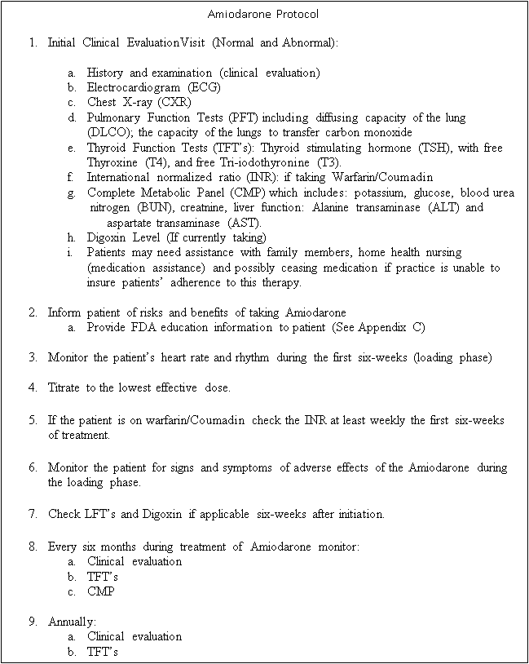
Structure and Processes of the Clinic (Appendix B)

Slide 27
Structure and Processes of the Clinic (Sample of Appendix C)
Patient Information Sheet: Amiodarone (marketed as Amiodarone, Pacerone)
Adapted from the FDA Medication Guide, Cordarone, Amiodarone (2004)
Medication Guide Amiodarone, Pacerone (Amiodarone HCl),
Read the Medication Guide that comes with your Amiodarone Tablets before you start taking them and each time you get a refill. There may be new information. This Medication Guide does not take the place of talking with your doctor about your medical condition or your treatment.
What is the most important information I should know about Amiodarone Tablets? Amiodarone Tablets can cause serious side effects that can lead to death including:
lung damage
liver damage
worse heartbeat problems
thyroid problems
Call your doctor or get medical help right away if you have any symptoms such as the following:
shortness of breath, wheezing, or any other trouble breathing; coughing, chest pain, or spitting up of blood nausea or vomiting; passing brown or dark-colored urine; feel more tired than usual; your skin and whites of your eyes get yellow; or have stomach pain
heart pounding, skipping a beat, beating very fast or very slowly; feel light-headed or faint
weakness, weight loss or weight gain, heat or cold intolerance, hair thinning, sweating, changes in your menses, swelling of your neck (goiter), nervousness, irritability, restlessness, decreased concentration, depression in the elderly, or tremor.

Slide 28
Implementation
A plan was created by the NP to organize and create the Amiodarone clinic
Protocols were written to meet HRS guidelines
Patients were informed about most serious side effects including pulmonary toxicity, hyperthyroidism, hepatotoxicity, optic neuropathy, and common side effects.

Slide 29
Implementation
Patients who are not compliant with medication will need to be further evaluated and based on cause of lack of adherence will determine further action. Patients may need assistance with family members, home health nursing (medication assistance) and possibly ceasing medication if practice is unable to insure patients’ adherence to this therapy.
Follow-up evaluations with history and physicals are conducted by the NP initially at one-month, three months when necessary, then biannually to monitor potential changes in symptomology

Slide 30
Evaluation
Since August, Of the 40 patients evaluated between April 2011 and April 2012, 27.5% had no work-up in the past, 12.5% had died and 2.5% were lost to follow-up
Between August 23, 2012 and September 21, 2012 nine patients (22.5%) were brought into the Amiodarone Clinic. The remaining patients have been contacted and have future appointments

Slide 31
Evaluation
All patients (22.5%) underwent history and physical examination by the practitioner. Diagnostic testing including blood testing for LFT’s, TFT’s, CMP, EKG, PFT’s, DLCO, and Ophthalmologic examinations have or are currently pending evaluation. One patient has corneal microdeposits and is currently being monitored. Two patients were found to have prolonged QT intervals on their EKG’s requiring adjusting Amiodarone
One patient had continued Amiodarone despite being told to stop one-year prior; the medication was stopped. One patient was found to have hypothyroidism requiring thyroid treatment. None of the patients had pulmonary problems. Secondary findings unrelated to the visit two patients were found to have end-of-life on their pacemaker generators requiring emergent treatment on one patient

Slide 32
Challenges and Quality Improvement
Educating staff
Costs versus benefit of following the patients in a separate clinic
Developing relationships with outside services to provide timely feedback of test results

Slide 33
Conclusion
The clinic is the first one of its kind established in Yuma, Arizona
There will be decreased incidence of adverse reactions associated with Amiodarone according to evidence-based practice
Dissemination of research into practice was bridged through evaluation to determine the need of an Amiodarone Clinic, develop a clinic using current HRS protocols, and implementing the clinic into practice with the assistance of identified stakeholders

Slide 34
References
American Heart Association (2008). Heart disease and stroke statistics 2008 Update at-a-glance. Dallas, Texas: American Heart Association.
Arizona Department of Health Services. Public Health Services. Arizona Health Status and Vital Statistics (2003). Rates for selected leading causes of death state and by county of residence, Arizona 2003. Retrieved from http://www.azdhs.gov/plan/report/ahs/ahs20 03/pdf/288t5e13.pdf

Slide 35
References
Arizona Department of Health Services. Public Health Services. Arizona Health Status and Vital Statistics (2010). Rates for selected leading causes of death state and by county of residence, Arizona 2010. Retrieved from http://www.azdhs.gov/plan/report/ahs/ahs20 10/pdf/288t5e13.pdf
Babatin, M., Lee, S., Pollak, P. (2008). Amiodarone hepatotoxicity. Current Vascular Pharmacology, 6 (3):228-23.

Slide 36
References
Bickford, C. L., & Spencer, A. P. (2006, April). Adherence to the NASPE guideline for monitoring at a medical university. Journal of Managed Care Pharmacy, 12(3), 254-59. Retrieved from www.amcp.org
Cahoon, W., Flattery, M., & Hess, L., (2007, September, 06). Amiodarone: Development, clinical indications, and safety. Progress in Cardiovascular Nursing. 22 (3): 173-176. doi: 10.1111/j.0889- 7204.2007.07398.x

Slide 37
References
Cairns, J. A., Connolly, C. J., Roberts, R., Gent, M. (1997, June 14). Randomised trial of outcome after myocardial infarction in patients with frequent or repetitive ventricular premature depolarizations: Canadian Amiodarone Myocardial Infarction Arrhythmia Trial Investigators. CAMIAT. Lancet. 349 (9067):675-682. Retrieved from http://ehis.ebscohost.com/eds/detail?sid=a085e87a-966b- 4314-8c4c- bda024989a98%40sessionmgr12&vid=8&hid=23&bdata=JnNp dGU9ZWRzLWxpdmU%3d
Calkins, H., Brudaga, J., Packer, D., Cappato, R., Chen, S., et. al., (2007, June). HRS/EHRA/ECAS expert consensus statement on catheter and surgical ablation of atrial fibrillation: Recommendations for personnel, policy, procedures and follow-up. Heart Rhythm, 4(6): 1-46. doi:10.1016/j.hrthm.2007.04.005.

Slide 38
References
Claritas, (2008). Demographic Information - Greater Yuma Economic Development . Sources: U.Census - Fact Finder; Claritas.
    www.greateryuma.org/growthindicators.html
Darmanata, J., Van Zandwijk, N., Duren, D., Van Royen, E., Mooi, W., Plomp, T., Jansen, H.,
Durrer, D. (1984). Amiodarone pneumonitis: three further cases with a review of published reports. Thorax 39:57-64.
DiCenso, A., Guyatt, G. & Cilska, D. (2005). Evidence-based nursing a guide to clinical nursing practice. St. Louis, Mo: Mosby, INC

Slide 39
References
FDA Medication Guide, Cordarone, Amiodarone (2004), 3042727 , Retrieved from
http://www.fda.gov/downloads/Drugs/DrugSafety/UC M152841.pdf
Frontline Pharmacist. (2009, November 15). Implementation of an Amiodarone ambulatory care
clinic. American Journal Health-System Pharmacy 66: 1997- 2001. Doi: 10.21.46/ajhp080555
Gilbert, J., (2008, November 08). Despite poor economy winter visitors still flocking to Yuma.
YumaSun.com. Retrieved from: http://www.yumasun.com/news/yuma-45957-despit inter.html#ixzz1y2ANqQvL

Slide 40
References
Goldschlager, N., Epstein, A., Naccarelli, G., Olshansky, & Singh, B. (2006, April). Practical guidelines for clinicians who treat patients with Amiodarone. Archives of Internal Medicine, 1741-1748.
Jessurun, G., Boersma, W., & Crijns, H., (1998, May). Amiodarone- induced pulmonary toxicity predisposing factors, clinical symptoms and treatment. Pharmacoepidemiology. 18 (5): 339- 344.
Julian D.G., Camm A. J., Frangin G, Janse M. J., Munoz A, Schwartz P. J., & Simon. P. Randomised trial of effect of amiodarone on mortality in patients with left-ventricular dysfunction after recent myocardial infarction: EMIAT. European Myocardial Infarct Amiodarone Trial Investigators. Lancet. (1997, March 08). 349 (9053):667-74.

Slide 41
References
Mackenzie, C., Syed, J., Pollak, T., & Koren, G., (2011, September 06). Falling between the cracks: a case of amiodarone toxicity. Canadian Medical Association Journal 183(12): 1393-97. Doi: 10.150./cmaj.100351
National Collatorating Centre for Methods and Tools (2010). Framework for adopting an evidence-informed innovation in an organization. Hamilton, ON: McMaster University. (Updated April 28, 2011). Retrieved from http://www.nccmt.ca/registry/view/eng/47.html.
PDR.Net. (2012, June 16). PDR.Net. Retrieved from http://www.pdr.net/drugpages/concisemonograph .aspx ?concise=1555: http://www.pdr.net

Slide 42
References
Rigas, B., Rosdefeld, L., Barwick, K., Enriquez, R., Helzberg, J., Batsford, W., Josephson, M., & Riley, Caroline (1986). Amiodarone hepatotoxicity. Annals of Internal Medicine, 104:348-351.
Siddoway, L. (2003, December, 01). Amiodarone: Guidelines for use and monitoring. American Family Physician. 68 (11): 2189-2196. Retrieved from www.aafp.org/afp
Stewart, S., Hart, C., Hole, D.J., & McMurray, J. J. (2002, October, 01). A population-base study of the long term risks associated with atrial fibrillation: 20-year follow-up of the
Renfrew/Paisley study. American Journal of Medicine, 113 (5): 359-364. doi:10.1016/S0002-9343(02)01236-6

Slide 43
References
Titler, M.G. (2002). Patient Safety Quality: An Evidence- Based Handbook for Nurses Vol.1 Retrieved from: http://www.ahrq.gov/qual/nurseshdbk/docs/ TitlerM_EEBPI.pdf
Van Herendael, H., & Dorian. (2010). Amiodarone for the treatment and prevention of ventricular fibrillation and ventricular tachycardia. Vascular Health and Risk Management. 2010 (6): 465-472.

