Slide 1
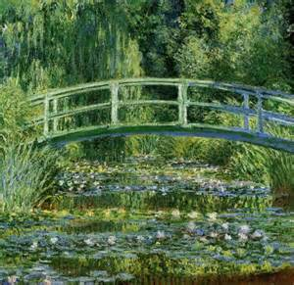
Belle Galerie d'art Impressionniste
Name
Course
Instructor
Date

Slide 2
Gallery Overview
Gallery opened in dedication to Impressionism
Birth of Impressionism 1874
Claude Monet
Pierre-Auguste Renoir
Camille Pissarro
Use of vivid and intense colors with evident brushstrokes
capturing light of the viewer
Important to modern art
Social, political, and cultural history of Paris in the 1860s to 1870s illustrated in the paintings
(FRIST, 2010)
Notes:
The Belle Galerie d’art Impressioniste, which is French for “Beautiful Impressionist art gallery”, has been opened for dedication to the great works of the impressionist painters from the impressionist movement. The Impressionist art began in 1874, when Claude Monet, Pierre-Auguste Renoir and Camille Pissarro introduced the first public illustration of paintings from scenes of everyday life, such as avenues, cafes, parks, countrysides…all near Paris, France. Impressionist art, as you will see in the following slides used vivid and intense hues with evident brushstrokes in order to capture the effects of the light acorss the visible field of vision. The dedication of the impressionist artists is important because impact on modern art, as well as showing history of Paris social, political and cultural changes.

Slide 3
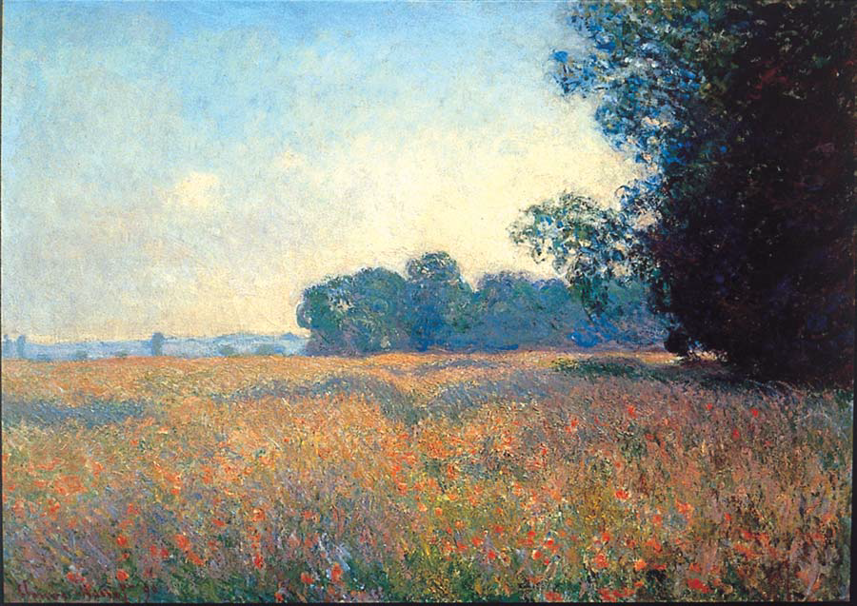
Claude Monet (1840-1926) Champ d’Avoine (Oat Field), 1890 Oil on canvas, 26 x 36 7/16 inches
-Oil paints on canvas shows colors, movement, sunlight, nature
Important to Impressionism: capturing the moment in time
Working outdoors
(Harn Museum of Art, 2008 )
Notes:
This painting was constructed by Claude Monet. The name of the painting is Champ d’Avoine or Oat Field and was painted in 1890 with oil paints on canvas. In this painting, the light and the effects of color, which was important to the impressionist paintings, is illustrated. The ability to capture the moment was part of the Impressionist paintings, as well as working outdoors to increase the effects of colors in the sunlight with nature.

Slide 4
Pierre-Auguste Renior La Moulin de la Galette 1876 Oil on Canvas 131 x 175cm Musee d’Orsay, Paris
-Known for joyful paintings
-Snapshots of real life
-Focused on light and water
-Worked with Monet and found the technique central to Impressionism: shadowing with colors.
-Using local color instead of dark or brown in the shadows
Artble (2013)
http://www.theartgallery.com.au/ArtEducation/greatartists/Renoir/moulin/
Notes:
Renoir was an artist famed for creating joyful paintings that were snapshots of real life, capturing the true spirit of the scene. Dance at le Moulin de la Galette was a great exampl. The Moulin de la Galette was one café that the Renoir frequented as it was close to his home and it provided a great theme for his work. closely with Monet and both were focused on painting light and water. It was during this time that they developed the technique that became central to Impressionism. They discovered that shadows are not brown or black but are colored by the objects around them, and that the 'local color' of objects is modified by the light and reflections of surrounding objects. (

Slide 5
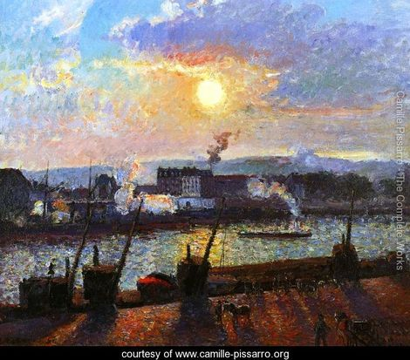
Title: | Artist: Camille Pissarro Sunset, Rouen
Painted by: | Camille Pissarro
Dimensions: | 25.59 inch wide x 21.26 inch high
Orientation: | Landscape
-the effects of light, climate, and the seasons are visible in the painting.
Notes:
Another famous impressionist painter, Camille Pissarro included light, climate, and the seasons capturing the moment in time.

Slide 6
Edoauard Manet
The Monet Family in Their Garden at Argenteuil, 1874 Édouard Manet (French, 1832–1883) Oil on canvas24 x 39 1/4 in. (61 x 99.7 cm) http://www.metmuseum.org/toah/works-of-art/1976.201.14
Boating, 1874 Édouard Manet (French, 1832–1883) Oil on canvas38 1/4 x 51 1/4 in. (97.2 x 130.2 cm)
http://www.metmuseum.org/toah/works-of-art/29.100.115
Notes:
Part of the Impressionists. As seen in the works by Manet, the modernity with the incorporation of new painting ideas on canvas with a depiction of modern life.

Slide 7
Edgar Degas, Beach Scene, about 1869-70
-Modern life popular subject.
Notes:
Here is a painting by Degas called the Beach Scene made around 1869-1870. Here the modern life and the way that ordinary people spent their free time were popular subjects with many Impressionist painters.

Slide 8
Social, Cultural and Historical Context of Impressionist Paintings
Impressionism broke every rule of the French Academy of Fine Arts
Exhibited scenes of modern urban and country life: unlike the effort to teach through history, mythology and biblical themes
accepted art was related to Greek and Roman art through idealized images
This art consisted of sooth surfaces: impressionism used texture and visible brush strokes
Early-mid 19th century: political instability in France with population doubling
Impressionists were interested in world surrounding them…people at work and play. New inventions, such as steam engine, streetlights, camera, fashions.
New economic prosperity with Industrialism was topic to Impressionists
Cafes, photography, people
Color Theory: broke away from traditional colors with brighter palette
(High Museum of Art et al.)
Notes:
Impressionism broke every rule of the French Academy of Fine Arts, which dominated art training since 1648. Impressionism
exhibited scenes of modern urban and country life: unlike the effort to teach through history, mythology and biblical themes. Accepted art at that time was traditionally drawn from Greek and Roman art through idealized images with use of smooth surfaces. Early-mid19 century was time of polical instability in France with the population doubling. Then the Industrial revoluation came about and Impressionists were interested in world surrounding them…people at work and play. New inventions, such as steam engine, streetlights, camera, fashions. With this new economic prosperity the impressionists uses the everyday life of cafes photography, people, etc. They also used the color theory and broke away from traditional colors with a brighter palette to capture the moment.

Slide 9
References
FRIST. (2010). The Birth of Impressionism. Masterpiecies from the Musee D’Orsay. Ingram Gallery. Retrieved from: http://fristcenter.org/content/uploads/gallery_guides/Impressionism_Teacher_Guide.pdf
Harn Museum of Art. (2008). Claude Monet and Impressionism. Retrieved from: http://www.harn.ufl.edu/education/Monet.pdf
Artble. (2013). Dance at le Moulin de la Galette http://www.artble.com/artists/pierre-auguste_renoir/paintings/dance_at_le_moulin_de_la_galette
Hight Museum of Art, Seattle Museum of Art, Denver Museum of Art. Impressionism Paintings Collected by European Museums A Resource Packet for Educators. Retrieved from: http://www.impressionism.org/teachimpress/impressionismTP.pdf

