Slide 1
Male Circumcision
Student Name

Slide 2
Medical Importance of Circumcision
Helps maintain sanitary practices
Avoid situation where adults can not repeal foreskin
Lowered risk of penile cancer
STI Prevention
Herpes
HIV
HPV

Slide 3
Circumcision Facts In United States
Third most common inpatient surgery
Fifty-six percent of male newborns circumcised before release from hospital in 2006
Funded by Medicaid in thirty-two states
Most common amongst Caucasians, least common amongst Hispanics.

Slide 4
Performance of Circumcision
Almost always within first week of life, usually within first forty-eight hours
Premature babies are usually not circumcised until just before hospital checkout
Performed by pediatricians, obstetricians, and family general doctors
Some are done as religious ceremonies out of hospital
A Jewish Circumcision ceremony, or bris, is performed by mohel at eight days old
Islam Circumcision, Khitan is performed sometime between the first week of life and puberty

Slide 5
Circumcision Operation
Requires local anesthetic
Topical Cream
Injected anesthetic
Must be routinely claimed with soap and water in immediate aftermath
Foreskin is held with clamps, while one third of it is removed
A metal or plastic piece is used to protect the glans

Slide 6
Potential Risks/Complication
One study estimated 1.5% of operations involve complications in infants
While some are performed post puberty or for adults, these come with higher complications. For this reason, circumcision should be done within first weeks of life.
Possible Complications
Infection
Meatal Ulcer
Urethral Laceration
Scarring and other largely aesthetic issues

Slide 7
Pros and Cons
Pros
Cons
Cleaner and easier maintenance
Reduces risk of
Penile Cancer
STI
Phimosis and other foreskin conditions
Urinary tract infections
Balanitis
Potential for surgical risk
Avoidable cost for surgery if unnecessary
Pain for infant
Reduced Sexual Function
Loss of nerve endings
Foreskin provides lubrication for sex, preventing dryness

Slide 8
Global and Cultural Practice
WHO estimates thirty percent of global males are circumcised
America is the only English speaking country where the majority are circumcised
Many circumcisions are performed for social purposes
Religion
Social/Familial Conformity
Practiced mostly by Jewish and Muslim males
Outlined in the Abrahamic Covenant of Old Testament
70% of global circumcisions are Muslim males

Slide 9
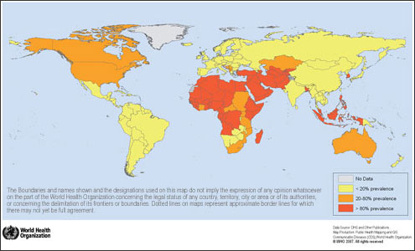
WHO Global Circumcision Map

