Slide 1
cisco internal analysis
Human Resource Department

Slide 2
Internal environment [v.i.r.o. analysis]
Values (Does it provide competitive edge?) [Competency]
Cisco has the highest value when it comes to employee productivity and innovation. By employing the best technicians from the best educational programs, the company and the department has managed to stay competitive as the best IT service provider.
Imitability (Is it costly for others to imitate?) [Asset]
Cisco has created a brand name through the high quality of its services and products. This is also reflected in its human resource department as it has employed human resource management techniques that are unique to its line of business.

Slide 3
Internal environment [v.i.r.o. analysis] (Cont)
Rareness (Do other competitors posses it?) [Asset]
Cisco possesses the highest quality in IT services. The Hman Resource department depicts this by employing only the best technicians available, all of which have undergone the best information technology education programs available on the planet. These include DeVry university and MIT.
Organization (Is the Firm organized to support?) [Competency]
Cisco has a very high standard of organization. Job descriptions are very clear and there is a strict management of projects and their timely delivery. There is a clear hierarchical management structure that also allows room for creativity and innovations amongst the employees.

Slide 4
Portfolio analysis
HIGH RELATIVE MARKET SHARE
Compare each product with competitors
STARS
QUESTION MARKS
CSM
DCMA
ON
INDUSTRY GROWTH RATE
CC
CASH COWS
DOGS
DCS
Routers
I&M
PS &SS
Revenue = area of the circle

Slide 5
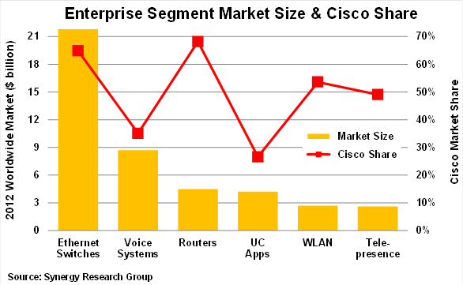
Cisco market share

Slide 6
Internal factor analysis
Internal Factor | Weight | Rating | Weighted Score | Total Weighted Score | Comments
Highly qualified technical staff | 1.0 | 5 | 5.0 | 5.0 | This is Cisco’s strength in the industry
High level of technology | 1.0 | 5 | 5.0 | 10.0 | Cisco leads the networking industry in technological advancements
Growing market for routing and networking | 0.7 | 4 | 2.8 | 12.8 | This is an opportunity for Cisco
Brand Name | 0.6 | 4 | 2.4 | 15.2 | This is an asset for Cisco
Launch of 4G network | 0.6 | 4 | 2.4 | 17.6 | This is an opportunity for Cisco
Conferencing Services Growth | 0.5 | 3 | 1.5 | 19.1 | This is an opportunity
Weighted Total | 4.4 |  | 19.1

Slide 7
Refernces
Cisco. (2013, November 01). Products & Services. Retrieved from Cisco: http://www.cisco.com/en/US/products/index.html
Gary, A. (2004). The strategic business planning for commercial producers program: Paper prepared for presentation at the Triennial Conference, Lexington, Kentucky, 15 - 16 June 2004. West Lafayette: Purdue University.
Higginbotham, S. (2013, February 27). Chart: Cisco owns the switching and routing world. Retrieved from Gigoam: http://gigaom.com/2013/02/27/chart-cisco-owns-the-switching-and-routing-world/
MSN. (2013, November 21). Cisco Systems. Retrieved from MSN: http://investing.money.msn.com/investments/stock-price?symbol=US%3aCSCO&ocid=en-us_bingiaquotebtn

