Slide 1
COMPUTER NETWORKS
OSI MODEL:
Physical Layer
Data Link Layer
Network Layer

Slide 2
OVERVIEW
Physical
Placing signals
on the carrier
network
Interface
card and cables
Devices
Hubs and
Repeaters
Data link
Error
control
and
Synchro-
nization
Devices
Bridges
and
Switches
Network layer
Data routing
through networks
Devices Routers
and Brouters

Slide 3
Physical Layer
Purpose
Deals with the transmission of 0s and 1s over the physical media
Transmission of the electrical signals over a communication channel
Translation of bits into signals
Pulse duration determination
Transmission synchronization

Slide 4
Physical Layer
Functions
Encode bits into signals
Carry data from the higher layers
Define the interface to the card
Electrical
Mechanical
Functional
Example: Pin count on the connector
NETWORK
SOFTWARE
NETWORK
CARD
NIC Driver
facilitates data
transfer

Slide 5
Data Link Layer
Subdivisions
Logical Link Control (LLC)
sub- layer
- Manages service access points (logical link)
- Error and flow control
Media Access Control
(MAC) sub-layer
- Applies directly to network card communication
Access control
Purpose
Manages data flow
over physical media
Ensures error-free transmission over
physical media and
error-free data
submission to the
Network Layer

Slide 6
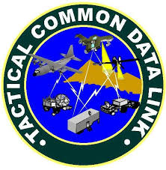
Data Link Layer
Functions
Point of origin
Packages data for transmission over physical line
Receiving end
Packages data for submission to the network layer
Deals with network transmission protocols
IEEE 802. protocols

Slide 7
Network Layer
Purpose
Addressing and routing the packets
- Example application at the router
- If the packet size is large, splits into
small packets
Header Trailer
Data

Slide 8
Network Layer
Functions
- Address messages
- Address translation from logical to
physical
Example: nganesa---->102.13.345.25
- Routing of data based on priority
- Best path at the time of transmission
- Congestion control

Slide 9
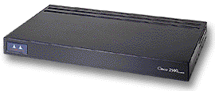
Network Layer
ROUTERS
- A layer 3 device that is used to interconnect 2 or more logical networks.
- Can filter broadcast traffic, preventing broadcast traffic from one network from reaching another network.
180.200.0.0
202.5.3.0

Slide 10
Summary
At each layer, additional information is added to the data packet
An example would be information related to the IP protocol that is added at the network layer

