Slide 1
Dove: Evolution of a Brand
Student Name
Course Title
Professor Name
Date

Slide 2
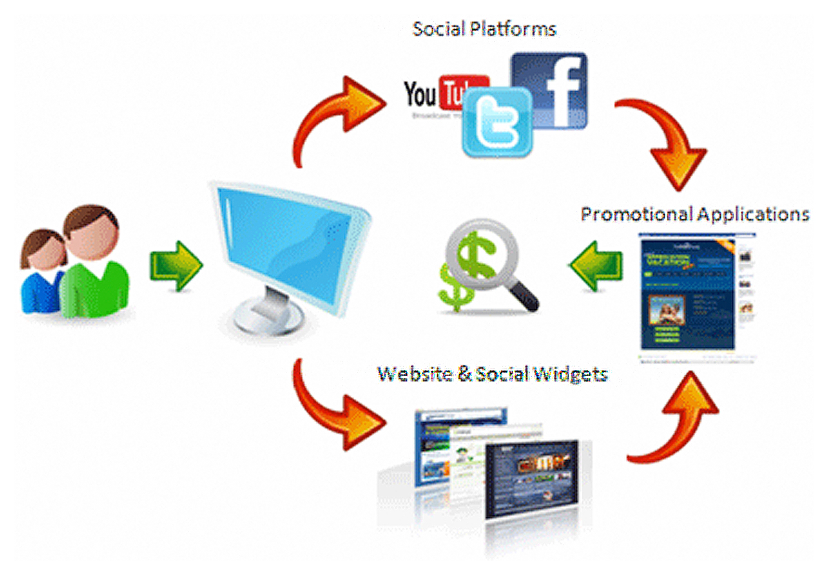
Marketing & The Internet
The Internet has changed the way businesses do business
The internet has put the power of Marketing in consumers hands no longer having to defend against attack marketing from businesses
The internet has given more companies a bigger audience for brand awareness, brand loyalty, and brand integrity
Notes:
Viral marketing is mainly useful as a marketing strategy because it eliminates a large cost of marketing. Marketers can use non-traditional media such as YouTube, blogs, and online. Businesses are moving towards creating a marketing event online by utilizing all the available tools, platforms, and avenues such as Facebook, YouTube, MySpace, Pinterest, Instagram, and a host of others. With the integrated approach of using the internet to market, companies are relying on the consumers to continually generate buzz by the companies engaging in them and creating an open space for consumers to give their opinions, reviews, and recruit others building up a customer base for the company. Unilever, tried an approach that was not seen yet in the marketing or online world.

Slide 3
Unilever Dove Brand
Dove was the world’s number one “cleansing” brand
Dove has netted sales of over $2.5 billion a year in over 80 countries
The products include:
Cleansing bars
Body washes, Hand washes
Face care, Hair Care
Deodorant , Anti-Perspirants
Body Lotions
Notes:
The Dove brand is one of the most well-known brands in the soap and beauty industry. Throughout the world they have netted billions in revenue and have products widths in cleansing bars, body washes, hand washes, facial care, hair care products, deodorants and anti-perspirants, and body lotions. Dove is one of the leading cleansing brands, that have multiple campaigns that mostly target women, working women, young adults, and families. Dove is a personal care brand that serves to be the all around product that meets the functional needs of the consumers. Dove is manufactured throughout the world in countries including Argentina, Pakistan, Netherlands, Brazil, Canada, India, and a host of other countries.

Slide 4
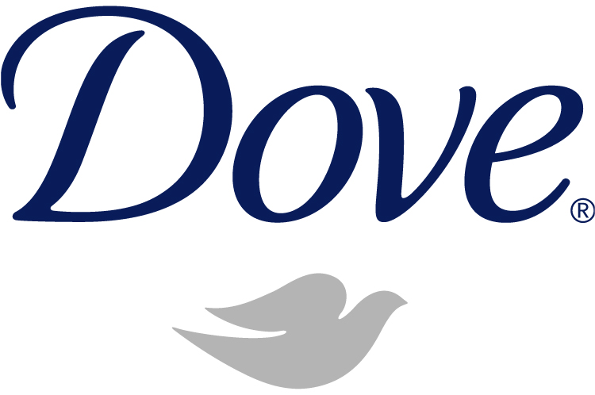
Question: What is a Brand?
A brand is a "Name, term, design, symbol, or any other feature that identifies one seller's good or service as distinct from those of other sellers.“ (MASB)
Brand is DIODIVAC
Delivering Quality
Identity & Ownership
Differentiation
Value Addition
Confidence
Notes:
Within this case study the meaning of brand is essential in evaluating the brand position within the markets, the company, and the customer base. In defining what a brand is, helps to understand the importance of developing a memorable campaign that not only reaches the target audiences but gains customers that are attractive to their media message, and their differentiation in products that creates brand awareness, brand loyalty, and brand recognition. The American Marketing Association gives a clear definition of what a brand is and the how brands add value to their company’s product portfolio.

Slide 5
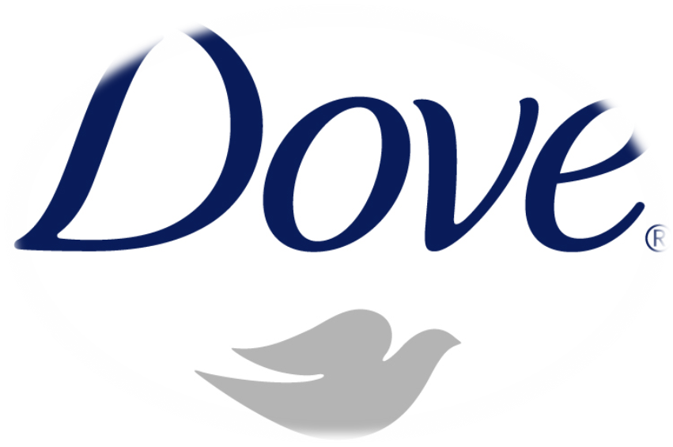
Company Background
Unilever
Anglo-Dutch company.
Formed in 1930 by the merger of Lever Brothers, British soap makers and Dutch, Margarine Unie in Rotterdam.
Two Companies
Unilever Plc, London
Unilever NV, Rotterdam
Leading manufacturer & marketer of foods beverages, personal care products.
Famous brands that have grossed over $1 billion globally
Knor
Surf
Vaseline
Sunsilk
Lux
Liptop
Ponds
Notes:
The Unilever brand is one of the most profitable and largest conglomerates in the world. An anglo-dutch multinational consumer goods company that operates globally in markets that include: food, beverages, cleaning, and personal care products. In 2011 it was named the world’s third largest consumer goods company with the purchase of largest ice cream maker. In total Unilever owns over 400 brands, with some of the leading brands including, Ben & Jerry’s, Slim Fast, Axe, Dove, VO5. Wish-n-Bone, Lipton, TreSemme and others. It operates under two companies that have the same directors which operate as a single business. Founded in 1930 by the Lever Brothers and the Dutch margarine producer, Margerine Unie.

Slide 6
Unilever Brand Strategy

Slide 7
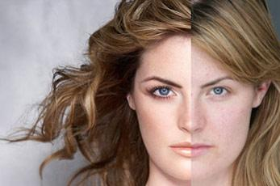
Unilever Brand Strategy
Then
Now
Unilever lacked a global identity
Their brand portfolio had grown but the brands were low-performing
The brands global decentralized mode brought problems of control, and their competition had better global presence in the markets
The brands had years of slow performances in markets
Their brand strategy was to market Dove as a cleansing bar, never drying out the skin but instead beautifying it
In 2000 they embarked on a 5 year strategic initiative ”Path to Growth”
The objective to wind down their 1600 brands down to 400 “Masterbrands”,
Serve as umbrella identities over a range of products
Global brand unit for each “Masterbrand” in charge
Added a new point of view that stood for something
Notes:
The Unilever brand strategy in the past lacked a unified global identity, their brand portfolio was growing at a lassie-faire fashions but their brands were low performing. Their global brands were decentralized which brought serious problems with control and their competition including Nestle and Proctor & Gamble were performing better. Unilever was disappointed in the slow movements in the market with some of their top brands, yet they were also low volume. Currently, the embarked on a five year journey, “Path to Growth” in 2000 that led them to wind down their 1600 brands to 400, “Masterbrands.” Unlike before the brands would fall under umbrella identities over ranges of products, and a global unit would be in charge of each Masterbrand. Their strategic initiative brought them to discovering something new for their Dove brand.

Slide 8
Dove Brand Evolution Timeline
1957
Functional Benefits Era
The first Dove product “The Beauty Bar”
1980
The Dove “Beauty Bar.” widely endorsed by Dermatologists and Physicians
Started to roll out globally
2000
Was wildly successful and was tapped to become a Masterbrand
Unilever continued to add, yet needed to connect to the consumer more.
Ogilvy and Mather advertising company created the launched marketing campaign
“Dove soap doesn’t dry your skin because its one quarter cleansing cream”
Differentiated itself in markets such as product wash, deodorants, hair care, facial cleansers, hair styling products, and body lotions
Never referred to itself as a soap, but a cleansing bar
All of these ads were illustrated with photographs that showed cream being poured into a tablet.
In addition; the ads were shot with natural looking women rather than models to convey the benefits of the product.
Notes:
Dove’s timeline includes their inception in 1957, however, the formula was first made in the 1940s but they launched the product later in 1957 as “The Beauty Bar”, never calling itself soap in order to differentiate itself from other cleansing bars. The advertising company Ogilvy and Mather created the ad campaign that ran in magazines, newspaper prints, and other mediums at that time. Their motto was that “ Dove soap doesn’t dry your skin because its one quarter cleansing cream.” Some of the most notable ads were the photos of cream being poured into a tablet shape. In addition to the normally printed ads, they shot natural looking women rather than models to show the benefits of the products. In 1980 they were endorsed by numerous dermatologists and physicians as one of the best beauty bars in the market. They started to market globally and expanded their customer reach. In 2000 they expanded their market reach even further by developing and adding more products to their brand including washes, hair care products, facial care, and body lotions. Dove became so successful that Unilever made them into a Masterbrand.

Slide 9
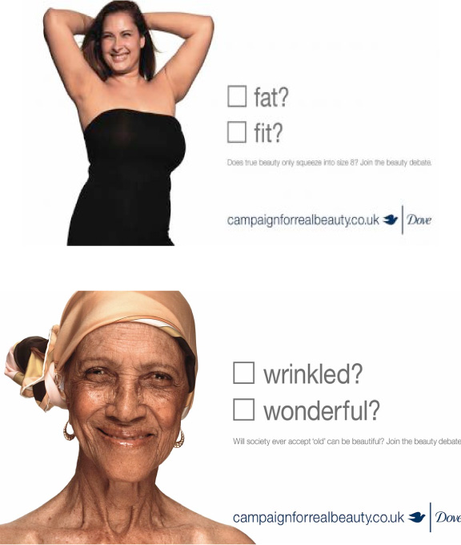
THE CAMPAIGN FOR REAL BEAUTY Operational Strategy
Unilever began to seek out the something different
Decided that Dove should stand for a Point of View
In 2002 Dove performed a worldwide investigation led by
the Connecticut global brand director, Silva Lagnado,
And had the help of Nancy Etcoff and Suzy Orbach
Aided with questions from Psychologists they were
Able to get the real answers from questions that
Were greatly affecting women’s self image
The survey went to over 3000 women in 10 countries
2% described themselves as beautiful
Notes:
Unilever felt that Dove did not serve as unified brand, it needed a change, and it needed to stand for a different point of view. In 2002 the Connecticut global brand director Silva Lagnado, led a world wide investigation aided by the help of Nancy Etcoff and Suzy Orbach. Then they embarked on a journey with the help of psychologists that were able to create a meaningful and emotional survey that went to ask over 3000 women in over 10 countries about questions that dealt with self image and definitions of beauty. The results showed a majority of women felt that they weren’t beautiful or attractive. The results motivated the group to develop a campaign that reached out to these women in order to give them a better definition of what is beauty.

Slide 10
Controversial Marketing Techniques
Dove took their advertising and marketing further as they begin to spring up billboards to display real women in the underwear
Advertisements that targeted real beauty, however they were met with an uncertainty would buy products that wouldn’t add much to make them “more attractive.”
This particular advertisement took the views and recorded the executives real daughters showing where their most were uncomfortable with their bodies
Notes:
Many saw their advertisements and campaigns as a breakthrough in shattering the Hollywood images of their perception of beauty. They used different methods and controversial marketing techniques that showed real women in their underwear displayed on billboards that allowed people to vote on their perceptions of what the images conveyed to them. Other controversial advertisements included targeting the self esteem issues that young girls and adults shared, including a controversial film that included the executives daughters sharing their views on what they felt was wrong with them.

Slide 11
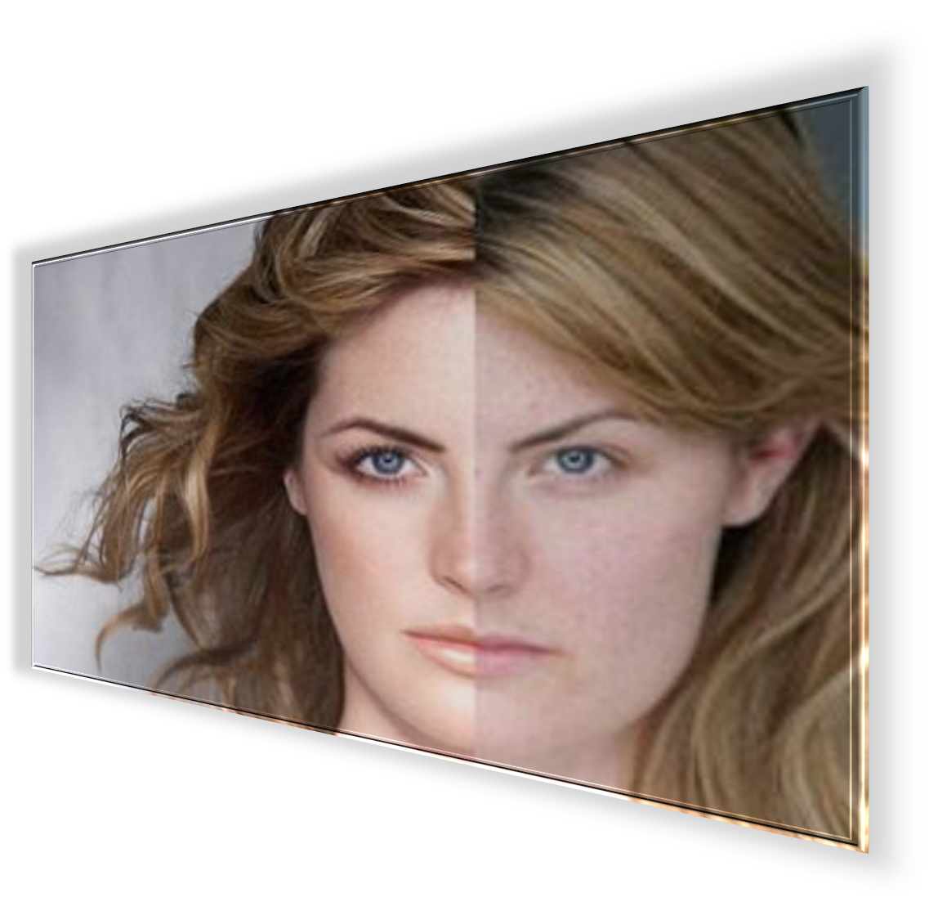
The Power of the Internet
Dove’s next step was to not only go a step further in personifying the affects of “tv/movie image” against real images of women’s beauty.
They decided to do a film, “The Evolution” that showed the photo shopping, computer, makeup, and glamour effects on a plain Jane into a movie star goddess.
For this feat however, they use the video-sharing, popular media tool YouTube.
3 million views were calculated in just 3 months
The exposure generated considerable buzz in blogs and chats rooms
And many topics on articles on the internet and in magazines
Notes:
The Campaign for Real Beauty utilized a space within the internet that many companies were not ready to realize its full potential. Their next advertisement included showcasing a short film that was too long for an average commercial so they put it on the popular video-sharing platform YouTube. “The Evolution” showed the photoshopping effects, with the help of make up, and glamour effects to turn a plan Jane looking woman in a glamoured up movie star. I just three months the film received over 3 million views. The exposure generated considerable buzz in blogs and chats rooms and became a popular topic on numerous articles on the internet, news, tv, and in magazines.

Slide 12
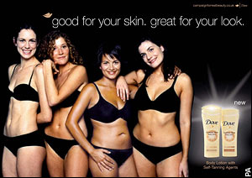
“Dove’s mission is to make more women feel beautiful every day by broadening the narrow definition of beauty and inspiring them to take great care of themselves.”
Dove started in 2007 to start another promotion with their Campaign for Real Beauty which allowed consumers to make their on ad, from first using their Cream Oil Body Wash.
The bonus was that it would be aired during the Academy Awards
This brought out the consumer’s point of view instead of just the brand’s.
Dove used technology in innovative ways to launch the website Campaignforrealbeauty.com
They used online vote casting, chat rooms, electronic billboards and mobile marketing events.
Notes:
The Campaign for Real Beauty was revolutionary in the approach to marketing. Dove’s mission is to make more women feel beautiful everyday by giving them a new definition of what beauty is. In the effort of giving a new perspective also encouraging the to take better care of themselves by giving providing them with as assortment of products. In order for them to continue their marketing efforts they launched another promotion that allowed consumers to be the creators in commercials. The commercials were shown during the Academy Awards and instructed women to use the products, and share in their experiences of what the product felt like and did to their body. The used the promotions a media vehicle in launching the CampaigforRealBeauty.com website. In their use of innovative promotions they used electronic billboards, marketing events, online vote casting, and mobile marketing.

Slide 13
The Campaign for Real Beauty

Slide 14
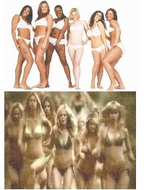
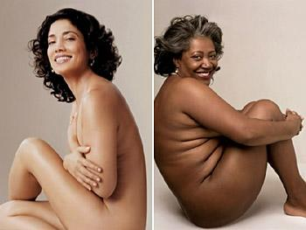
Campaign for Real Beauty “Issues”
Operational
Within Unilever’s Portfolio they had many brands that didn’t follow the same marketing tools as Dove did, they stood to be contradictory as Dove aimed at showing real women in their films, TV ads, and other ads, but Unilever’s other brand advertisements showed skinny models in skimpy bikinis.
The promotions that Dove would run with its ads were not related to the overall message
The methods of marketing were wary at the beginning of pitching ideas, the film, and the ad featuring the executives children was a controversial ideal that received a little backlash from some groups.
Competition began to copy their untraditional approach to marketing to women
Strategic
Dove’s Campaign was meant to get women’s real perspective and redefine what beauty is however, they questioned the original heritage of what they company was established for as being functional
The contradictory of the campaign was that the products were meant to bring out the consumers beauty, however, women purchase products to make them more beautiful, not depend on their own natural looks.
Notes:
The Campaign for Real Beauty wasn’t without its issues and detractors. The Dove campaign’s mission was to make real women feel beautiful about the beauty they already have. However, this change in the way the brand was marketing was a variance from the original heritage of the brand, that was established as being a functional product. The campaign was viewed by some as contradictory in nature as consumers intent was to buy products that enhance their looks and body, however, the marketing campaign was targeted as a means of showcasing the beauty that the women already had. Many of the ads were a little controversial to run on mainstream television, as well as the advertisements of real images of women plastered on billboards, and magazines. Many were uncomfortable with seeing the images of not normally viewed women in their underwear. Other contradictions followed suit with Unilever’s other brands that included Axe, that in their displayed scantily clad, skinny, made up women that opposite were Dove’s real images of women that you wouldn't typically find in a magazine. Other operational issues included. The promotions that Dove would run with its ads were not related to the overall message
The methods of marketing were wary at the beginning of pitching ideas, the film, and the ad featuring the executives children was a controversial ideal that received a little backlash from some groups.
Competition began to copy their untraditional approach to marketing to women.

Slide 15
Future Position of Dove
Then
Now
Before the Campaign for Real Beauty Dove was seeing declining sales within the crowded market, the brand was seen as a functional benefit within the beauty market
Competition was springing up with Aloe, Jergens, and other brands,
Too much advertising that only confused consumers
Was not able to grow in the categories necessary, no matter how many products added to the portfolio
There was a need for brand positioning as the image needed to be updated and evolve into a brand that drove growth but didn’t lose their customer base
In 2000 It was made into the Masterbrand for Unilever, it expanded its range within the market, and was able to gain customers across the world
The ability to differentiate itself from other products in the market drove brand awareness and brand loyalty
There success in other mediums of advertising saw rising sales and revenues, with many consumers willing to defend the campaign because they showed real images and issues that they identified with
Brand management split into two groups.
Brand development – developed idea behind the brand , marketing strategy on the internet and television, centralized global scope, located where the brand is the strongest
Brand building –replicated in each of the major brands in the markets, bring the brand to life in local market, responsible for PR and other media advertisement campaigns, decentralized local scope
In 2004 launched its global campaign, year later saw revenues of $50 billion.
2006 one of the 10 brands with the greatest percentage gain in brand health and business value in the past three years, a growth of $1.2 billion.
Notes:
The past position of Dove when it launched in 1957 as “The Beauty Bar.” was a leader within the beauty market. Later after the endorsements from dermatologists and physicians began to role out globally and expanded its products. However the market became crowded with competition that were much cheaper. Much of the advertisements were confusing to the consumer, and they were not able to expand in the markets no matter the number of products added to their portfolio. In 2000 It was made into the Masterbrand for Unilever, it expanded its range within the market, and was able to gain customers across the world. The ability to differentiate itself from other products in the market drove brand awareness and brand loyalty. There success in other mediums of advertising saw rising sales and revenues, with many consumers willing to defend the campaign because they showed real images and issues that they identified with Brand management split into two groups. Brand development – developed idea behind the brand , marketing strategy on the internet and television, centralized global scope, located where the brand is the strongest Brand building –replicated in each of the major brands in the markets, bring the brand to life in local market, responsible for PR and other media advertisement campaigns, decentralized local scope. In 2004 launched its global campaign, year later saw revenues of $50 billion.

Slide 16
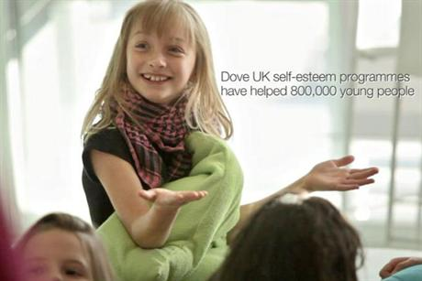
Target Market and Brand Value
From all the exposure that the innovative campaigns have received the brands value and equity has expanded tremendously
More customers are aware of the advertisements and the campaigns on YouTube and TV shows.
The brand is discussed all over the world, in a open dialogue from its unique message it delivers
The Self-Esteem Fund adds the value of the brand by showing the public its self awareness in social responsibilities by spreading the message of building self esteem in young girls, and ignoring the media interpretation of what is beautiful.
Dove had developed self-confidence work shops for women and girls, which are in line with its objective of maintaining the “Real Beauty” image, which only adds to their brand value.
The Fund also supports Body Talk, an educational program for schools in the United Kingdom and Canada.
Dove also created global touring photography exhibit, beyond compare. Women photographers on beauty , showcasing diverse images of female beauty from 67 female photographers, and showing beauty beyond stereotypes.
When Dove formed the Campaign for Real Beauty it was positioned as aesthetic need for consumers
The campaign didn’t focus on the functional benefits but on the need to feel good by representing a point of view from regular women
The message was delivered through untraditional media methods from the Real Beauty Campaign and Self-Esteem Campaign, that questioned the targeted market’s perception of beauty
The wide exposure of the controversial digital campaigns gave Dove free exposure and media on TV, blogs, and social networks.
TV shows like Today show and Good Morning America talked about these campaigns and Oprah Winfrey show was dedicated an entire episode to the Self-Esteem campaign to discuss the self-esteem concept with centered attention on the Dove campaign
At the time of the case study and afterwards, the uniqueness's of the campaign created a firestorm of dialogue spread through the internet and the media
Notes:
When Dove formed their campaign their target market was to women young and old that needed to convince that they were already beautiful. When Dove formed the Campaign for Real Beauty it was positioned as aesthetic need for consumers. The campaign didn’t focus on the functional benefits but on the need to feel good by representing a point of view from regular women. The message was delivered through untraditional media methods from the Real Beauty Campaign and Self-Esteem Campaign, that questioned the targeted market’s perception of beauty. The wide exposure of the controversial digital campaigns gave Dove free exposure and media on TV, blogs, and social networks. TV shows like Today show and Good Morning America talked about these campaigns and Oprah Winfrey show was dedicated an entire episode to the Self-Esteem campaign to discuss the self-esteem concept with centered attention on the Dove campaign.. At the time of the case study and afterwards, the uniqueness's of the campaign created a firestorm of dialogue spread through the internet and the media. The brand is discussed all over the world, in a open dialogue from its unique message it delivers
The Self-Esteem Fund adds the value of the brand by showing the public its self awareness in social responsibilities by spreading the message of building self esteem in young girls, and ignoring the media interpretation of what is beautiful. Dove had developed self-confidence work shops for women and girls, which are in line with its objective of maintaining the “Real Beauty” image, which only adds to their brand value. The Fund also supports Body Talk, an educational program for schools in the United Kingdom and Canada. Dove also created global touring photography exhibit, beyond compare. Women photographers on beauty , showcasing diverse images of female beauty from 67 female photographers, and showing beauty beyond stereotypes.

Slide 17
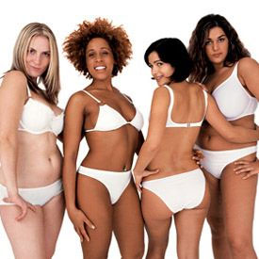
Marketing Communication
Unilever used an integrated marketing approach to market their campaigns for Dove
Their marketing communications included
Giving interviews, interviewing real women from different countries and different age groups, ethnicities, and backgrounds
Conducting surveys from different types of women and girls, used grounded research in order to come up with the media plan
Using innovative technology to market their message such as online advertisements
Electronic Billboards that offered On demand voting
Traditional Billboards, Billboard Panels
Mobile Campaigning
Chat Rooms and Blogs
YouTube Films and Videos that led to an innovative and popular Viral Campaign
Open dialogue and discussions on
TV Shows, Specials, Articles
TV COMMERCIALS
PROGRAMS and Workshops
Campaignforrealbeauty.com, THE DOVE SELF-ESTEEM FUND WEBSITE
All these marketing communication methods help to increase their brand, build their customer base globally and locally, and create a healthy yet needed debate on self image within the media, the responsibility for corporations, and the effects on young girls growing up in the self image obsessed society.
Notes:
Unilever used several marketing communication techniques in order to communicate with their target audience and effectively market their campaign. Unilever used an integrated marketing approach to market their campaigns for Dove. Their marketing communications included: Giving interviews, interviewing real women from different countries and different age groups, ethnicities, and backgrounds
Conducting surveys from different types of women and girls, used grounded research in order to come up with the media plan. They used innovative technology to market their message such as online advertisements, Electronic Billboards that offered On demand voting, Traditional Billboards, Billboard Panels. Mobile Campaigning, Chat Rooms, and Blogs. Some of the most popular marketing communication tools included, YouTube Films and Videos that led to an innovative and popular Viral Campaign. The use of open dialogue and discussions on TV Shows, Specials, Articles, TV commercials. They targeted the women with building up their self esteem through, programs and Workshops. Campaignforrealbeauty.com, THE DOVE SELF-ESTEEM FUND WEBSITE. All these marketing communication methods help to increase their brand, build their customer base globally and locally, and create a healthy yet needed debate on self image within the media, the responsibility for corporations, and the effects on young girls growing up in the self image obsessed society.

Slide 18
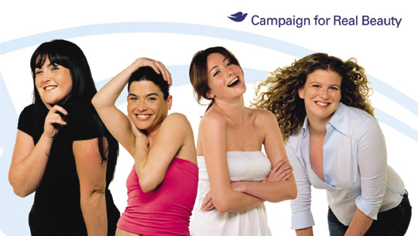
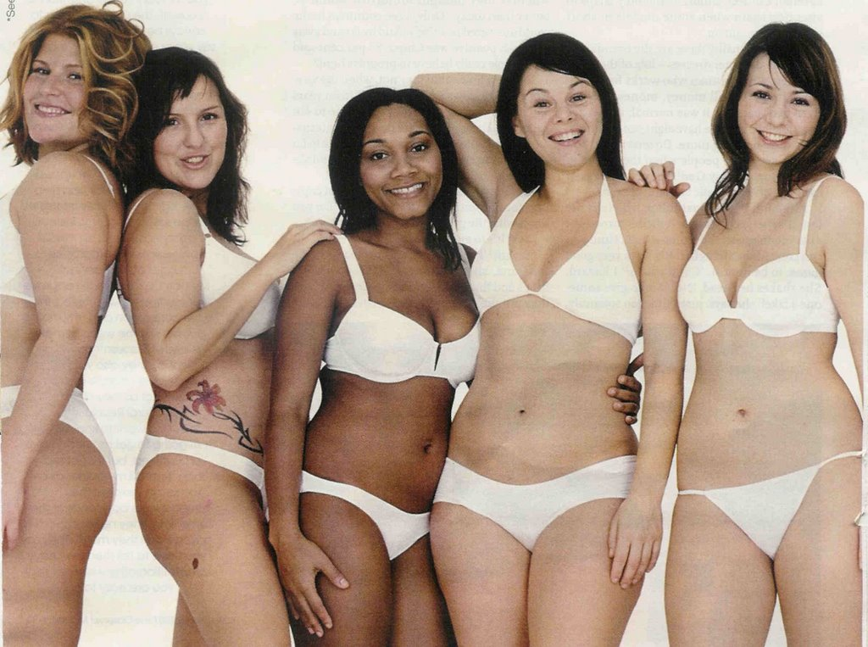
A Critical Look
In evaluating Dove’s Real Beauty Campaign, there are some major risks that could harm the brands value, position, and future growth within the market and with consumers
They run the risks of being the brand for “fat girls”
"How could the same company that launched Dove's Campaign for Real Beauty, celebrating women's natural appearance over media stereotypes, be behind the arguably degrading depictions of females in ads for Axe?" asked marketing experts from Northwestern's Kellogg School of Management in a 2012 case study.
Dove is completely eliminating the reference group which kills the aspirational element from the whole ad campaign. The aspirations of women to become more beautiful or attractive is undermined by “celebrating real beauty.”
The objectification of women tends to not sit well with feminists groups who point out the contradictory .
Many competitors are copying the approach, and many have parodied it online
Their blogs that they created do not get updated and lose out on engaging consumers who are frequent online blogs
Sustainability of campaign in long runs the risk of being over exposed on social media
The brand’s nontraditional marketing may lead consumers, or potential customers, to believe that Dove products are for unattractive, over-weight women, or those who don’t consider themselves to be beautiful.
They have left out another category: Men, who also suffer from self esteem issues that impact their lives
More importantly some of their ads for their campaigns does not mention any products, or has the intention of selling the public any products. They run the risks of losing out on money, since one of the purposes is to sell products.
Notes:
Taking a critical look into the campaign and into Dove’s marketing approach included, In evaluating Dove’s Real Beauty Campaign, there are some major risks that could harm the brands value, position, and future growth within the market and with consumers They run the risks of being the brand for “fat girls” as the women were usually a little less than the typical skinny woman images in magazines, "How could the same company that launched Dove's Campaign for Real Beauty, celebrating women's natural appearance over media stereotypes, be behind the arguably degrading depictions of females in ads for Axe?" asked marketing experts from Northwestern's Kellogg School of Management in a 2012 case study. Dove is completely eliminating the reference group which kills the aspirational element from the whole ad campaign. The aspirations of women to become more beautiful or attractive is undermined by “celebrating real beauty.” The objectification of women tends to not sit well with feminists groups who point out the contradictory. The objectification of women tends to not sit well with feminists groups who point out the contradictory . Many competitors are copying the approach, and many have parodied it online. Their blogs that they created do not get updated and lose out on engaging consumers who are frequent online blogs. Sustainability of campaign in long runs the risk of being over exposed on social media, The brand’s nontraditional marketing may lead consumers, or potential customers, to believe that Dove products are for unattractive, over-weight women, or those who don’t consider themselves to be beautiful.

Slide 19
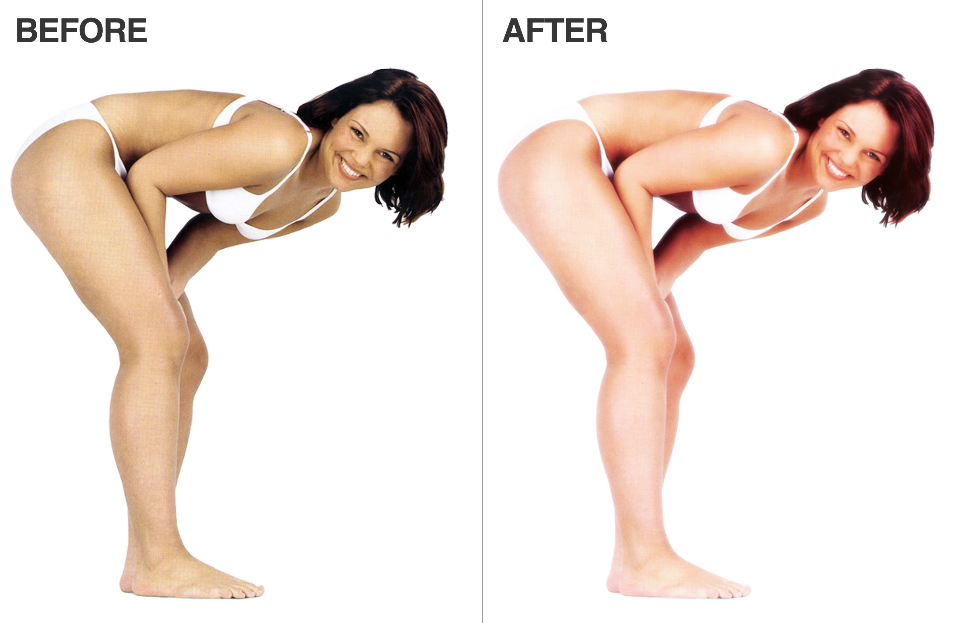
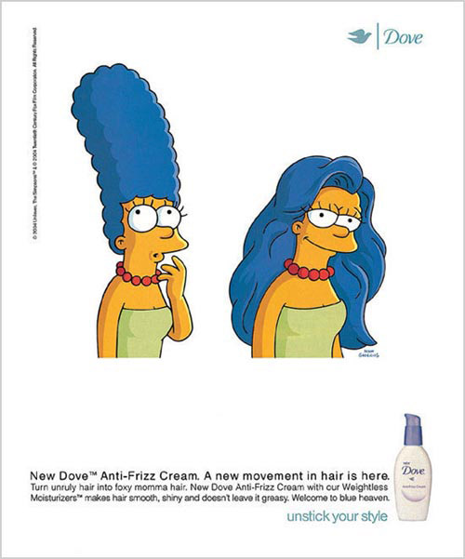
A Critical Look Continued
The campaign has a lot of mixed messages. As the promote “real beauty” they continue to use other images that include cartoons, and sometimes more skinner women in specific regions in order to cater to a specific market. The use of photoshopping in some images combats the image of real beauty.
Notes:
Just as pointed out on the previous slide, there were many issues about the Campaign that drew in not only controversy but also contradictory as they started to use Cartoon characters in their ads to show the effects of their products. The campaign was hell-bent on using the images of real women, yet they turn to made up characters to advertise. The other contradictory included the discovered use of photoshooping in some of their ads. Dove won’t admit if the photoshopping is by their own advertisement team or by others, however the issue left a bad taste in some consumers mouths about the authenticity of the campaign.

Slide 20
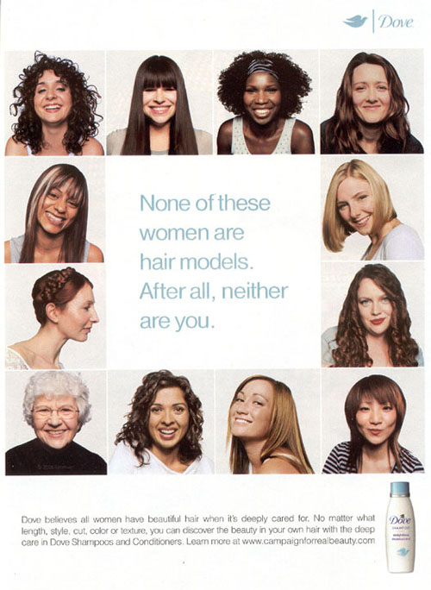
Current Brand Management
Previous
Current
Marketed their brand after their main competition Proctor & Gamble.
Their brand management involved product categories that offered multiple brands were led by brand managers that acted as entire separate business in competition with products in the same company and other companies.
A brand assistant or staff would be in charge of executing policies :
Delivering brand strategy
Profit targets
Power over marketing decisions
Trade promotions and Advertising
Now their objective is to bring the most valued or top brands into the market to create brand awareness
Use advertising that connects with consumer needs Let the consumer know more about the product’s uses
Shifted from an out-and-out house of brands to endorsing all its products linked to its corporate logo.
Converged the marketing of disparate arms due of the lack of brand recognition.
Dove's extension into deodorant - Long-term strategy built to set global; brands.
In 2005, developed a Brand Imprint to help Lifebuoy, Pepsodent, Close Up develop their social missions.
Since 2002, became more visible to shoppers, with corporate logo appearing on the back of all our product packs.
Notes:
Unilever changed the way they managed their brands. They previously marketed their brand their main competition Proctor & Gamble. Their brand management involved product categories that offered multiple brands were led by brand managers that acted as entire separate business in competition with products in the same company and other companies. A brand assistant or staff would be in charge of executing policies : Delivering brand strategy, Profit targets, Power over marketing decisions, Trade promotions , and Advertising. Now their objective is to bring the most valued or top brands into the market to create brand awareness. Use advertising that connects with consumer needs Let the consumer know more about the product’s uses shifted from an out-and-out house of brands to endorsing all its products linked to its corporate logo. Converged the marketing of disparate arms due of the lack of brand recognition. Dove's extension into deodorant - Long-term strategy built to set global; brands.
In 2005, developed a Brand Imprint to help Lifebuoy, Pepsodent, Close Up develop their social missions. Since 2002, became more visible to shoppers, with corporate logo appearing on the back of all our product packs.

Slide 21
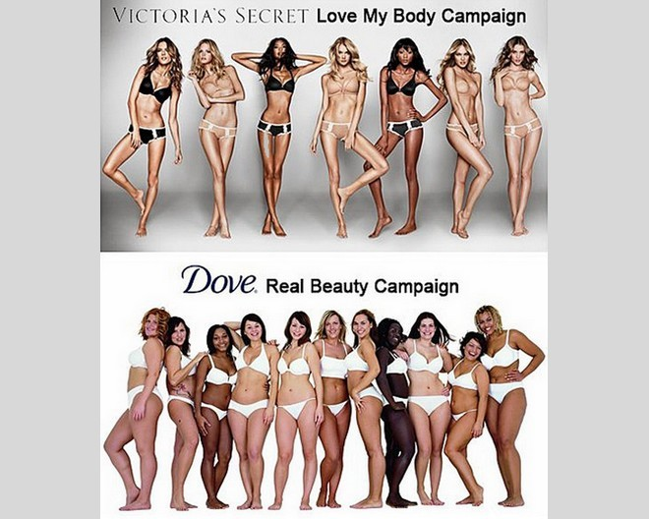
Has the Campaign been a success?
The campaign returned $3 for every $1 spent
In the first six months of the campaign, sales of Dove’s firming products increased 700 % in Europe and in the United States, sales for the products in the advertisements increased 600 % in the first two months of the campaign
“Evolution” the viral video and the most famous execution of the campaign to date had global impact. The viral has been viewed more than 15 million times online and seen by more than 300 million people globally in various channels of distribution, including news coverage
They have won several awards and continue to excel and create buzz with new ads.
Over Dove’s Campaign for Real Beauty has been a success in generating buzz, creating sales and revenue, and changing the perception of the real images of beauty.
The campaign has gained momentum since its inceptions which has been aided by controversial yet provocative ads that get the attention of the internet buzz feed, local and global news, TV shows, big named celebrities and News mediums.
The success of the campaign has netted other initiatives including the Self-Esteem Campaigns, the Self-Esteem Fund, among others to draw attention and teach women old and young to love their selves.
Notes:
The question then lies, is Dove’s Campaign for Real Beauty been a success? Over Dove’s Campaign for Real Beauty has been a success in generating buzz, creating sales and revenue, and changing the perception of the real images of beauty. The campaign has gained momentum since its inceptions which has been aided by controversial yet provocative ads that get the attention of the internet buzz feed, local and global news, TV shows, big named celebrities and News mediums. The success of the campaign has netted other initiatives including the Self-Esteem Campaigns, the Self-Esteem Fund, among others to draw attention and teach women old and young to love their selves. The campaign returned $3 for every $1 spent. In the first six months of the campaign, sales of Dove’s firming products increased 700 % in Europe and in the United States, sales for the products in the advertisements increased 600 % in the first two months of the campaign “Evolution” the viral video and the most famous execution of the campaign to date had global impact. The viral has been viewed more than 15 million times online and seen by more than 300 million people globally in various channels of distribution, including news coverage. They have won several awards and continue to excel and create buzz with new ads. Overall the campaign has been successful on a global scare, making Dove one of the leaders in the cleansing market.

Slide 23
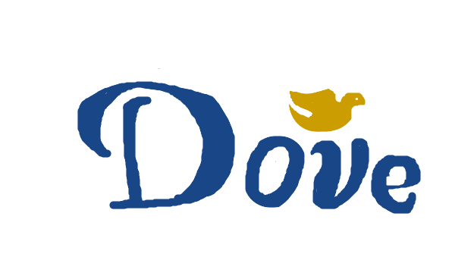
Can the brand evolve any further?
Dove is positioned as a Personal Care brand, no longer reliant on their beauty bars that have added hundreds of products to their portfolio and have a global reach within 80 countries.
Dove wanted to understand how women define beauty; how satisfied they are with their beauty; how they feel about female beauty’s portrayal in society; and, how beauty affects their well-being.”
Redefining Beauty allowed the Dove campaign to distinguish themselves as a quality product and socially responsible company.
The new image of what women perceive beauty to be is an opportunity for
Dove to develop a strong ethical position and realign ethical and social strategies with their products
The opportunities exists to expand the Real Beauty Campaign to include men, they have an opportunity to reach an untapped market that showcases the insecurities that men have with self image
By expanding their markets, they can also reposition their selves as a unified global entity.
Continuously evolving the campaign by coming with more innovative ways to market to the customers, keep the dialogue fresh and open for more debates online and offline.
Continue to fund and show social responsibility in their funds and programs that promote positive self image and combat the media’s perception of beauty.
The one main recommendation is to reconnect the products to the promotions. Even though sells are in the billions they could be able to sell their wide range of products if they refocus on selling products to the customer base.
Notes:
Dove is positioned as a Personal Care brand, no longer reliant on their beauty bars that have added hundreds of products to their portfolio and have a global reach within 80 countries. Dove wanted to understand how women define beauty; how satisfied they are with their beauty; how they feel about female beauty’s portrayal in society; and, how beauty affects their well-being.” Redefining Beauty allowed the Dove campaign to distinguish themselves as a quality product and socially responsible company. The new image of what women perceive beauty to be is an opportunity for Dove to develop a strong ethical position and realign ethical and social strategies with their products. The opportunities exists to expand the Real Beauty Campaign to include men, they have an opportunity to reach an untapped market that showcases the insecurities that men have with self image by expanding their markets, Dove can also reposition their selves as a unified global entity. Continuously evolving the campaign by coming with more innovative ways to market to the customers, keep the dialogue fresh and open for more debates online and offline. Continue to fund and show social responsibility in their funds and programs that promote positive self image and combat the media’s perception of beauty. The one main recommendation is to reconnect the products to the promotions. Even though sells are in the billions they could be able to sell their wide range of products if they refocus on selling products to the customer base.

Slide 24
References
“Brand.” AMA. (n.d). Retrieved from http://www.marketingpower.com/_layouts/dictionary.aspx?dletter=b
Deighton, John. “Dove: Evolution of A Brand.” (2007). Harvard Business School.
Kurtzleben, Danielle. (2013). “Do Dove and Axe Sell the Same Message?” US News. Retrieved from http://www.usnews.com/news/articles/2013/04/18/unilever-faces-criticism-for-real-beauty-ad-campaign
“Was Dove Campaign a Success.” Quora. Retrieved from http://www.quora.com/Was-Doves-Real-Beauty-Campaign-successful

