Slide 1
Anger!
The Role of Anger as a Social Emotion
http://www.youtube.com/watch?v=zerCK0lRjp8

Slide 2
Dictionary Definition
ANGER:
a strong feeling of displeasure and usually of antagonism
Notes:
The dictionary defines “anger” as a strong feeling of displeasure, usually accompanied by antagonism and even aggression

Slide 3
Social Psychology Definition
ANGER:
An emotion that results from displeasure at an undesired event, particularly one that is perceived as having resulted from someone's blameworthy action
Notes:
The Social Psychology definition of Anger is more specific. In this context, Anger is an emotion that results from displeasure at an undesried event, particularly one that is perceived as having resulted from someone’s blameworthy action. In other words, when we feel angry, we are usually angry at something or someone, and we usually feel wronged by this external situation or person

Slide 4
Social Learning Theory
Social Learning Theory states that behavior is learned from the environment through the process of observational learning
Children observe the people around them behaving in various ways
Behavior is either rewarded or discouraged
Positive and Negative Reinforcement Can Shape Future Behavior
Notes:
Many theories exist in the field of Social Psychology that explore the nature of Anger and attempt to understand what purpose or function anger plays in society. Social Learning Theory states that behavior is learned from the environment through the process of observational learning. Emotions such as anger are expressed through behavior, and Social Learning Theory addresses the subject of how behaviors are learned. According to this theory, children learn how to express emotion by observing the behavior of others, such as adults, siblings, and other members of society. When children imitate the observed behavior, their behavior is rewarded or punished to varying degrees, which provides positive and negative reinforcement for the behavior. Social Learning Theory also considers a range of other physiological, psychological, and social factors when seeking ways to understand and explain how emotions and behavior are connected. In general, however, this theory views the constructs and rules of society as being the primary means by which emotions and their associated behaviors are mediated and influenced.

Slide 5
Bandura’s Bobo Doll Experiment
Nursery School-aged Children Observed Adults Expressing Anger and Aggression Towards a “Bobo Doll” (An Inflatable Punch-Doll)
Each Child Was Later Given the Chance to Interact With the Bobo Doll
Most of the Children Demonstrated Agressive Behavior Towards the Bob Doll
Bandura Proposed that Children Learn to Express Emotion through Social Learning
Notes:
Researcher Albert Bandura conducted an experiment with a group of young children to see if their behavior would be influenced through observation. Each child was given an opportunity to play with a group of toys with an adult present. After a few minutes of play the adult would begin to demonstrate aggressive behavior to a Bobo doll, which is an inflatable punching-doll toy, in the presence of the child. This behavior included striking and kicking the doll as well as expressing verbal anger towards it. Later, the same child would be given a chance to play with toys again, but would be interrupted after a few minutes as a means of inducing feelings of frustration in the child. When the frustrated children were given the opportunity to interact with the Bobo doll, most of the children demonstrated aggressive behavior towards the doll that was very similar to the behavior they had witnessed the adults expressing in the earlier part of the experiment.
This research, and other studies that are similar, have been used to examine the ways that children learn to process and express emotions. Some studies along similar lines have found links between violent movies and video games and expressions of aggression and violence in children who are regularly exposed to such media.

Slide 6
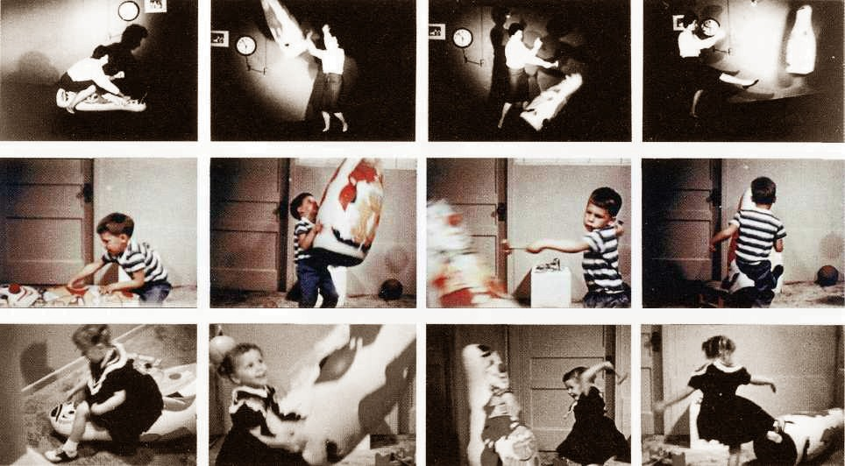
Bobo Doll Experiment

Slide 7
Anger is Natural
Anger is a natural and mostly automatic response to pain of one form or another (physical or emotional)
Anger can occur when people don't feel well, feel rejected, feel threatened, or experience some loss
The type of pain does not matter; the important thing is that the pain experienced is unpleasant
Notes:
Anger is a natural and mostly automatic response to pain of one form or another. This pain can be physical, emotional, or a combination of both. Anger can occur when people do not feel well, experience rejection, feel threatened, or experience loss. The type of pain does not matter, what matters is that the pain is unpleasant. Anger is rooted in physiological responses to threats, fear, and pain, and is universal. What varies from one individual to the next, and from one society to the next, is how they deal with, process, and express Anger.

Slide 8
Anger is a Natural and Universal Emotion

Slide 9
Anger is a Social Emotion
Anger is a social emotion
You always have a target that your anger is directed against (even if that target is yourself)
Feelings of pain, combined with anger-triggering thoughts motivate you to take action, face threats and defend yourself by striking out against the target you think is causing you pain

Slide 10
Anger and Social Psychology
Anger's relevance to social psychology includes its roles in aggression and violence
Anger also has roles in regulating interpersonal relations and conflict by expressing disapproval and by threatening and justifying retaliation
Social Psychologists study the role that anger plays in societies and how it mediates and influences behavior
Notes:
Although Anger is rooted in physiology, and is viewed by evolutionary biologists and other physiologists as part of the instinctive set of “fight or flight” responses, it is also of interest to Social Psychologists. For researchers and others in this field, the matter of how Anger influences behavior is of primary concern. From this perspective, Anger plays a role in aggression and violence, and also plays roles in regulating interpersonal relationships and conflict. Anger can be a means of expressing disapproval, of provoking threatening behavior, and of prompting retaliation over perceived threats or other behaviors. The effect of Anger on interpersonal relationships and interactions is manifested at both the individual level and at the larger social level. Social Psychologists study the role that anger plays in societies and how it mediates and influences behavior.

Slide 11
Anger and Society
The significance of Anger in different societies varies
The Utku Eskimos place great value on the limited expression of Anger
Their society emphasizes the control of Anger as a sign of maturity, and Utku children are taught from a young age to control their emotions
Notes:
Although Anger is a universal emotion, it is expressed in different ways by individuals and in societies. Some societies and cultures value anger and believe that it plays an important role in driving or justifying behaviors. Other societies have constructs that seek to limit expressions of anger and mediate behaviors associated with Anger. The Utku Eskimos are an example of a society that place great value on the limited expression of Anger. The Utku society emphasizes the control of emotional expression, especially of emotions that are considered to be negative or harmful. The Utku believe that the ability to control personal feelings of Anger, and to restrict and limit aggression and other behavior associated with Amger, is a sign of developmental maturity.

Slide 12
Anger and Society
The Warrior Culture of ancient Sparta valued Anger. The Military was the center of society in Sparta, and Anger was not an emotion to be avoided, bit to be embraced
Many stories from ancient Greek and Roman literature are written about how the Anger felt by the main character drives him or her to seek revenge or justice
Notes:
Other cultures and societies have taken much different views on Anger. Some societies have even embraced and glorified Anger, such as the Warrior culture in ancient Sparta. The Spartans viewed their military capability as the most important function of their society. Anger was not something that the Spartans attempted to limit or avoid, in the way that the Utku Eskimos did. The Spartans were always maintaining their readiness for military action and war. Anger, and the expression of emotions related to Anger, was valued and cultivated within Spartan society.
Many stories from ancient Greek and Roman literature are written about how the Anger felt by the main character drives him or her to seek revenge or justice.

Slide 13
Anger and Spartan Society

Slide 14
Anger in Philosophy and Religion
Philosophy and Religion often address the issue of Anger
Christianity teaches followers to “love thy enemy” and to “turn the other cheek”
Buddhism teaches followers to overcome emotions such as anger through meditation and reflection
Philosophers from Socrates to Nietzsche considered the issue of Anger from different perspectives
Notes:
Philosophers and religious figures throughout history have considered the emotion of Anger and how it affects individuals and societies.
Various religions have considered the emotion of Anger, and the ways that it can be expressed by individuals and societies. Most religions teach followers that Anger is a negative, harmful emotion that should be avoided. Christianity teaches followers to “love thy enemy” and to “turn the other cheek.” Buddhism teaches followers to overcome emotions such as anger through meditation and reflection
Philosophers such as Socrates considered Anger to be a wasteful and unnecessary emotion, while the German philosopher Friedrich Nietzsche believed that Anger was a necessary emotion, and one that could drive individuals to seek vengeance or justice.

Slide 15
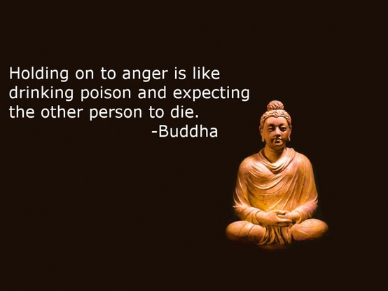
Buddhism and Anger

Slide 16
Anger as a Force for Social Change
Anger can help to drive social change
Individuals and groups who feel Angry over issues of social justice may be prompted to take action
Anger can drive change through violent means or through non-violent means
Anger drives acts of Terrorism
Anger drives movements that embarce non-violent confrontation, such as the U.S. Civil Rights Movement
Notes:
Anger can help to drive social change. Individuals and groups who feel Angry over issues of social justice may be prompted to take action. Anger can drive change through violent means or through non-violent means. Individuals and groups who engage in acts of terrorism often make public pronouncements about the social, political, or economic circumstances that Anger them, and blame these circumstances for their actions. Anger can be channeled into non-violent behaviors that can force social change. Many of the leaders of the U.S. Civil Rights movement, such as Martin Luther King Jr., often expressed anger at the social injustices felt by African-Americans. While Anger was a significant emotion that helped to drive this movement, these leaders often encouraged activists to channel their Anger into non-violent expressions of behavior, such as peaceful protests and non-violent confrontation.

Slide 17
Anger Can be a Destructive Emotion
Anger is often associated with Stress and Anxiety
These Emotions and Feelings can lead to significant psychological, physical, and social problems
Stress has been linked to heart disease, stroke, and other serious illnesses and disorders
Anger is linked to domestic violence and other socially-unacceptable behaviors
Notes:
Anger can be a destructive emotion, and is often associated with anxiety and stress. Anger, anxiety, stress, and other related emotions can lead to significant psychological, physical, and social problems. Stress has been linked to heart disease, stroke, and other serious illnesses and disorders, and Anger has linked to domestic violence and other socially-unacceptable behaviors. On a social level, Anger can cause problems within individual societies and can drive confrontation and aggression among different societies.

Slide 18
Anger Management
Contemporary Psychologists and Therapists offer suggestions about how to manage and control Anger to reduce the potential physical, psychological, and social consequences
A significant number of books, programs, and other resources are available for individuals with Anger issues. Some individuals are directed by the legal system to enter Anger management programs
Notes:
Contemporary Psychologists and Therapists offer suggestions about how to manage and control Anger to reduce the potential physical, psychological, and social consequences.
A significant number of books, programs, and other resources are available for individuals with Anger issues. Some individuals are directed by the legal system to enter Anger management programs.

Slide 19
Anger Management Techniques
Learning How to Identify Triggers
Learning Relaxation Techniques
Developing Communication Skills
Cognitive Behavioral Therapy
Notes:
Psychologists, therapists, and others involved in the field of Anger Management attempt to teach subjects various techniques for controlling Anger. Subjects are taught to identify the things that can trigger Anger and inappropriate behavioral responses. Various methods for responding to or coping with triggers are used in Anger Management programs, such as learning relaxation techniques and developing more effective ways of expressing and communicating Anger and other emotions. In some cases cognitive behavioral therapy and other techniques may be employed to help individuals with Anger Management issues learn how to process and express their emotions in healthier and more effective ways.

Slide 20
Is Anger a Learned Emotion?
Anger is a natural and universal emotion
Like all emotional responses, Anger is rooted in physiological and biological processes
How individuals express Anger can be mediated and influenced by external influences such as family upbringing and the larger social structure
Different societies view and respond to anger in different ways
Notes:
Anger is not necessarily a learned emotion, but the ways that individuals express Anger is certainly shaped and influenced by social constructs. Anger is a natural and universal emotion; like all emotional responses, Anger is rooted in physiological and biological processes. How individuals express Anger can be mediated and influenced by external influences such as family upbringing and the larger social structure. Different societies view and respond to anger in different ways, and individuals express Anger through a variety of behaviors that are influenced by phsyiological and social factors.

Slide 21
References
Besharat, M. A., & Shahadi, S. (2010). Perfectionism, anger, and anger rumination.International Journal of Psychology, 45(6), 427-434.
Braund, S. M., & Most, G. W. (2003). Ancient anger: Perspectives from Homer to Galen. New York, NY: Cambridge University Press.
Briggs, J. L. (1970). Never in anger: Portrait of an Eskimo family. Cambridge, MA: Harvard University Press.
Chapman, G. D., & Chapman, G. D. (2007). Anger: Handling a powerful emotion in a healthy way. Chicgo, IL: Northfield Pub.
DeFoore, B. (1991). Anger: Deal with it, heal with it, stop it from killing you. Deerfield Beach, FL: Health Communications.
Ellis, A., & Tafrate, R. C. (1997). How to control your anger before it controls you. Secaucus, N.J: Carol Pub. Group.
Gentry, W. D. (2007). Anger management for dummies. Hoboken, NJ: Wiley Pub., Inc.
Kassinove, H., & Tafrate, R. C. (2002). Anger management: The complete treatment guidebook for practitioners. Atascadero, CA: Impact Publishers.
Kweon, B. (2008). Anger and Stress : The Role of Landscape Posters in an Office Setting.Environment and Behavior, 40(3), 355-381.
Lerner, J. S., & Keltner, D. (2001). Fear, Anger, and Risk. Journal of Personality and Social Psychology, 81(1), 146-159.
Mills, H. (2005, June 25). Psychology of Anger - Anger Management, Anxiety Attacks & Social Anxiety Disorder. Retrieved from http://www.mentalhelp.net/poc/view_doc.php?type=doc&id=5804&cn=116
Miron, A. M. (2008). Deterring Anger and Anger-Motivated Behaviors. Basic & Applied Social Psychology. Oct-Dec2008, Vol. 30 Issue 4, p326-338, 30(4), 326-338.
Parrott, G. (1996). anger : The Blackwell Encyclopedia of Social Psychology : Blackwell Reference Online. Retrieved from http://www.blackwellreference.com/public/tocnode?id=g9780631202899_chunk_g97806312028993_ss1-21
Science and Technology: Anger management; Evolutionary psychology. (2006). The Economist, 379(8481), 94.
Siegman, A. W., & Smith, T. W. (1994). Anger, hostility, and the heart. Hillsdale, N.J: Lawrence Erlbaum Associates.
Stearns, C. Z., & Stearns, P. N. (1986). Anger: The Struggle for Emotional Control in America's History. Chicago, IL: University of Chicago Press.
Tavris, C. (1982). Anger, the misunderstood emotion. New York, NY: Simon and Schuster.
Thurman, R. A. (2005). Anger: The seven deadly sins. New York, N.Y: New York Public Library.

