Slide 1
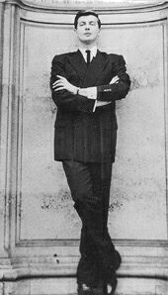
Hubert De Givenchy
Knowing the Man
Behind the Fashion
Presented By: ________________________________

Slide 2
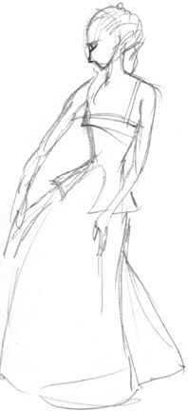
Where it all began…
Full Name: Count Hubert Marcel Taffin De Givenchy
Date of Birth: February 21, 1927
Place of Birth: France
Born to a family of designers, artists and entrepreneurs,
Givenchy had his right foot forward as he steps towards
the path that leads towards his
life’s most valuable dream.
Notes:
As a born individual who knew what he wanted, Givenchy was even given the chance to be born to a family that welcomes opportunities as they come. With being an artist running through his blood, Givenchy began to dream and held on to that dream until he finally fulfilled his desires of being able to share his talent to the world.

Slide 3
The Beginning of a Dream
I want to work ‘somewhere in the fashion industry’
-Givanchy
1937-
Givanchy was inspired to embrace the fashion industry as he went to the world’ fair in Paris that showcased the different fashion-styles of the world. He knew he wanted to make a name through his skills in design and creativity.
He enrolled to learn
fashion and design
at Ecole des Beaux-Arts
Notes:
As he entered the university, Givanchy knew what he wanted and he readily know what to plan ahead for his future. From this point, he has become as motivated as possible to fulfill a dream that is he knows would bring him to places and would let him know the right people for the right aspiration of his life.

Slide 4
Working with and Working for the Best
People he worked with:
Pierre Balmain
Christian Dior
Elsa Schiaparelli
People he worked for:
Jacques Fath
Robert Piguet
Lucien Lelon
Audrey Hepburn
Notes:
Listed herein are some of the best designers he worked with and learned from.
The other presentation lists some of the foremost clients that Givenchy served with whom he shared his first designs with.

Slide 5
The Creation of a Champion
1951-
Givenchy established his first store;
It did not fair properly and later on went bankrupt
-this did not stop him from his quest
1952-
Givenchy established the HOUSE OF GIVENCHY
as his personally managed business that
showcases most of his designs
While he began roughly at first,
it was his second attempt to an elusive dream
that got him the chance to finally join in the
luxurious bandwagon of the fashion industry
in the early 1950’s
Notes:
Making a name was not that easy for Givenchy. However, it was the desire and the motivation he personally had in himself that pushed him to become more than just what he was expected to become. He wanted something, and he made sure that he gets good results from the efforts he put forth for the fulfillment of his dream.

Slide 6
The Best Offers in the Market
1952:
Launched Separates
(Skirt and blouse made from raw cotton)
1954:
Launched ready to wear line
(Givenchy Universite)
1960:
Introduced the Sack Dress
phenomenon in the industry
1968:
Introduced ready to wear collection
(Givenchy Nouvelle Boutique)
1978:
Created and released Gentlemen Givenchy
-a clothing line for men
Notes:
Here are some of the most notable works of Givenchy that spearheaded his recognition as an Aristocrat of fashion in the realm of world fashion development.

Slide 7
Branching Out
After creating a name in the field of
making clothing line designs, Givenchy wanted to
contribute more to the industry…
To do so, he branched out and introduced
his own accessory and fragrance line
Notes:
It was not enough for Givenchy to just make the clothes, to earn more and to contribute more to the industry, he decided to branch out and offer more for the market.

Slide 8
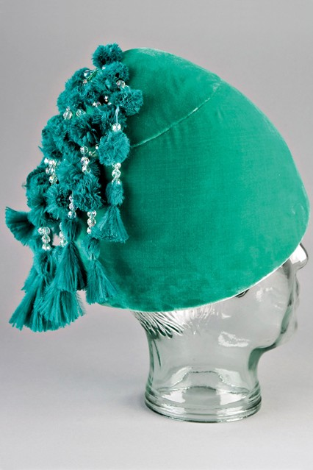
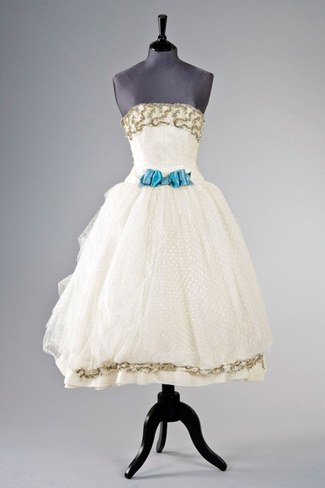
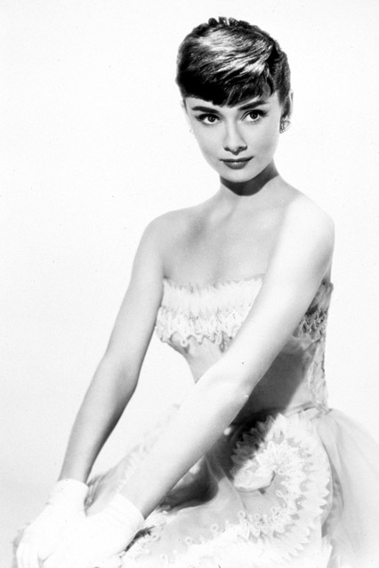
Works and Collections (1)
Audrey Hepburn
Notes:
The head dress is called the Givenchy domed jade green velvet hat
While the dress is The Givenchy haute couture white point d'esprit ball gown he created for Audrey Hepburn

Slide 9
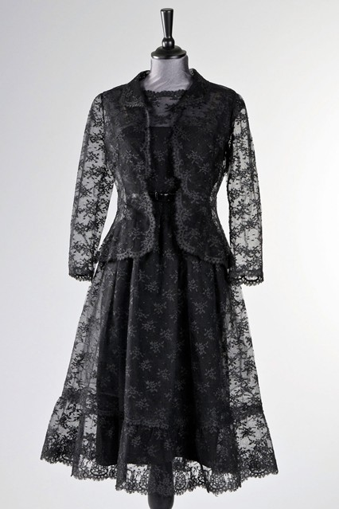
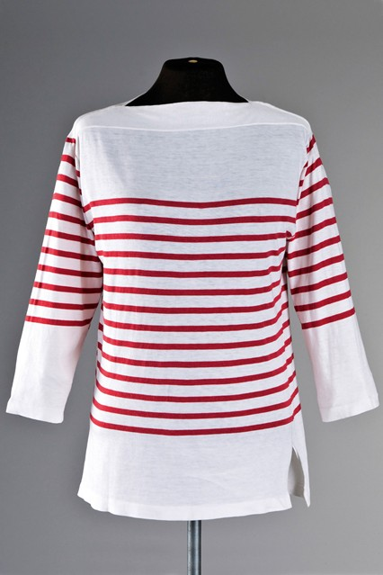
Works and Collections (2)
Notes:
The striped shirt is a Mark Cross red and white striped knitted cotton top included in the most recent collections of Givenchy that is still out in the market
The black dress is The Givenchy haute couture black chantilly lace cocktail dress which was worn in How to Steal a Million (1966)

Slide 10
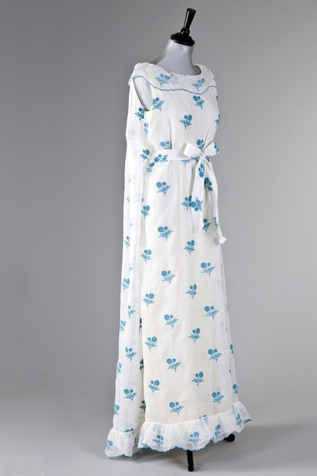
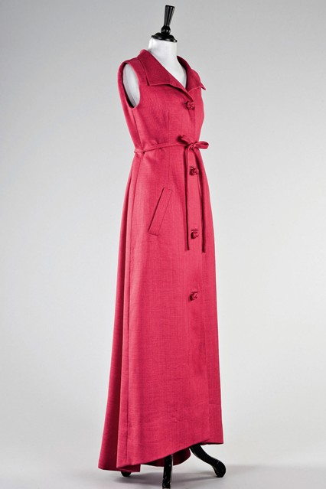
Works and Collections (3)
Notes:
The pink dress is known as the Givenchy haute couture fuchsia pink evening gown while the white one is identified as the Givenchy embroidered organza evening gown which are both included in the spring-fall collection released under the Givenchy label.

Slide 11
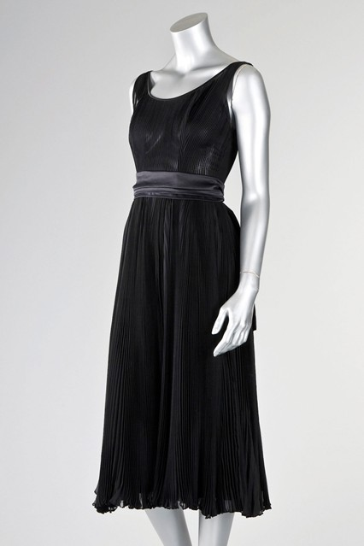
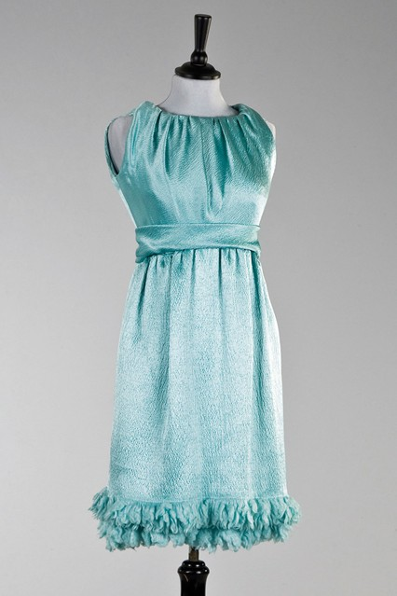
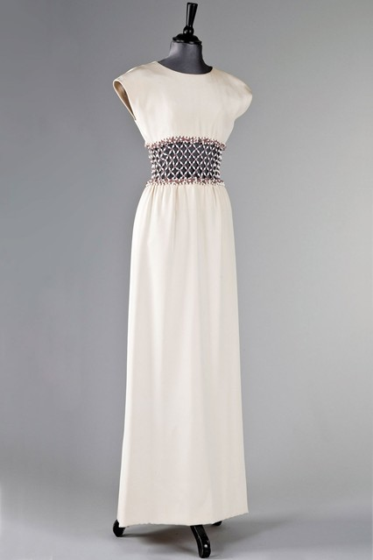
Works and Collections (4)
Notes:
The green dress is the Givenchy haute couture turquoise cloqué silk cocktail gown,
the white one is the Givenchy haute couture cream silk evening gown with elaborately beaded and jewelled midriff,
And the black dress is the The Elizabeth Arden black goffered chiffon cocktail dress…
Which are all included in the fall-winter collection of Givenchy

Slide 12
A Legacy to Fashion
“The dress must follow the body of a woman, not the body following the shape of the dress.”
– Hubert de Givenchy
Simplicity
Detail and Originality
Elegance and Comfort
Notes:
These are three primary aspects of fashion practice that Givenchy applies which he believes strongly adheres to the idea of creating fashion for the body and not finding the right body for the good fashion. It is the enhancement of the natural beauty that Givenchy considers as an important aspect of true fashion.

Slide 13
A Legacy to Commerce
…In fashion, the people are the client, the people are the business, the people are the managers of the industry…
1. Know the client and respect
their personality
2. Never fear to innovate if it is
what the market demands for
3. Giving attention to details
Always pay largely.
Notes:
When it comes to running a business, Givenchy believes in strategy. Among the most important aspects of the strategy he used in business are the three elements of success noted in this slide.

Slide 14
References:
Braudel, Fernand. (1990). Civilization and Capitalism, 15th–18th Centuries,
Vol 1: The Structures of Everyday Life," p317, William Collins & Sons, London.
Breward, Christopher. (2003). The culture of fashion: a new history of fashionable dress.
Manchester: Manchester University Press.
Françoise Mohrt. (1998). The Givenchy Style. Assouline.
Keogh, Pamela Clarke. (1999). Hubert de Givenchy (introduction):
Audrey style. Aurum Press.
Laver, James. (1999). The Concise History of Costume and Fashion.
Abrams. p. 62.
McDermott, Kathleen. (2010). Style for all: why fashion, invented by kings,
now belongs to all of us (An illustrated history). Manchester:
Manchester University Press.
Perrot, Philippe (translated by Richard Bienvenu). (1994).
Fashioning the bourgeoisie: a history of clothing in the nineteenth century.
Princeton NJ: Princeton University Press.
Steele, Valerie. (1999). Paris fashion: a cultural history,
(2. ed., rev. and updated), Oxford: Berg.
Notes:
Overall, it could be analyzed that with the beginning of a dream and its pursuance, any person like Givenchy would be able to attain whatever the heart desires to have. With strategy and proper motivation, no dream is impossible to reach.

