Slide 1
Impact of Chinese Economy on Saudi Arabia

Slide 2
China Saudi Arabia Comparison (All Figures are Approximations)
2010 GDP - $5.9 Trillion
2010 Oil Imports - $164 Billion
2010 GDP - $441 Billion
2010 Oil Exports - $205 Billion
Daily Saudi Oil Export to China (2010) 1 Million Barrel
Price Per Barrel (2010) $85 (Avg.)
Annual Saudi Oil Export to China (2010) $31 Billion

Slide 3
Saudi Arabia – Oil Dependent Economy
Oil is biggest Saudi export in terms of both volume and trade value
Oil accounted for 87% of the total $235 billion Saudi exports in 2010
Thus, market oil prices have significant impact on Saudi exports on year-to-year basis
Saudi Arabia has been trying to increase non-oil exports such as petrochemical and plastics and China has become an important market
Saudi oil export to China alone counted for approx. 7% of its 2010 GDP
Along with the U.S., China is Saudi Arabia’s largest oil customer
China’s 2010 oil imports from Saudi Arabia was almost twice the 2009 level
China’s importance will only grow over time due to its economic growth rate and higher appetite for energy sources

Slide 4
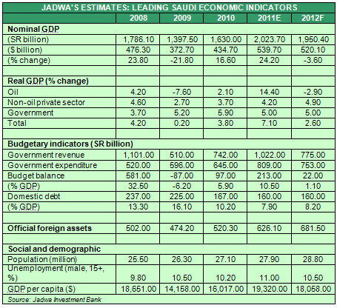
Saudi Dependence on oil
Saudi economic performance is highly reliant on oil as shown in the table
Non-oil private sector
and the government sector
is expected to grow in 2012
Yet Nominal GDP is expected
to decline by 3.6% in 2012 because
Oil production is expected to fall

Slide 5
Inflation and China
Inflation is a major concern for Chinese Policymakers
Lending to the private sector has been tightened
Impact of tighter lending in China
Many small businesses have been closed
Small firms in private sector have been hit the hardest
Manufacturing sector contracted for a third consecutive month in September, 2011
Capital investment plans have been cancelled
As a result
Aggregate supply of manufacturing products has fallen
Unemployment has risen
Higher unemployment results in a decline in aggregate demand of products as well
Tighter lending may help combat inflation but at the expense of higher unemployment and lower manufacturing levels
China’s annual economic growth slowed down in the 3rd quarter as compared to the 2nd quarter during 2011

Slide 6
Counter-Inflationary Measures by China
Chinese authorities are concerned by the falling health of banks
Have purchased stocks of some of the largest banks
Stock purchases may support banks but
Stock purchases by the government means higher money supply
Increased money supply in the economy means higher price levels
This is puzzling
Chinese authorities do not seem to have clear monetary policy
Tightened lending to control inflation yet expansionary monetary policy has exactly the opposite impact on price levels

Slide 7
Chinese Central Bank
The Central Bank is pursuing a contractionary monetary policy
Has raised interest rates at least five times since October 2010
Higher interest rates increase borrowing costs for lenders and discourage lending
Lower demand for money means lower inflationary pressures
Has increased banks’ reserve requirement ratios (RRR) at least nine times since October 2010
Banks have lower amount of money to lend
Lower levels of lending mean lower production activity in the economy
Inflation has become the utmost concern of the government
Wants to slow down the economic growth to avoid bubble
Wants to discourage lending to risky businesses

Slide 8
Economic Characteristics of OIl
The oil prices are dependent upon the forces of demand and supply
Economic trends have positive relationship with demand and prices
Price Per Barrel – 8th January 2010 - $82.7
31st December 2010 - $91.38
The world economy had improved by the end of 2010 as compared to early 2010, hence higher oil price per barrel
Oil has low price elasticity of demand
Energy is one of the major drivers behind economic growths and oil is one of the most-sought after energy resources
Oil has no good substitutes at the moment. Alternative energy sources are still not economical or technologically advanced

Slide 9
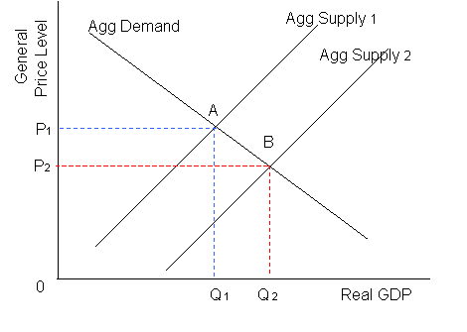
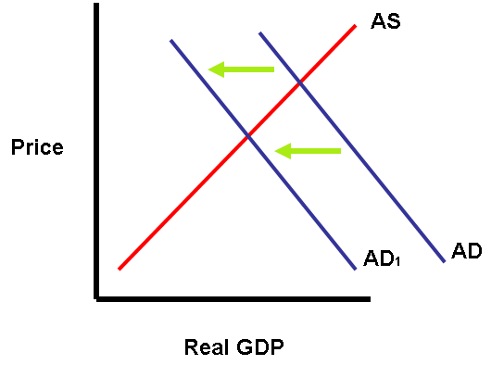
Impact of lower saudi exports to china
Lower demand by China will force Saudi Arabia to lower oil supply, resulting in a decrease in aggregate supply from Agg Supply 2 to Agg Supply 1. This will increase the price per barrel of oil.
But at the same time, aggregate demand for
oil will also fall due to lower Chinese demand,
resulting in lower price per barrel of oil.
The ultimate price will be determined by the
relative movements of aggregate supply and
aggregate demand curves. If aggregate supply curve
moves by a greater margin than the aggregate
demand curve, the overall price per barrel will
increase and vice versa.

Slide 10
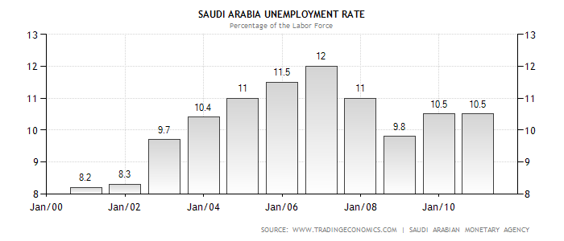
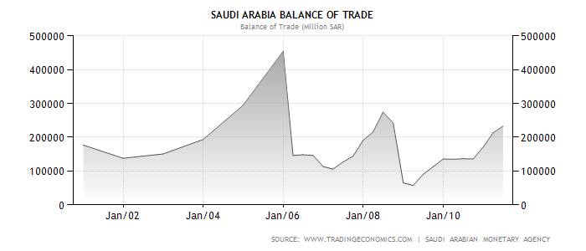
Potential Impact of Weaker China on Saudi Arabia
Saudi unemployment rate will stay above 10 %
Unemployment rate was above 10% in 2010
Oil industry is a major employer in the country
Saudi trade surplus may most likely fall
Weaker economic conditions mean China will decrease imports from Saudi Arabia by a greater proportion than Saudi Arabia would
Saudi real economic growth rate may fall as well
The combination of high oil dependence and lower demand by a major customer will have a noticeable impact on economic growth rate

Slide 11
Unemployment in Saudi Arabia
Unemployment is only slightly expected to fall in 2012
Not due to higher economic productivity but due to bigger government employment sector
Oil demand is weaker
Major customers such as U.S. and Europe have been suffering and China wants to slow down its economic growth rate
Inflation has been declining
Government’s subsidies to its citizens
Lower demand due to high unemployment

Slide 12
Saudi economic prospects- 2012
According to SAMA Governor Al-Jasser
2011 growth rate lower than previously expected
Inflation rate expected to decline in the future
According to IMF
Economic growth rate will slow from 6.5% in 2011 to 3.6% in 2012
According to Saudi American Banking Group (SAMBA)
Real GDP will decline from 6.6% in 2011 to 3.9% in 2012

Slide 13
Saudi Arabian monetary agency (SAMA) - Potential Monetary and Fiscal Policy
SAMA will keep the current low interest rates or may further lower them
To encourage capital investment and hiring by the private sector
To lower inflation rate
SAMA may devalue currency by selling currency in the open market
To boost exports because Saudi products will be cheaper to trading partners
Budget deficit may increase
Higher unemployment benefits
Higher government spending to support job creation

Slide 14
Recommendations
Saudi Arabia should promote non-oil sector
High reliance on a single industry is dangerous in the long term
Diversify customer base
To minimize the negative impact on the economy by a single major customer
Invest in alternative-fuel technologies
Oil may remain the primary energy source for the next few decades but what after that?
It is possible that the progress in alternative technologies happen faster than expected

Slide 15
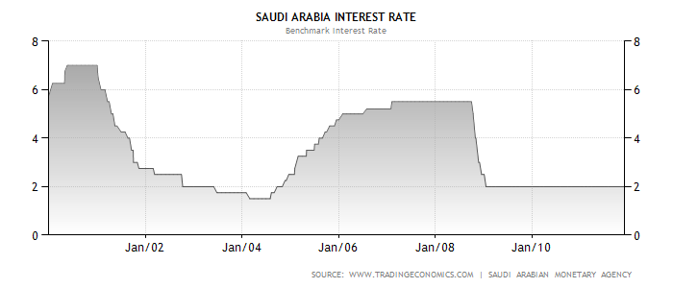
SAMA’s Response
As seen below, SAMA has left the interest rates unchanged since early 2009
SAMA doesn’t fear inflation due to weak demand
SAMA believes the interest rates should be left unchanged at existing low levels if not further lowered to encourage lending and investment

Slide 16
References
Economy Watch. China (People's Republic of China) Economic Statistics and Indicators. 23 December 2011 <http://www.economywatch.com/economic-statistics/country/China/>.
—. Saudi Arabia Economic Statistics and Indicators. 23 December 2011 <http://www.economywatch.com/economic-statistics/country/Saudi-Arabia/>.
Index Mundi. China - Saudi Arab Charts. 23 December 2011 <http://www.indexmundi.com/g/g.aspx?c=ch&c=sa&v=21&v=65&v=66&v=67&v=74&v=78&v=85&v=89>.
Knowledge@Wharton. Shifting Sands: Saudi Arabia's Oil Moves East to China. 5 April 2011. 23 December 2011 <http://knowledge.wharton.upenn.edu/arabic/article.cfm?articleid=2649>.
NYSE.TV. Crude Oil Price History. 23 December 2011 <http://www.nyse.tv/crude-oil-price-history.htm>.
Trading Economics. Saudi Arabia Balance of Trade. 23 December 2011 <http://www.tradingeconomics.com/saudi-arabia/balance-of-trade>.
—. Saudi Arabia Unemployment Rate. 23 December 2011 <http://www.tradingeconomics.com/saudi-arabia/unemployment-rate>.

