Slide 1
Art: Islamic depiction and Caligraphy
Art
Notes:
This is the Title Page

Slide 2
DEPICTIONS OF MUHAMMAD
Restrictions are normally based upon rulings from Hadith and the Islamic Law
Public depictions of the prophet are considered offensive and disrespectful of the faith
Islamic scholars state main reason is the pictures might be worshiped. This is forbidden in the Qu’ran
Shi’ites tend to be more tolerant of images than Sunni’s
Neither the Qu’ran nor Hadith mention depictions of Muhammad
Notes:
In general terms the Hadith and Islamic law provide rulings that forbid the pictures of the prophet Muhammad and Allah (God). The main reasons are cited that they fear that such pictures may be worshipped and this is strictly forbidden in the holy book of the Qur'an ( Islamic Scriptures). Public depictions are also considered both offensive and disrespectful of the faith. This is why so much controversy sprung up over the Danish cartoons: the issue of disrespect to Islam and Muslims. Within the Arabic world the Shiite's tend to be more tolerant than the Sunni`s, who tend to hold a more radical view on the use of images. The Hadith is important here because its words are considered binding in the Muslim faith.

Slide 3
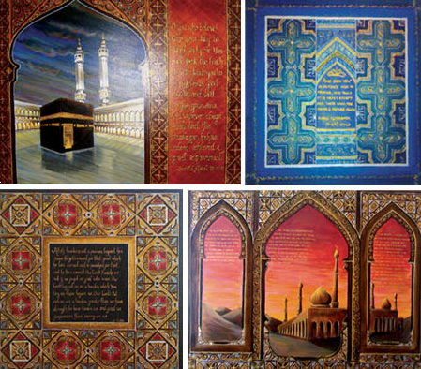
IMAGES AND FIGURATIVE ART IN ISLAM
Islam was influenced by Byzantine culture; this influenced negative associations with religious art
8th, 9th, Century art focused on human and animal depictions
The Shi’ite dynasty (909-1171 AD) focused on calligraphy. The fatimids produced ceramics with plain decorations
The Mamluks ruled Egypt, Palestine and Syria from 1260-1517 and this affluent dynasty built dome of the rock in Jerusalem and were famed for splendid architecture
Notes:
In the very early days of Islam there was not any specific Islamic art form or culture. However, as they expanded their territories the culture started to develop with it. In the 8th Century the Hadith had made a ruling on the use of religious images. The influence with the Byzantine culture had a negative influence on the production of religious art. In the 9th century there started to appear influences from the Chinese culture but there remained a consistency in the use of decorative art forms that depicted both humans and animals. The Shi’ite dynasty (909-1171 AD) focused on calligraphy. The fatimids produced ceramics with plain decorations.
The Mamluks ruled Egypt, Palestine and Syria from 1260-1517 and this affluent dynasty built dome of the rock in Jerusalem and were famed for splendid architecture

Slide 4
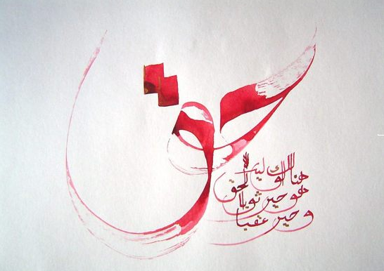
THE LEGACY OF ARABIC CALLIGRAPHY
Arabic is the language of Islam & its prophet Muhammad
The Holy Qur'an is the sacred scripture that binds all Muslims into a single brotherhood
Qur’anic verse is seen throughout mosques, palaces and the homes of the followers.
The Arabic language lends itself to the art of calligraphy and great decorative use.
Notes:
Arabic is considered the language of Islam and that of the prophet Muhammad. It is the language upon which the Holy Qur'an was written and the language used by Muslims in their worship. It is considered the single language that binds all Muslims into a single brotherhood. It is this love of the language and the special significance of the Qur'an that calligraphy became an important part of Islamic culture. The use of Qu`ranic verses in Arabic writing adorn most of their buildings, places of worship and homes. Owing to the unusual character set the language lends itself to the creation of decorative scripts and motifs. Arabic calligraphy is seen to have taken on new meaning throughout the Arabic world and is proudly used in Hotels, Airlines and Exhibitions throughout the world

Slide 5
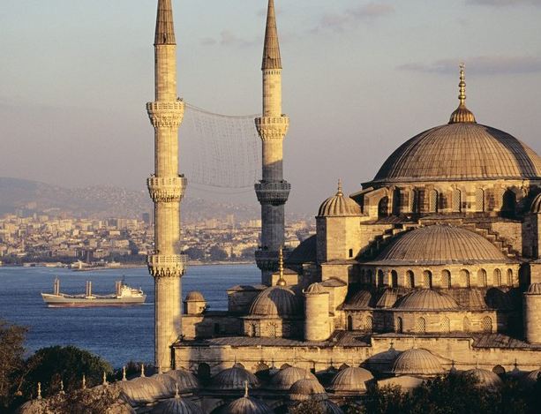
ISLAMIC ARCHITECTURE
The Dome of the Rock in Jerusalem constructed in 691-92 believed to be the spot where Muhammad ascended to heaven
8th Century desert palace Khirbat al-Mafjar in Jordan has carved and moulded stucco presentations, stone reliefs and fresco paintings
9th Century the famous Mosque in Cairo, Egypt
The Hagia Mosque in Turkey
Notes:
Islamic Architecture has a long history and dates back before the 8th Century. Examples of Islamic architecture can be seen throughout the world. Some of the most notable exhibits include that of:
The Dome of the Rock in Jerusalem constructed in 691-92 believed to be the spot where Muhammad ascended to heaven
8th Century desert palace Khirbat al-Mafjar in Jordan has carved and moulded stucco presentations, stone reliefs and fresco paintings
9th Century the famous Mosque in Cairo, Egypt
The Hagia Mosque in Turkey

Slide 6
References
Islamic Art, Elisabeth Siddiqui, 2011, MSA, Suny-Buffalo, http://www.colostate.edu/orgs/MSA/find_more/islart.html
Islamic Figurative Art and Depictions of Muhammad, Religious Facts, 2011, http://www.religionfacts.com/islam/things/depictions-of-muhammad-in-islamic-art.htm

