Slide 1
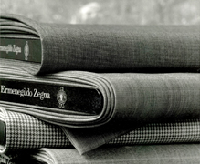
Understanding the Branding Approach of Zegna Wool Mill
A Presentation on Analyzing the Marketing Approach of the Company

Slide 2
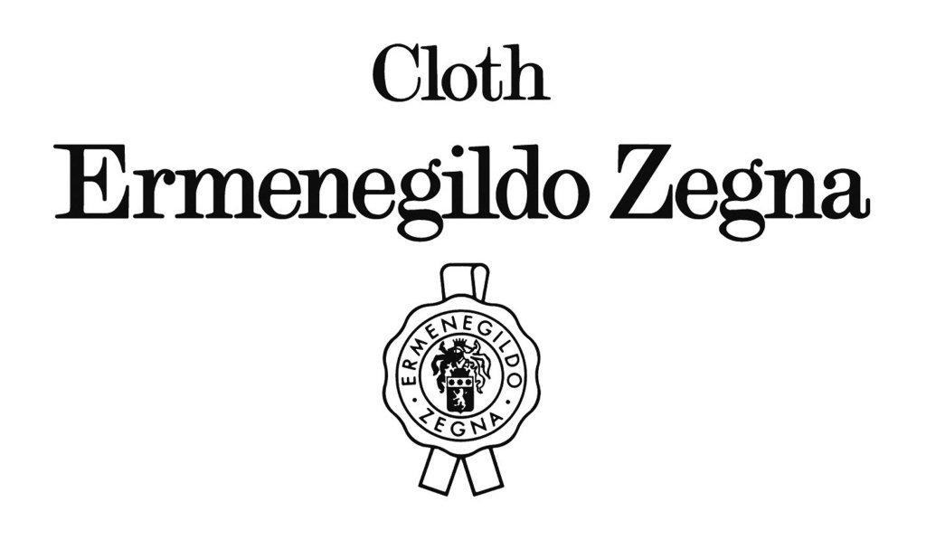
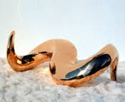
Case Background
Zegna is established under the course of a value for art
2. Zegna realizes the need for valuing client demands
3. Zegna is based on comfort and style
4. Zegna is based on serving the community’s desires and needs
5. Zegna is established on the course of wanting to provide
what is wanted and needed by the market
Notes:
Here are the five primary points that defines the business case of Zegna and the way it operates in the market.
(ANSWER FOR QUESTION 1)

Slide 3
The Quality that Goes
with the Name
While there are many luxury brands for women, Zegna
Wool Mill is one that remains strongly relative to the desire
of serving the needs of men for comfort and style
With the quality that Zegna tried to
establish in the past, his personal involvement
in the process of producing the finest products
in his company makes each final result a source of
quality defined name as presented in the market.
Notes:
Quality is one matter that remains as the strong source of confidence for companies like Zegna. It could be understood that somehow, the capacity of the company to provide what is needed by its clients has made Zegna a great name in the industry?
(ANSWER FOR QUESTION 2)

Slide 4
Comfort and Style In Exchange
For LOYALTY
The branding approach of Zegna is based on
providing what their market demands for
The difference between serving men and women in fashion obviously draws down with that of the fact that men also focuses on high-end comfort apart from style. Believably, this is the reason why Zegna aims to give what the men clients want from their clothes.
Men are willing to pay,
and when they find what they want,
they stay loyal to the brand.
Notes:
It is important for brands like Zegna to remain in relative line to defining their strength in remaining in the industry. Knowing who their market is and knowing what they want specifically gives Zegna an edge apart from the others.
(ANSWER FOR QUESTION 2)

Slide 5
Considering Corporate Responsibility
as a Source of Market Competence
Establishing the Zegna Foundation
gives the company a chance to give back
to the society what they have gained
from serving the market.
The foundation supports several welfare programs that assist the less fortunate members of the community. This gives the organization an opportunity to mark the cause behind their efforts of providing luxurious clothing for men.
Every organization needs to give back to the society.
For Zegna, their foundation provides this option
through providing more than what is needed.
Notes:
Corporate responsibility is the element that makes business organizations more responsive to the needs and demands of the community. It could be realized that somehow, it is through this that corporations are able to give back to the communities that they are supposed to serve.
(ANSWER FOR QUESTION 3)

Slide 6
Considering Corporate Responsibility
as a Source of Market Competence
CESA ZEGNA and ALL APERTO
These institutions established by the business specifically provides a better source of trust for the community to give them particular a particular mark in the market.
Mostly focused on art and culture,
these agencies of the organization aim to preserve
the value of the business for art, style and design.
Notes:
Art is an important part of the company’s value. Establishing agencies that could preserve these matters could actually make it easier for the organization to retain a name in the market from the point of their beginning to the point of their development in the market.
(ANSWER FOR QUESTION 3)

Slide 7
The Concept of Luxury
ZEGNA follows the assumption by which
it attaches its culture to what is most likely desired
by the market it serves.
It also considers the need to provide what is needed
by the community as a whole. Through mandating
their assets, they intend to give attention to what they
could give back to the society as part
of their responsibility.
Notes:
Luxury for Zegna is more than just a concept. It is a culture that specifically makes a great impact on how its people intend to live their lives according to style, comfort and quality which specifically marks their name in the market they are engaged with.
(ANSWER FOR QUESTION 4)

Slide 8
REFERENCES
Ermenegildo Zegna. http://fashiongear.fibre2fashion.com/brand-story/ermenegildo-zegna/journey.asp. (Retrieved on April 19, 2013)
Matten, D.; Crane, A.; Chapple, W. (2003). "Behind the mask: Revealing the true face of corporate citizenship". Journal Business Ethics 45 (1): 109.
Menon, A.; Menon, A. (1997). "Enviropreneurial marketing strategy: the emergence of corporate environmentalism as marketing strategy".Journal of Marketing 61 (1): 51–67.

