Slide 1
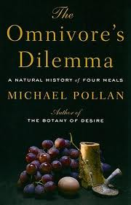
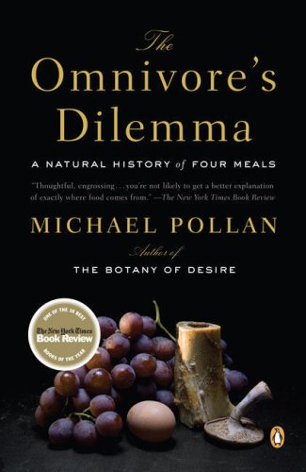
OMNIVORE’S DILEMMA
BY MICHAEL POLLAN

Slide 2
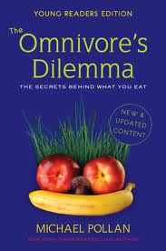
Introduction
This is an article that tackles the various eating habits of the people.
The eating habits contribute to meal time dilemmas that individuals face while selecting foods.
It considers three main categories of food sources.
The categories are classified by the author as food chains.
Food chains include the industrialized, organic and farming foods.
Changes in the eating habits and cultural affiliations will aid in resolving dinnertime dilemmas.
Notes:
The Omnivore's Dilemma is a true-life book written by Michael Pollan. This book explores the eating habits of people and dilemmas that they face during dinnertime. The majority of individuals take dinner meals relative to their beliefs, but not in respect to the consequences of consuming unidentified foods (Chevat & Pollan, 2009). America is facing a national consumption disorder since individuals have formed the habit of eating one diet fab after another. This is due to the actuality that they cannot resolve on the right choice of foodstuff, which include fast food, organic and subsistence foods (Pollan, 2007).

Slide 3
Suggestions of the author
Sensible eating habits are vital to stop mealtime dinners.
Consideration of subsistence farming improves livelihood of food.
Changes in beliefs are also influential towards transforming eating manners.
The book is instrumental in guiding readers on how to eat the different foods in the food chain.
Notes:
Sensible eating habits incorporates consumption of foods that the sources are known and contain high nutrient contents in them. For instance, a person should not prefer industrialized foods from McDonalds to cooked foods at homes. This is why it is essential to practice farming, which will ensure eating foods from identified sources and improving the environment. Changes in cultural and religious values reduce chances of developing eating disorders and poor eating conducts. This is because some religious beliefs encourage fasting while people still consume fatty meals from supermarkets. This explains why eating foods from different vendors in the food chain will enhance healthy development of the body (Pollan, 2006).

Slide 4
OUTLINE FOR CHANGES IN DINNER MANNERS
The outline includes formation of research questions, which will guide in the research.
Another section contains the thesis of the proposal. This section offers the theme of the research in attempting to resolve dilemmas.
The body will offer the main outcomes of the research.
However, during the research, some challenges were encountered.
Solutions were formulated to tackle the challenges.
Notes:
The outline is a description of the research proposal that facilitated steps towards finding of appropriate solutions of dinnertime challenges and eating behaviors. The thesis of the research was reduction in overconsumption of industrialized foods is a crucial aspect to individuals who take other foods from the food chains. This shows that Americans should take considerable quantities of foods from the three categories and not overeating foods from shops and supermarkets (Wilde, 2008).

Slide 5
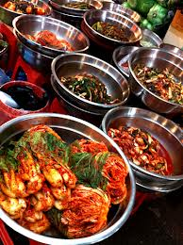
THE BODY OF THE OUTLINE
This section offers the findings, challenges, solutions and recommendations from the field.
The body is vital for education people on various aspects approaches to dinnertime dilemmas.
This is the main area where different opinions and views are presented on issues of dinner meals.
Notes:
Ways of improving Dinner manners
This implies to changing patterns of preparing food from the modern methods of using microwaves back to use of traditional methods. Most of the Americans prefer buying foods that ready because they not appreciate traditional customs of eating together at home. According to Pollan, people should solar to preserve foods instead of refrigerators, cook on fire than electricity (Wilde, 2008).
Problems associated with Dinner Dilemmas
Industrial inventions
Traditionally, since the discovery of fire, man has constantly faced food choice difficulties (Pollan, 2007). This is because prosperity, lavishness and the lack of steadiness, centuries-old food beliefs have machinated to make Americans dysfunctional shoppers, possessed with getting skinny while becoming fat, stunning from one erroneous bit of dietetic wisdom (margarine is better for them than fat) to another.
Abundance production of food
“The omnivore’s dilemma” has returned to an unfamiliar extent, as the lavishness of the current American supermarket and fast-food channel provokes people with a perplexing and deceitful food landscape (Wilde, 2008).

Slide 6
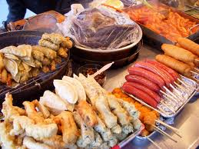
Solutions and recommendations
This section provides various solutions that if adopted can alienate food dilemmas.
Americans should exercise independence of food diets and choice.
Responsible eating habits and encouragement of cooking foods at homes.
This entails sampling various foods from the chain and balancing consumption.
Notes:
A research by Pollan asserts that integrating responsible eating habit at the early phases of a person’s life aids in reducing dinner dilemmas. This is because a person acquires the benefits of consuming considerable amount of foods from trusted vendors, for example, home made meals. These foods do not contain fatty ingredients and are nutritious. Another solution is that independency of determining the right foods to take limits submission to promotions carried out at supermarkets and McDonalds. This means sampling all the varieties offered at the different food chains suggested by Pollan in the book. Therefore, diversifying methods of obtaining foods is a crucial step, which will save the societies to measure their time and reduce predicament by eliminating costs connected to health matters and buying of harmful foods (Pollan, 2006).

Slide 7
Cultural Changes in Dinner Manners
Religious and traditional beliefs influence eating habits.
Fasting is a common spiritual belief among different religions such as Muslims and Catholics.
The majority of individuals observe religious beliefs without consideration of healthy consequences.
Cultural inclination affects eating habits, perceptions and food patterns.
Culture also instills traditional significance of foods and the role of preparing foods at home.
Notes:
Some food principles and practices are due to sacred beliefs. Around the universe, Muslims starve during Ramadan, consumption and drinking before morning and after dusk. Similarly, Orthodox Jews and some traditional Jews follow nutritional laws, traditionally referred to as a kosher nourishment, deliberated in Jewish scripture (Hellen, 2008). The dietary decrees, which describe the custom and preparation of animal foods, are observed for devotions of spiritual health. These beliefs can contribute to poor eating habits or decent preparation of healthy foods. However, observation of the beliefs can produce changes in eating patterns influenced by taking one or two meals a day (Bawadi, Al-Hamdan and Ershidat, 2012).

Slide 8
Challenges of cultural inclination in solving Dinnertime Dilemmas
Cultural inclinations can contribute to health issues.
The issues can be poor eating patterns, health disorders or cultural derailment.
Cultural adherence can lead to collapse of industrialized markets.
Dinner time dilemmas also arise because families cannot agree on the right foods to take.
Culture also faces the challenges of technological advancements to complete against modernity.
Notes:
Health issues occurs when a person decides to fast yet he or she is undergoing treatment. This is because of the belief that fasting brings blessings and the sick will be healed if they fast (Kulka, 2007). It can also cause poor eating habits during breaking of fast because believers will only eat to satisfy their hunger and not for healthy reasons. This arises because of changes in the eating programs that dictates what is eaten, amount, source and relevance. For instance, a person who likes industrialized meals might be forced to take a lot of traditional foods, this is a change in normal eating patterns (Kawash, 2011).
Most of the people who adhere to the traditional cultures are against buying of foods at the counters. This can contribute to collapse of the industries if demand drops.
Dinner time challenges arises because tradition plays a part in food varieties and food habits linked to moral or religious beliefs (Kawash, 2011). A person is only forced to consume foods that religion recommended and cannot go against that proposal.
Several technological innovations influence the increasing demands for more commercial meals such as the microwave, cultural variations with multicultural civilizations presenting new foods as well as the rise in single families, a decrease in family feasting together and more women hunting paid work.

Slide 9
Conclusion
Changes in the eating habits are essential for solving dinner time dilemmas.
Modification and diversification of beliefs promotes sustainability.
Changes in cultural patterns to incorporate modernity of applications.
Diversification of food patterns and diets to contain all elements in the food chains.
Consideration of farming practices and reduction of overconsumption of industrialized foods.
Notes:
people need to change their beliefs about dinner meals and focus on sustainable habits that will ensure survival in the future. Eating varied natural foods obtained through known sources, and avoiding oily, unhealthy foodstuffs is a suitable way of encouraging sustainable eating habits.
In order to sustain the agricultural and economic sustainability, people need to modify their beliefs about dinner meals and concentrate on sustainable habits that will ensure the existence in the future.
Diversification of cultural affiliations also limits overutilization of industrialized meals because of the choices that consumers opt for at dinner times and the deliberations that determine the genuine meal times.
Cultural traditions are slowing losing value due to industrialization, and this influences increasing consumption of ready-meals and convenience foods.
Embracing farming practices since some cultures consider farming their own foods, which they labour to enjoy. Food source determines the cost of consumption and nutrient derived from the foods.

Slide 10
References
Bawadi, H., Al-Hamdan, Z., Ershidat, O., Hammad,
F., et al. (2012). Cultural Eating Practices among Jordanians. Food and Nutrition Sciences. Scientific Research Publishing. Irvine. 790-795.
Chevat, R., & Pollan, M. (2009). The omnivore's dilemma: The secrets behind what you eat. New York: Dial Books.
Helen, K., M. (2008).Eating habits and the drive toward thinness: A cross-cultural Comparison. Psychotherapy. The American University.
Kawash, S. (2011). New Directions in Motherhood Studies. Signs: Journal of Women In Culture & Society, 36(4), 969-1003.
Kulka, S. (2007). Dinner talk: cultural patterns of sociability and socialization in family discourse. Mahwah, NJ: L. Erlbaum Assoc. Publishers. 32- 38.
Pollan, M. (2007). The omnivore's dilemma: The search for a perfect
meal in a fast-food world. London: Bloomsbury.
Pollan, Michael. (2006). The Omnivore's Dilemma: A Natural History of Four Meals. Library Journal. Vol. 130, Issue 20. 03630277. New York, United States.
Wilde, P., E. (2008). The Omnivore's Dilemma: A Natural History of Four Meals by Pollan, Michael. American Journal of Agricultural Economics. 10.1111/j.1467- 8276.2007.00998_5.x. Blackwell Publishing.

Slide 11
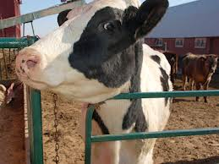
images

