Slide 1
Operations External Analysis
A Presentation Based on the Operation of the
HR Department of an IT Consulting Firm
Presented By:
_____________________

Slide 2
Industry Background
The growing industry of consulting companies dedicated to providing IT assistance services is at a rise.
Considering the need of both old and new organizations to sync within the new options of operation, consulting firms for IT are highly required to be involved in the establishment of new organizations in the market.
Notes:
Currently, there are different organizations aiming to emerge and remain in the market. With IT becoming the controlling factor on most operations of modern businesses, IT consulting companies are specifically in demand.
Relatively, for this presentation, the role of the HR Department in defining the course of the company’s path shall be given specific attention to.

Slide 3
ANALYZING THE REMOTE ENVIRONMENT
Notes:
This section provides the internal aspects that affect HR Department’s operation based on the different factors that establishes the internal operations in the IT consulting industry

Slide 4
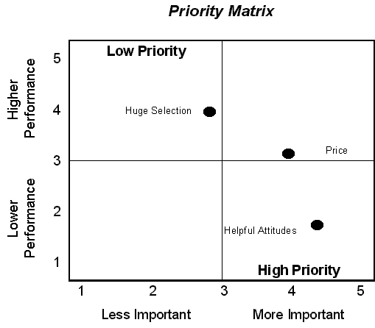
Issues Priority Matrix
A considerably high number of employees to mark the company’s capacity to finish projects on time
Gaining a population of highly competent IT professionals who can provide ACE results for the clients of the business
Development of specialized workers who are to focus on particular IT consulting projects only
Development of programs that would provide satisfaction for the workers hence improving performance outcomes
Notes:
Considering the operation of the Human Resource Department, the issues priority matrix presented herein specifically identifies closer connection with the people to be an important aspect of managerial success on the part of the administrators and supervisors of the people

Slide 5
Opportunities and Threats
Opportunities
To develop highly skilled individuals who are able to take on tasks that are necessary in establishing modern businesses
To define the industry with a line of innovative individuals who are willing to go beyond the traditional way of handling IT responsibilities
Threats
Fast Track changes in the field of IT and how it is applied in business operations: Immediate and regular training of personnel is required
New comers in the industry are more updated hence imposing on the need to further research procedures for the sake of keeping updated with the IT trends
Notes:
As seen in this presentation, it is a huge opportunity for the HR department of an IT consulting company to produce highly dependent individuals who are able to provide IT services as needed; however it is also a threat that new comers [new IT specialists/fresh graduates] are more updated in the new system of IT operations hence distinctively imposing on the need to further researches on the latest IT innovations available.

Slide 6
INDUSTRY ANALYSIS
Notes:
This section introduces the overall analysis of the IT consulting industry thus pointing out how the firms included within its limits are supposed to operate according to the market trend it is involved with.

Slide 7
Forces Driving Industry Competition
Innovation
Development
Human Input
With the field of IT continuously developing, it is expected that the field of IT consulting industry needs to be updated all the time to be able to meet modern business needs and expectations.
The society embraces development fully; IT specialists are then required to recognize such matter as a primary driving factor towards their work output.
Human behavior does have a great impact on how the industry operations. Both internally and externally involved individuals in the system of operating in relation to IT consulting industry are required to take note on how they accept technology as a highly influential matter in the society today.
Notes:
Relatively, the forces noted herein have a great impact on how the human resource department is supposed to operate. Seeing how the balance between people, performance and outcome specifically plays in the picture of developing the IT consulting industry, HR administrators should learn how to make sure that they have the right people for the right jobs.

Slide 8
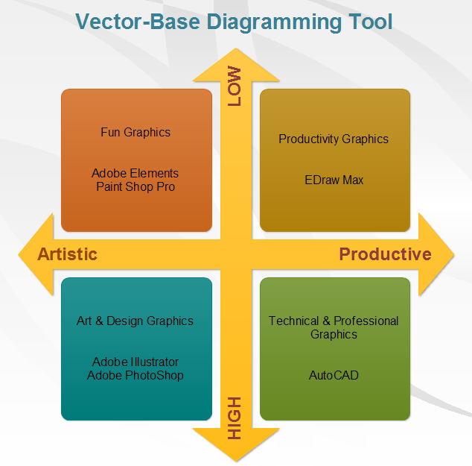
Industry Position Map
Individual IT Professionals offering personal services in the market
Small organizations composed of specialists that are dedicated to IT development
Efficient
Allied organizations of IT specialists collaboratively operating for business IT needs
Online connections between organizations and specialist that provide IT aligning services
Notes:
Noted in this industry position map, the competition between IT organizations and experts is notably tough especially in relation to how they intend to offer the services to the clients they hope to serve. The competition is internal as the services offered are focused and specialized.

Slide 9
EXTERNAL FACTOR ANALYSIS SUMMARY
Opportunity to develop specialists and IT experts who will handle general tasks
Opportunity to reestablish healthy competition in the industry through basing operations on innovation and IT development through investing on the people
Opportunity to develop a more defined process of assisting businesses in becoming highly IT-defined giving them the opportunity to operate in a high tech world.
Achieving success from highly satisfied individuals working in the industry
Threats are weighed against the opportunities in the IT consulting industry and these opportunities were considered to overthrow the threats through the application of proper management among organizations involved
Notes:
In this presentation, it could be analyzed that after analyzing the different factors that make up the IT consulting industry, the HR Department’s role in developing well motivated individuals who are supposed to work in the industry could be seen to take a great role in fueling the entire industry’s capacity to provide service to the target market.

Slide 10
END OF PRESENTATION

