Slide 1
Recycling: Paper, Plastic, or Poison?
EN 101 17/18
5 December 2012

Slide 2
Introduction
Recycling has been a long-term debate regarding its benefit versus its cost.
Recycling is not a new concept, it has been around for centuries. The contemporary concept of recycling was born in the 20th century.
The controversy associated with recycling is that it causes more damage and money to recycle than the overall benefit gained from it.

Slide 3
Thesis and Framing Statement
Recycling prevents excess waste, disposes of hazardous product properly, and prevents overcrowding of the landfills.
Excess waste causes unnecessary space usage
Disposal of hazardous product eliminates the danger that could happen from improper disposal.
The overcrowding of landfills means that there is new spaces needed to facilitate disposal of trash wasting space.

Slide 4
Recycling prevents excess waste
Throughout history, people have always found ways to reuse materials that still had value even if they were no longer adequate for the purposes for which they had originally been designed or built.
Wood that had originally been used in the construction of a barn, for example, could be used to make furniture or other items once the barn had reached its end of life phase in its life cycle (Torzewski).
Finding ways to prevent excess waste is as easy as reusing products.

Slide 5
Dispose of Hazardous Product Properly
For the first few decades that computers began to be widely used by the public, computer screens were made with Cathode Ray Tubes (CRTs). These CRTs contain, among other things, leaded glass, mercury, and other potentially dangerous materials.
“Chronic effects on the nervous system - paralysis of motor nerves, poor aptitude (especially in children) and other effects on cognitive functions.” (Lead in the Environment) Although most modern landfills are designed to trap as many materials as possible to keep them from entering the surrounding environment, these efforts are not always successful (Torzewski).

Slide 6
Prevents Overcrowding of the Landfills
As the population grows, so does the waste, and the need for new places to dispose of the garbage. By recycling it will prevent the overcrowding of the landfills and prevent wasting environmental space on new ones.
The message that those involved in recycling efforts wish to convey is not just that items and materials can be recycled, but that it is also important to reduce the amount of natural resources we all use and to reuse items and materials as often as possible, rather than throwing them away after their initial use (Palliser).

Slide 7
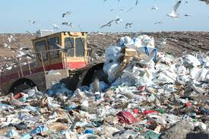
Overcrowded Landfill

Slide 8
Arguments Against Recycling
There are concerns associate with the resources used to recycle, and that they may be doing more harm than good. Then, state why those that have this viewpoint think they are right.
A common counter-argument against recycling is that people don’t know how or what to recycle.
Finally, is it argued that people don’t know how or where to recycle.

Slide 9
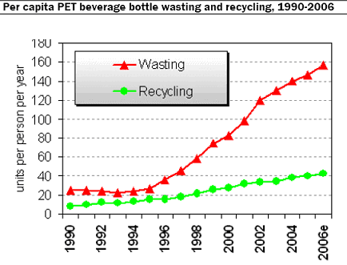
Waste Vs. Recycling (Special)

Slide 10
Conclusion
Recycling prevents excess waste, disposes of hazardous product properly, and prevents overcrowding of the landfills.
Recycling prevent hazardous product from being carelessly disposed of.
Recycling allows products to be reused.
Recycling prevents excess fill that is unnecessary and damaging to the environment.

Slide 11
References
Torzewski, Kate. “Recycling Cathode ray Tubes.” Chemical Engineering,2009. Web. 30 October 2012.
Palliser, Janna. “Revisiting Recycling.” Science Scope, 2011. Web. 30 October 2012.
“Special Report: Investing in Recycling!” Progressive Investors, 2012. Web. 30 October 2012.

