Slide 1
CAPSIM Reflection and Reaction Report Presentation

Slide 2
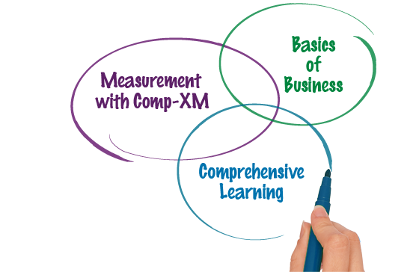
The Core Reasons of CAPSIM Operation Applications
CAPSIM operates to serve students the best source of practical practice that they need to know the use of important business tools in handling actual business cases

Slide 3
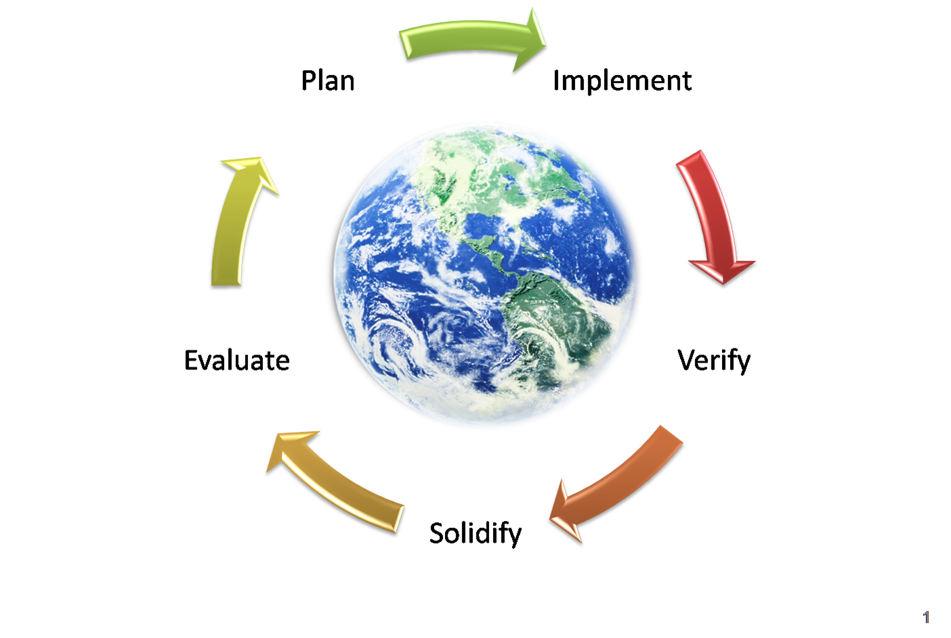
Core Lessons Learned through CAPSIM
With the implicative approach to business solutions presented through CAPSIM, students are given the chance to explore the different stages of business processing applying every approach in every detail of the cases to be assessed and solved.

Slide 4
Tool Used for the Simulation
THE PERCEPTUAL MAP:
For the simulation that has been completed, the perceptual map has been used to simulate the values of the elements affecting the decision to be made to solve the matter at hand.

Slide 5
Effects of Properly Utilizing the Tool
1
The perceptual map provided a visual presentation of the elements that would greatly affect the impact of the decisions to be made
2
The map provided an easier path that could be used to identify the problems involved in the issue and further create more referenced form of development that the students could use.
3
The conceptualization insisted on a more refined manner of identifying the probable solutions that fit the factors contributing to the growth of the problem being addressed in the case.

