Slide 1
Sickle cell anemia and endometriosis
Prepared by: ___________________

Slide 2
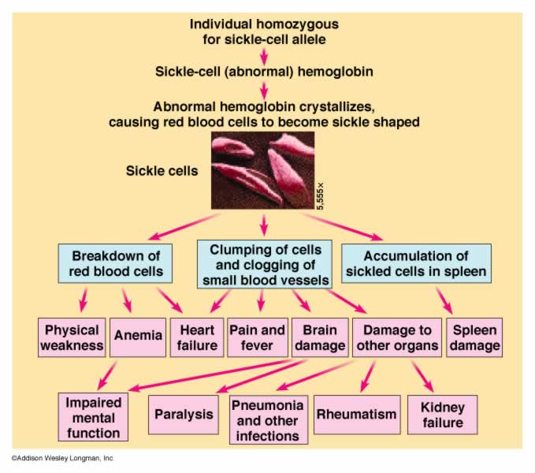
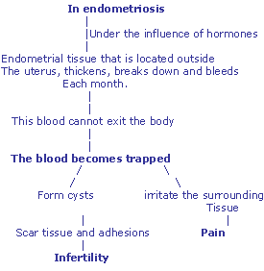
Similarities of Sickle Cell Anemia and Endometriosis
Both are characterized by pain
Notes:
Sickle cell anemia and endometriosis are two very different diseases, with different etiologies. However, both diseases are characterized by the experience of pain.

Slide 3
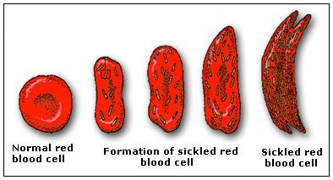
Sickle Cell Anemia
Red blood cells, which are usually shaped like a disc become sickle or crescent shaped.
Notes:
Sickle cell anemia is an abnormality found in hemoglobin, a protein found inside red blood cells which delivers oxygen throughout the body. It is genetic in nature and inherited from both mother and father. Red blood cells, which are usually shaped like a disc become sickle or crescent shaped, hence the name. People from tropical, sub-tropical and sub-saharan regions are more likely to have the disease

Slide 4
Symptoms of Sickle Cell Anemia
Crises or painful episodes
Bones
Back
Chest
Long bones
Notes:
Most patients experience painful episodes, referred to as crises and lasting for hours to days at a time (Chiang & Frenette, 2005). The pain from these crises is often felt on the bones of the back, chest and long bones. The intensity, duration and frequency of these crises can also vary from patient to patient and can necessitate admission to an acute care facility.

Slide 5
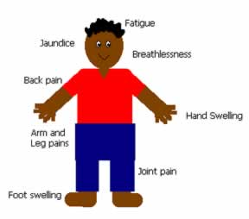
Symptoms of Sickle Cell Anemia
Fatigue
Pallor
Jaundice
Tachycardia
Shortness of breath
Poor eyesight
Confusion
Growth retardation
Delayed sexual development
Notes:
The sickle-shaped cells have less oxygen carrying capacity and they can get trapped more easily within blood vessels, causing blockages and interrupting blood flow. These can result to symptoms such as poor eyesight, blindness, confusion and ulcers, particularly on the lower legs. Growth retardation, delayed sexual development and less than normal body weight is also characteristic findings.

Slide 6
Laboratory tests
HgB S test
Complete Blood count
Serum Creatinine
Serum Potassium
Blood oxygen levels
Notes:
Laboratory tests are crucial in diagnosis and monitoring of the disease. The Hgb S test is often ordered, wherein a blood sample is obtained to check the presence of hemoglobin S. A positive result will necessitate further tests to determine the number of sickle cell genes and differentiate between sickle cell trait and sickle cell disease. Blood sample is further examined under a microscope to verify significant amount of sickle cells to confirm the diagnosis (Clarke & Higgins, 2000)

Slide 7
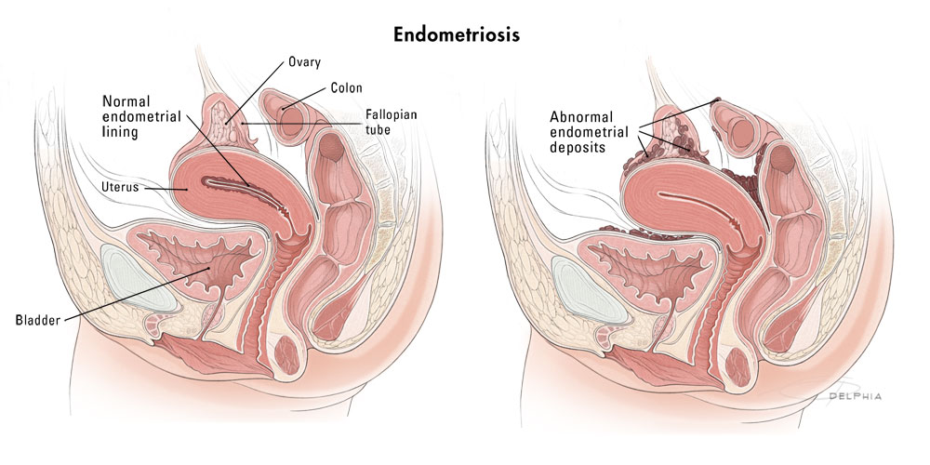
Endometriosis
A gynecologic health condition
The lining of the uterus, called endometirum, proliferate outside the uterine cavity, largely influenced by hormones.
Notes:
Endometriosis is a gynecological condition afflicting women. It is characterized by the proliferation of the endometirum at a site other than the uterine cavity, most commonly on the abdominal cavity. Endometral cells are often influenced by hormones, thus even cells that are similar to hose found in the endometrium respond to hormonal changes.

Slide 8
Symptoms of Endometriosis
Pelvic pain
Does not signify extent of the disease
Ranges from mild to severe
Concentrated on the pelvis, lower back, legs and rectal area
Fatigue
Difficulty urinating
Painful sexual intercourse
Severe dysmenorrhea
Notes:
Pelvic pain is a major symptom of endometriosis, ranging from mild severe. The pain typically occurs in the pelvis but it can also radiate to the lower back, legs and even the rectal area. The extent of pain is not associated with the severity of the disease as the pain experience can vary from one individual to the next. Other symptoms associated with endometriosis include painful sexual intercourse, dysmenorrhea, difficulty urinating and generalized fatigue (Stratton & Berkley, 2011)

Slide 9
Diagnostic tests
Physical examination
Laparoscopy
MRI (Magnetic Resonance Imaging)
Ultrasound
Notes:
Laparoscopy is a surgical procedure to view the abdominal cavity. Although this is the gold standard in confirming a diagnosis of Endometriosis, most health insurance plans may not cover these. Ultrasound and MRI are also popular diagnostic imaging tools. However, normal results does not totally eliminate the possibility of Endometriosis as these may be too small to be picked up Ultrasound or MRI.

Slide 10
References
Chiang, E.Y & Frenette, P.S (2005, October). Sickle cell vaso-occlusion. Hematol Oncol Clin North Am.19(5):771-84,
Clarke, G.M & Higgins, T.N. (2000, August) Laboratory investigation of hemoglobinopathies and thalassemias: review and update. Clin. Chem. 46 (8 Pt 2): 1284–90.
Stratton, P. &Berkley, K.J (2011). Chronic pelvic pain and endometriosis: translational evidence of the relationship and implications. Hum. Reprod. Update 17 (3): 327–46.

