Slide 1
STRESSOR
Drug Addiction

Slide 2
Drug Addiction (Stressor)
What types of people are addicted to drugs?
What are their occupations?
Where do they live?
What is their demographic makeup?
Tutsking.com
Notes:
Many people deal with stressors in their lives. One of these is drug addiction.
Drug addiction is no respecter of persons. It is a disease that can happen to anybody, no matter where they live or where they work. Drug addicts can be male or female, any race or ethnicity, and any age.
However, research shows that some people are more susceptible to becoming addicted when using drugs. This has to do with a person’s biological makeup and environmental and developmental factors (NIH, 2012).

Slide 3
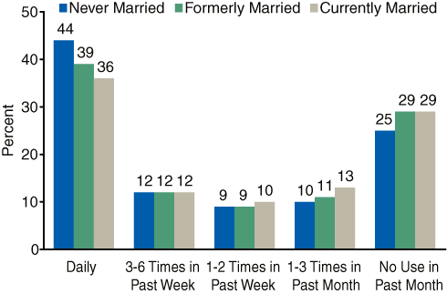
Frequency
What is the prevalence for drug addiction?
How many people abuse drugs and how often?
Samhsa.gov
Notes:
Research shows that that more the 500,000 people die each year due to substance abuse. This could mean deaths from overdoses or other factors related to chronic use, such as cardiovascular disease. This is true for adolescents, teens, young adults, middle-aged adults, older adults, pregnant women, and the elderly (UofU, 2013).
The chart shows statistics based on married and unmarried people, with the majority of people using drugs on a daily basis.

Slide 4
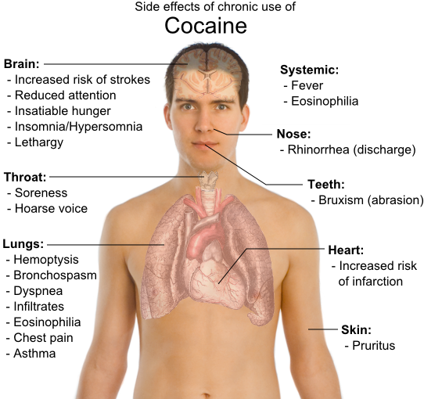
Is drug addiction an acute or chronic stressor?
Answer: Chronic
It affects the heart and other vital organs.
Medicinechest1.com
Notes:
Although acute drug abuse (short-term use and less frequent) can lead to temporary stress. Studies show that chronic drug abuse (long-term, frequent use) causes long-term stressful events in a person’s life, such as loss of employment, family, money, health, sanity, etc. Both acute and chronic drug use and abuse cause health stressors, particularly on the heart (Kloner, Hale, Alker, & Rezkalla, 1992).
As shown in the diagram, chronic drug use can affect the brain, lungs and the body’s vital systems, as well.

Slide 5
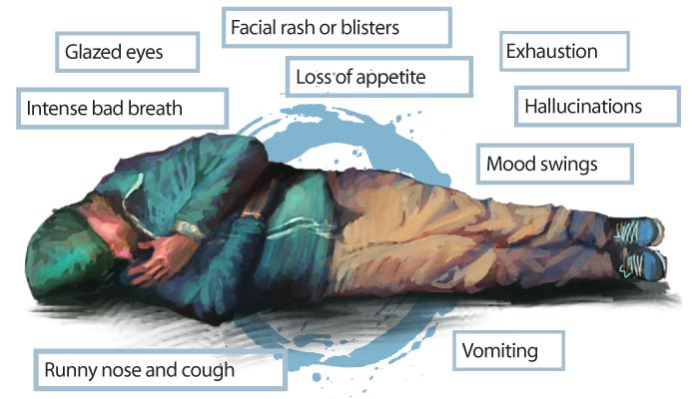
Affects on the Body
Fight or flight
Physiological symptoms
Psychological symptoms
My.opera.com
Bestdrugrehabilitation.com
Notes:
The flight or fight response is a reaction that serves as a self-preservation technique for the body in reaction to danger or perceived danger. This response gives the body a sudden adrenaline rush to cope with stressful situations. This has both physiological and psychological symptoms in the body such as temporary increased heart rate, increased sensory perception, decreased carbon dioxide levels in the blood, dizziness, hyperventilating, etc. This response often happens to people who are addicted to drugs, due to increased anxiety and other issues (MH, 2013).

Slide 6
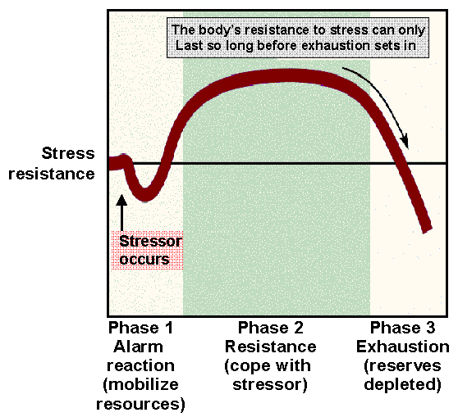
General Adaptation Syndrome
P2pu.org
Notes:
The General Adaptation Syndrome refers to how the body reacts to stress in terms of resistance. The premise of this syndrome states that it only takes so long before a person becomes exhausted, due to stress. The chart shows the three phases that occur with this syndrome. First, a person realizes the stress, becomes alarmed and looks for ways to deal with the stress. Second, the person then tries to resist the stress by using coping mechanisms. Third, the person becomes tired and worn out because of being drained from the pressure of the stress (Zuck, 2002).

Slide 7
Treatment Options
Counseling
Medications
Support Groups
Behavioral Therapy
Detoxification
Rightstep.com
Notes:
There are various treatment options available that work in conjunction to help someone beat drug addiction. These include counseling, medications, support groups, behavioral therapy and detoxification. Many successful drug addiction treatments are through outpatient treatment centers, even though many addicts must be hospitalized before hand to treat withdrawal symptoms through detox. Treatments also often involve 12-step programs that have good support groups and counseling. Medications used are non-addictive and help regulate their brain chemistry (Morton, 1999).

Slide 8
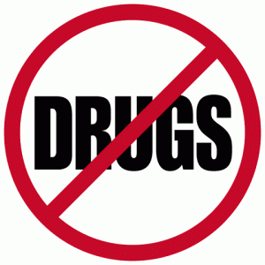
Preventive Measures
Saying no to drugs
Educating children and adults
Community outreach programs
Dominicanewsonline.com
Notes:
The best way to fight drug addiction is through preventing it from happening in the first place. This includes drug addiction prevention programs that advocate saying no to drugs, drug addiction education for children and adults, and community outreach programs that can break habits passed on in certain environments or cultures. It is important that teachers, educators, and medical professionals are involved with drug abuse prevention programs. The drug addiction is a disease that is preventable (NIH, 2012)
.

Slide 9
References
Kloner, R. A., Hale, S., Alker, K., & Rezkalla, S. (1992). The effects of acute and chronic cocaine use on the heart. American Heart Association, 407-419.
MH. (2013). The Flight or Fight response. Retrieved from Mental Healthy: http://www.mentalhealthy.co.uk/anxiety/anxiety/the-fight-or-flight-response.html
Morton, W. A. (1999). Cocaine and Psychiatric Symptoms. Primary Care Companion Journal of Clinical Psychiatry, 1(4), 109-113.
NIH. (2012). DrugFacts: Understanding Drug Abuse and Addiction. Retrieved from National Institute on Drug Abuse: http://www.drugabuse.gov/publications/drugfacts/understanding-drug-abuse- addiction
UofU. (2013). Utah Addiction Center. Retrieved from University of Utah Health Sciences: http://healthsciences.utah.edu/utahaddictioncenter/healthcare_professionals/Tr aining_Modules/module1.htm
Zuck, M. (2002). General Adaptation Syndrome. Retrieved from Healthline: http://www.healthline.com/galecontent/general-adaptation-syndrome

