Slide 1
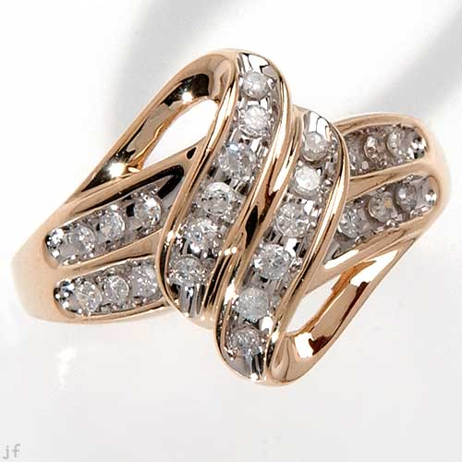
The Jewelry Campaign
A Marketing Presentation for Launching and Promoting a Jewelry Shop for a New Target Market
Notes:
This presentation is dedicated to showing how collaborative approaches of Marketing could be successfully used to campaign for a new jewelry shop that is targeting a new group of responders in the market.

Slide 2
The Pre-Launch Campaign
Starting from the Basics
Location-based handbills
Shop Dress-up
Pre-opening promotions
Introductory sales pricing
Social Media Promotion Postings
Notes:
In marketing promotions, it is always important to start with the basics. Since the business being promoted has a physical base, it is important to start the campaign from there. The location-handbills are designed to get the attention of the local residents of the area, the shop dress-up entails to present the shop in good décor that would not only present the products, but would also provide comfort to clients who want to see what the store has to offer.
The pre-opening promotions involve a good sense of control on how partner products are to be sold along with other jewelries along with the introductory sales price offers.
For beginners, it could be assumed that social media promotion is an easy step to enter the field of internet for marketing the shop and the products it has to offer.

Slide 3
The Launching Day
Live Music and Entertainment
Sales Strategies Exclusive on the Launching Day
Launch day promotions
Couple’s Choice
Occasional Gifts
Special Mementos
Notes:
During the launching day, the shop is expected to come alive. The live music and entertainment need not be expensive nor very loud either. Jewelries are often defined to be sophisticated and luxurious, choosing the right music to introduce it to the people is needed.
The launching-day promotions such as the couple’s choice, the occasional gifts and the special mementos are designed to help the market grab their own jewelries that the shop is ready to offer under special pricing strategies.

Slide 4
Entering the Realms of the Internet
The huge space in the
internet allows for a huge
distinction on how a
particular business is marketed.
Notes:
Among the largest and most effective courses of marketing that attracts individuals to appreciate any particular product offered in the market is through the internet. To make sure that this system of marketing works for the length of time that the business is operating, it is important to know three of the most common approaches to internet marketing that best gets the attention of the target market and at times even a larger scope of individuals in the international scene.

Slide 5
SOCIAL NETWORK MARKETING
Reaching a huge number of individuals
with one posting of a marketing campaign
is one of the benefits of modern
social network marketing
Notes:
Through social networking sites such as facebook and twitter [currently the most popular in the field], businesses would be able to reach a huge number of individuals in the market as they introduce and promote their products. These postings simply need to be attractive and intuitive in providing the target market with what they want and what they expected from the organization.

Slide 6
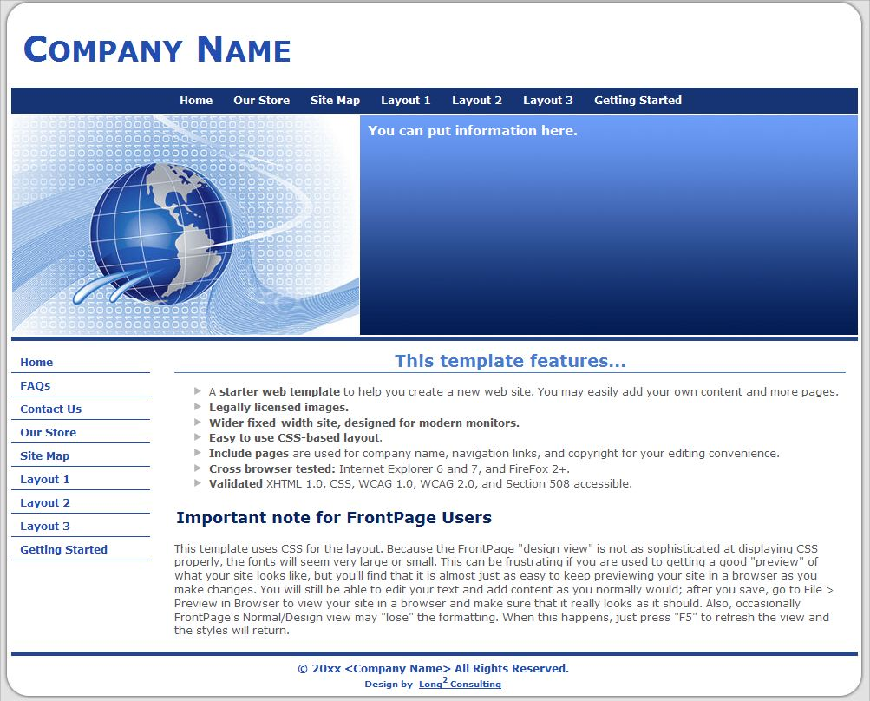
Creating a Company Website
Creating a company website in the internet
is like establishing a virtual shop where
interested clients could visit to see what the
company is ready to offer and likely
establish communication and transactions
with the business online
Notes:
A company website could be established under free-hosting or a paid one depending on how the company wants to use the said online domain for business. Usually, it is the impact of the design of the website that creates both attraction and interest to buy on the part of the individuals being targeted in the market.

Slide 7
Making it Personal and Direct
Getting the contact emails of the regular clients
visiting the shop and the company website
shall allow the administrators to know who to directly
contact with the most recent updates about the
company’s latest offerings and activities
Notes:
Making a persona and direct relationship with the regular customers would basically build up customer loyalty which would bring business to the organization for a long time.

Slide 8
REFERENCES:
Kotler, Philip & Keller, L. Kevin (2012). Marketing Management 14e. Pearson Education Limited 2012/ b A Framework for Marketing Management (4th ed.). Pearson Prentice Hall. 2009..
Adcock, Dennis; Al Halborg, Caroline Ross (2001). "Introduction". Marketing: principles and practice. p. 16. / "Marketing Management: Strategies and Programs", Guiltinan et al., McGraw Hill/Irwin, 1996
"Swarming the shelves: How shops can exploit people's herd mentality to increase sales". The Economist. 2006-11-11. p. 90.
Kotler, Armstrong, Philip, Gary. Principles of Marketing. pearson education.
D.S. Hochbaum, E. Moreno-Centeno, P. Yelland, and R.A. Catena. Rating Customers According to Their Promptness to Adopt New Products, Operations Research 59(5): 1171-1183, 2011

