Slide 1
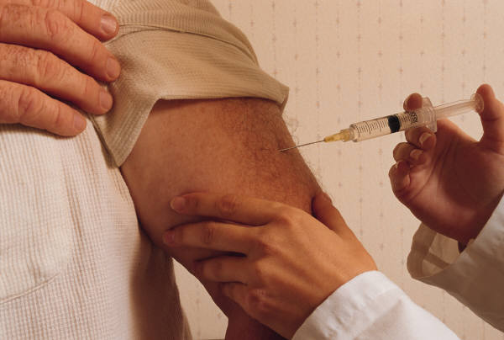
Vaccination
.

Slide 2
Outline
Introduction
Vaccinations
Required versus optional
Pros and con of vaccinations
Research studies on vaccinations
Conclusion

Slide 3
Introduction
Vaccination is a term used in describing the introduction of an antigen into the body. This action is expected to stimulate the person’s immune system by producing antibodies against the pathogenic organism introduced through vaccination (Fiore et.al, 2009).

Slide 4
Introduction
This presentation seeks to outline some major concerns regarding vaccinations in our society today. The nation’s children are compelled to take vaccines. This ideological premise is based on the fact that it prevents disease and acts as a prophylactic measure. It is my desire to discuss the necessity of vaccines, the pros and con of vaccination and offer support findings from recent studies.

Slide 5
Vaccinations Required versus Optional
Legislative attorney Kathleen Swendiman (2011) in her report to congress highlighted mandatory vaccination legislation and its requirement for entry into public schools across America. These include diphtheria, measles, rubella, polio, pertussis, and tetanus. Some states require students to be vaccinated against Hepatitis B and meningococcal infections also. The attorney contents that regardless of these laws many states provide exemptions for religious, philosophical and moral reasons (Swendiman, 2011).

Slide 6
Vaccinations Required versus Optional
Institutions employing health care workers also are mandated to vaccinate employees against tuberculosis, measles, mumps and rubella. As a condition for employment the Department of Defense requires all civilian employees to be vaccinated against the flu virus. Opt-out laws are also available for these vaccines if they are contraindicated for medical reasons (Swendiman, 2011). For admission to school smallpox, malaria, influenza and pneumonia vaccines are not mandatory.

Slide 7
Pros and Cons of Vaccinations
Public health authorities claim that vaccines have been one of the greatest developments in public health over the past century. Current data shows where vaccines have eradicated many deadly diseases such a whooping cough, diphtheria and polio, which claimed the lives of our children. Therefore, there must be some sense to the vaccine madness as some have projected. Vaccination compliance over the past year across America has been 95, 41% (Stacher, 1999)

Slide 8
Pros and Cons of Vaccinations
Immunization programs among school aged children have lowered infection rates by 95% since the first vaccine was used in 1955. Overwhelming success came from destruction of Haemophilus influenzae type b (Hib),which infected approximately one in 200 children, under the age of five during 1988 (Stacher, 1999).

Slide 9
Pros and Cons of Vaccinations
People demonstrate adverse effects to vaccination as they would to any drug or substance. Some 11,000- 12,000 reports are made to VAERS and investigated yearly. Vaccine safety monitoring across the nation is a priority because many reports even though linked to the vaccination process many not be directly related to the vaccine itself.

Slide 10
Pro- Healthy Family
.

Slide 11
Con- Sick Child
.

Slide 12
Research Studies
Study Author | Title | Conclusion
Mrozek-Budzyn D, Kiełtyka A, Majew ska R. (2010) | Lack of association between measles-mumps-rubella vaccination and autism in children: a case-control study | They concluded that there was no positive relationship between autism and measles vaccine
Doja A., &Roberts W. (2006). | Immunizations and Autism: A Review of the Literature | The conclusion suggested that with decreasing uptake of immunizations in children it was time for widespread

Slide 13
Research Studies
Study Author | Title | Conclusion
 |  | education informing patients that there is no relationship of vaccines to autism.
Wood, P. (2012) | Vaccination Programs among Urban Homeless Populations: A Literature Review. | Programs ought to focus on ‘well-designed, validated methods for delivering vaccines to this at risk population’ (Wood, 2012) was the researcher’s recommendation.

Slide 14
Conclusion

Slide 15
Conclusion
Scholars should endeavor to clarify predisposing processes and potential mediators of vaccination decisions. A great future challenge is embedded in evidence-based public health communication. The advice is that research should have an interdisciplinary approach involving public health, medical research, communication science and psychology (Betsch, 2011).

Slide 16
References
Betsch C. (2011). Innovations in communication: the Internet and the psychology of vaccination decisions.wEuro Surveill.16(17),
Doja A., Roberts W. (2006). Immunizations and Autism: A Review of the Literature. The Canadian Journal of Neurological Sciences, 33(4), 341-6
Fiore, E. Bridges, B., & Cox, J. (2009). "Seasonal influenza vaccines". Curr. Top. Microbiol. Immunol.. Current Topics in Microbiology and Immunology 333, 43–82.

Slide 17
References
Mrozek-Budzyn D, Kiełtyka A, Majewska R. (2010). Lack of association between measles- mumps-rubella vaccination and
autism in children: a case-control study. Pediatr Infect Dis J.
29(5):397-400.
Satcher, D. (1999). Statement on Risk vs Benefit of Vaccinations. U.S. Department of Health and Human Services
Swendiman, K. (2011). Mandatory Vaccinations: Precedent and
Current Laws. Washington. Congressional Research Service
Wood, P. (2012) Vaccination Programs among Urban Homeless Populations: A Literature Review. J Vaccines Vaccin 3:156.

