Slide 1
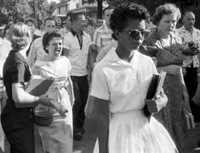
A Mighty Long Way
Author Name

Slide 2
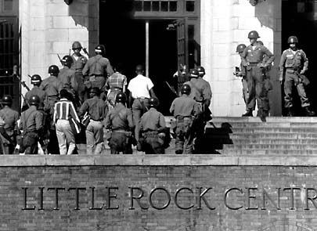
Little Rock Nine
Little Rock Central High School, Arkansas (1957)
Little Rock Nine: Nine black students who enrolled in the school
One of the most important milestones in Civil Rights Movement
Notes:
The Little Rock Nine were a group of nine African-American students who signed up to attend the Little Rock Central High School in Little Rock, Arkansas in 1957. In the midst of the Civil Rights Movement, resistance to integration was still high; as a result, there was significant attention paid to the attempts of these nine students to attend this school. This attention was enhanced by the presence of national media and press coverage, which was persistent and pervasive. This spotlight shone on the Little Rock Nine by the media made it one of the most important milestones of the Civil Rights Movement. In this presentation, we will look at the media's role in the event through the lens of Carlotta LaNier, one of the Little Rock Nine, through her book A Mighty Long Way.

Slide 3
The Media
Important to bringing story of Little Rock Nine to American attention
Carlotta’s experiences: Media was omnipresent
Changed public opinion toward efforts of the Nine
Carlotta was resistant to media presence at first
Increased stakes of battle for integration, for better or worse
Notes:
The media played an important part in bringing the story of the Little Rock Nine to national attention. "We had the burden of being among the first to integrate a Southern school. We weren't the first, but the media let the world know" (LaNier, p. 292). They were omnipresent; they moved in next to the area, bunking in homes nearby. According to LaNier, "I never knew when I would be asked to do an interview" (p. 109). The extensive media presence allowed the entire country to see the attempts by the Arkansas National Guard to prevent the Nine from entering the school. Public opinion began to turn toward the efforts of the Nine, as the cruel and arrogant actions of the protestors and the National Guard was suddenly put on a pedestal for all to see.
LaNier was one of the Little Rock Nine to be the most resistant to the notion of the media following them everywhere. "I didn't understand then how necessary the media was to this greater good the nine of us had been anointed to carry out. I was just one who never liked a whole lot of hoopla" (p. 74). There were possibly some downsides to the national attention the press was bringing to the event; by making it an important event the entire country was watching, it also put undue pressure on the Nine, particularly LaNier, who did not want any of it. All they wanted to do was attend school; the national attention likely brought just as many segregationists as it did integrationists, increasing the scale of the conflict immensely.

Slide 4
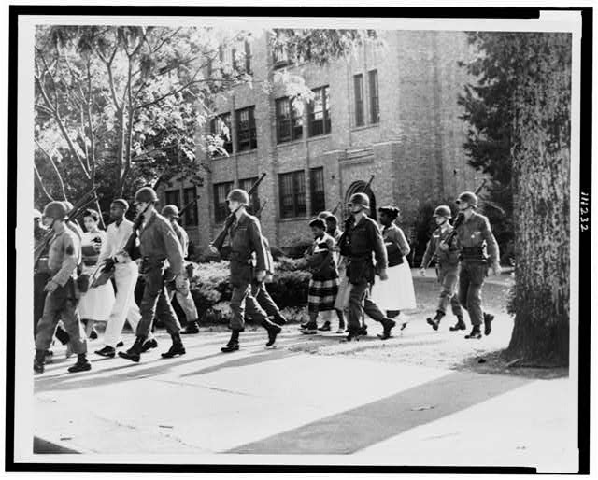
African-American Life
Black media was harassed (e.g. Alex Wilson hit with a brick)
Added accountability to actions of segregationists, shined light on violence
Notes:
The overall impact of the media coverage of this event on the African-American community was staggering. For once, significant national attention was being paid to a brazen act of violence and discrimination against a group of blacks who were gaining notoriety. It helped to put a face on the struggle for blacks to integrate into white society, and gain their freedom. It also provided an outlet for black reporters to have a story they could personally invest in - "As leery as I was of the press, I felt a kind of kinship with the black reporters who were risking their own lives to tell our collective story" (p. 85). The black media experienced their own share of violence as well; reporters like Alex Wilson encountered threats and attacks, one where he was hit with a brick. The media’s presence added accountability to the actions of segregationists and shined a light on the violence and threats that were being sent against the Nine in their struggle to integrate.

Slide 5
Conclusion
The Media provided a significant amount of exposure to the plight of the Little Rock Nine
Added extra exposure to integration, put a face to black students struggling to attend school with whites
Helped to humanize the Civil Rights Movement
Notes:
In conclusion, the role of the media in the story of the Little Rock Nine was substantial. It afforded the black community an outlet to show the blatant disrespect and violence of segregationists to the rest of the nation, and created substantial sympathy for their cause. It put a face on the Civil Rights Movement and humanized it for those who felt a distance from the struggle. The Associated Press had ranked the Little Rock Nine integration story the top story of the year for 1957; this was a testament to the importance of the event, and the amount of attention it received. While the media presence was often unwanted by the Nine themselves, their role in bringing their story to the world cannot be overemphasized.

Slide 6
Works Cited
"'A Mighty Long Way' From Little Rock." NPR. N.p., 26 Aug. 2009. Web. 9 Oct. 2011. <http://www.npr.org/templates/story/story.php?storyId=112256670>.
Fradin, Judith Bloom, and Dennis B. Fradin. The power of one: Daisy Bates and the Little Rock Nine. New York: Clarion Books, 2004. Print.
LaNier, Carlotta Walls, and Lisa Frazier Page. A mighty long way: my journey to justice at Little Rock Central High School. New York, NY: One World Ballantine Books, 2009. Print.
Walker, Paul Robert. Remember Little Rock: the time, the people, the stories. Washington DC: National Geographic, 2009. Print.

