Slide 1
Anxiety Disorder
Student Name
Institutional Affiliation
Professor’s Name
Course Code
Date

Slide 2
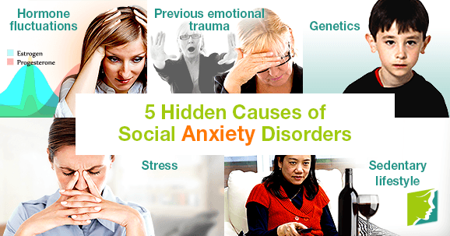
Introduction
Anxiety disorder refers to a condition when a person is constantly restless due to fear of something bad happening.
Patients with anxiety disorder ore often uneasy of their environments.
It is a symptom of other underlying conditions such as PTSD, social anxiety disorder and a range of phobias (Wilson, n.d).
It starts with the feeling that someone is not sufficient enough to manage expectations which generates the fear.
Picture Retrieved from: https://www.menopausenow.com/anxiety/articles/5-hidden-causes-of-social-anxiety-disorders
Causes
Use of depressants
Use of controlled drugs e.g. marijuana
Social pressures
se of stimulants
Notes:
Ladies and gentlemen welcome to today’s presentation. The presentation is about anxiety disorder as a mental health condition. I am sure all of you have encountered anxiety in one way or another in your lifetime. As students, we are always in constant fear of what becomes of our actions, sometimes wondering about tests, exams, relationships, and more. No one is spared when it comes to anxiety disorders because we all have fears. You might be thinking it stops with students, but the truth is that anxiety affects people of all ages because no one is ever sure of tomorrow. You need to know that by the time a patient shows signs of anxiety, they always have an underlying condition, which should concern healthcare practitioners and the general public altogether. As you can see, the conditions include post Traumatic Stress Disease, or otherwise referred to as PTSD, a social anxiety disorder that makes someone afraid of social interactions. Finally, it is a general feeling of phobia for things someone could initially face. You should not look that far, ask yourself; are you enough? Are you ready? Can you face your fears? When you hesitate to answer these questions, there could be a possibility that you are anxious. Anxiety is caused by several factors, especially drugs, prescription medicine, controlled drugs, and the pressure to please people. How will you know if someone has an anxiety disorder? Let us look at the next slide.

Slide 3
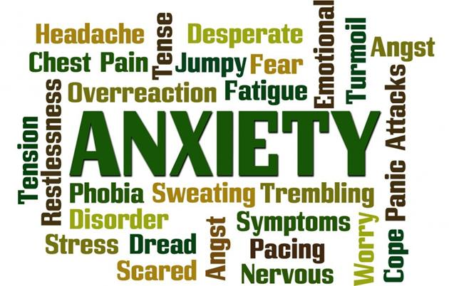
Symptoms of Anxiety Disorder
Anxiety disorder has been witnessed in about 20% of all the adult population annually (Munir &Takov, 2020). It is characterized by the following symptoms;
Being restless
Fatigue
Muscular tension
Irritability
Reduced concentration
Picture Retrieved from: https://www.welovecaring.com/?p=11725
Notes:
So these are the symptoms you should look out for to determine whether someone has an anxiety disorder. You realize that you have witnessed some of them in your friends who show them all of a sudden. Sometimes you wonder whether you are the one with the problem, but you realize that there is more to it. Being restless is probably due to the fear and the feeling of anxiousness that the patients often feel. To know that someone is restless, you will realize that they are never settled in a place.Fatigue is when someone is always tired, even when they have done less strenuous activity. I am sure you have come across such people.Muscular tension is when someone feels continuously tense, and this can be discovered from how they talk and construct their words. Irritability is when someone feels so bitter about mere things that ordinarily should be taken lightly in addition to losing concentration in class and other platforms.

Slide 4
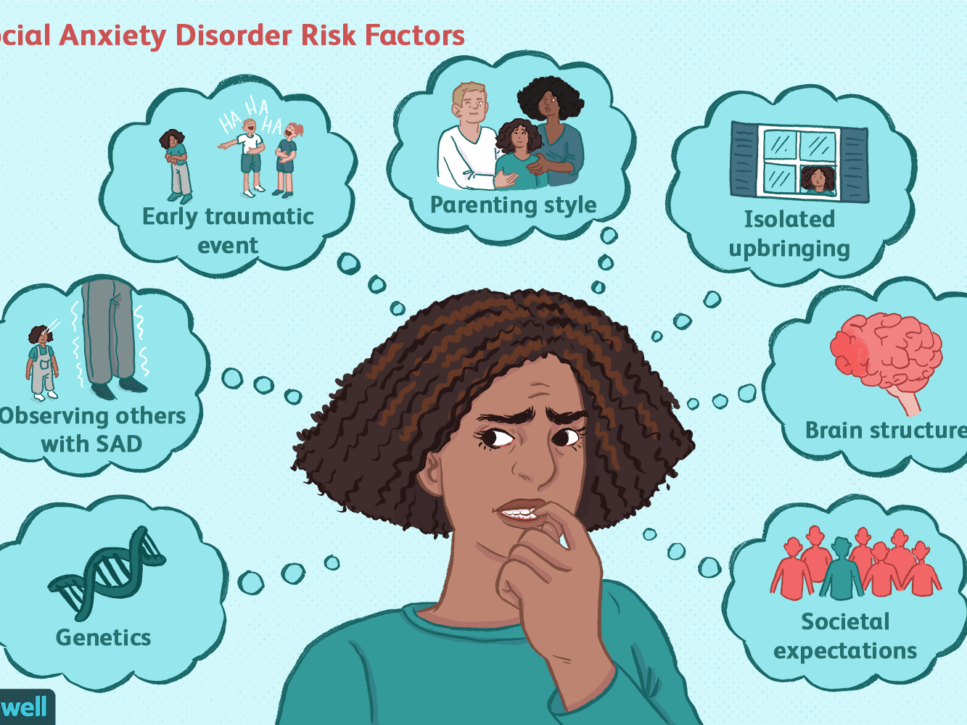
Risk Factors
Genes and family history of anxiety disorder
Sexual Abuse
Low self esteem
Childhood upbringing
Environmental, development and psychological factors
Retrieved from: https://www.google.com/url?sa=i&url=https%3A%2F%2Fwww.verywellmind.com%2Fsocial-anxiety-disorder-causes-3024749&psig=AOvVaw09M3WgHMmcskY_lAWCUJPD&ust=1604534464769000&source=images&cd=vfe&ved=2ahUKEwirltjnyufsAhUU8xoKHXd7Cm0Qr4kDegUIARCkAQ
Notes:
As we can see in this slide, several factors increase an individual's chances of having an anxiety disorder. According to Blanco et al. (2014), an anxiety disorder may genetically run in the family with a history of this disorder. Also, the environment that a child was brought up in and the conditions they were raised in may form a basis for the disorder. Further, personal factors such as low self-esteem or failure to accomplish certain goals increased the likelihood of having the disorder (Blanco et al., 2014).

Slide 5
Management of Anxiety Disorder
Mindfulness(Mental Health Foundation, n.d)
Medication/Pharmaceutical management e. the use of antidepressants
Coping mechanisms (Bandelow et al, 2017)
Hospitalization in suicidal cases
Picture Retrieved from: https://www.google.com/url?sa=i&url=https%3A%2F%2Fwww.verywellmind.com%2Fgeneralized-anxiety-disorder-treatment-4171993&psig=AOvVaw3veTinNrD4GLvgL9JuofE-&ust=1604534920912000&source=images&cd=vfe&ved=2ahUKEwjV-JjBzOfsAhUP4oUKHXgyB2IQr4kDegUIARCkAQ
Notes:
Since anxiety disorder is a form of distress that depends on the state of mind, studies show that it can be managed by an individual simply being mindful of their environments. This can be done by meditation and sparing time to spend with people. A person with anxiety usually needs someone to assure them that it is all okay and that there is nothing to worry. Pharmacological management can include the prescription of antidepressants aimed to calm the patient down. In some instances, drugs can be administered to counter the adverse effects of other drugs related to anxiety.In chronic cases, an individual can learn to cope with the disorder by joining support groups or seeing a counselor.Sometimes the disorder can induce suicidal thoughts on the victim, thus bringing the need for them to be hospitalized for closer monitoring. Otherwise, an anxiety disorder can always be managed on an outpatient basis.

Slide 6
Medication
Benzodiazepines (tranquilizers)- slows down the nervous system
SSRIs Antidepressants-Eases symptoms of anxiety.
Anxiolytic-Relieves anxiety and tension and also promotes sleep.
Sedatives- Brings about calmness, drowsiness as well as dulled senses
Picture Retrieved from: https://www.google.com/search?q=medication+for+anxiety+disorder&rlz=1C1CHBD_enUS917US917&sxsrf=ALeKk01dsj3AdkokMhWb1WBTHy1q6AxO2w:1604432970140&source=lnms&tbm=isch&sa=X&ved=2ahUKEwj05oDKkufsAhW5UxUIHWBEA1AQ_AUoAXoECB0QAw&biw=1366&bih=568#imgrc=jvwbDIytyzzTYM
Notes:
Most drugs prescribed for depression are also used in treatment of anxiety disorder. The most common medications include Benzodiazepines which are also called tranquilizers. These drugs work by slowing down the nervous system thereby causing relaxation. The other medications include; SSRI antidepressants which helps to ease anxiety symptoms; anxiolytics which relieves tensions and anxiety, and sedatives among others

Slide 7
Summary and Conclusion
Generalized anxiety disorder is a mental health condition that affect not only students but the general adult population
On an annual basis, about 20% adults are affected by the disorder which means that they are rendered unable to perform tasks as expected of them
The disorder can be caused by preexisting conditions related to trauma, drug abuse, societal pressure to meet expectations and it also exist as a side effect of prolonged use of prescription stimulants and depressants
Symptoms include irritability among others related to reduced activity.
Being mindful, pharmaceutical management and hospitalization are some of the management measures
Notes:
Well, as you can see, these are some of the takeaways from today’s presentation. Remember to keep in mind that anxiety disorder can occur at any stage of life. To secure the future of worries, learn to let it go, and be hopeful that everything will be okay. From the presentation, you realize that there is a way out, and this is what you should always stress to your peers and your friends so that they can always seek help. I hope this presentation has enlightened you on matters of mental health. Thank you for your time.

Slide 8
References
Bandelow, B., Michaelis, S., & Wedekind, D. (2017). Treatment of anxiety disorders. Dialogues in clinical neuroscience, 19(2), 93–107. https://doi.org/10.31887/DCNS.2017.19.2/bbandelow
Blanco, C., Rubio, J., Wall, M., Wang, S., Jiu, C. J., & Kendler, K. S. (2014). Risk factors for anxiety disorders: common and specific effects in a national sample. Depression and anxiety, 31(9), 756-764.
Mental health Foundation(n.d). How to Look After your health using mindfulness
Munir S, Takov V.(2020) Generalized Anxiety Disorder. In: StatPearls [Internet]. Treasure Island (FL): StatPearls Publishing; 2020 Jan-. Available from: https://www.ncbi.nlm.nih.gov/books/NBK441870/
Wilson H. (n.d). Mental Health: Conditions and Interventions

