Slide 1
Brain Development
Psychology
Notes:
This is the title page

Slide 2
Normal Development of the Brain
The First 8 weeks (Embryonic Period) – organs, systems, tissues of the future are induced
Fetal Stage (3rd -9th month) brain functions expressed via neural circuitry
Birth – All reflexes are of brain stem origin with a minimum cortical control
Post natal development – Goes from 10% of body weight to 2% for the Adult Brain
Notes:
There are numerous detailed stages that outline the developmental process of the brain. The most important of these being:-
The First 8 weeks (Embryonic Period) – organs, systems, tissues of the future are induced
Fetal Stage (3rd -9th month) brain functions expressed via neural circuitry
Birth – All reflexes are of brain stem origin with a minimum cortical control
Post natal development – Goes from 10% of body weight to 2% for the Adult Brain [ G.J. De Montfort & Dr. Rosemary Boone, 2010 ]
Medical Science still has difficulties in pinpointing the exact causes behind birth abnormalities and this accounts for up to 70% of all birth defects. At the birth stage there are so many combined complex and intricate processes under way and the cause of these are easily disrupted.

Slide 3
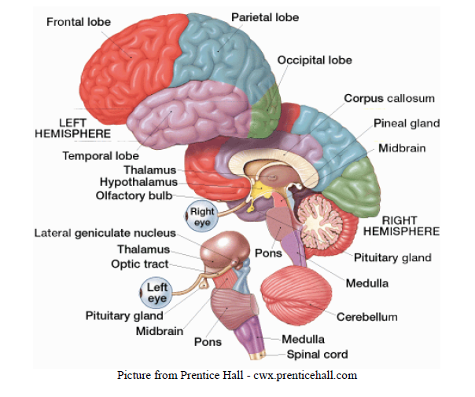
Structure of the Brain
Notes:
The map illustrates the complex structure of the brain and the many different functions contained within it. The main map of the brain is structured into the following components:-
Cerebellum
Occipital Lobe
Parietal Lobe
Frontal Lobe
Temporal Lobe
Brain Stem
Each of these deals with different functionalities of the body like vision, hearing, smell, movement, balance, blood pressure etc. Hence brain injury can create severe disruption to other bodily functions [ R.P. Lehr, PhD 2011]

Slide 4
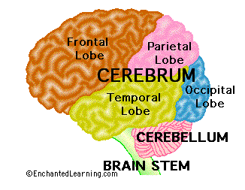
Structure of the Brain
Frontal Lobe
Parietal Lobe
Temporal Lobe
Occipital Lobe
Cerebellum
Brain Stem
Notes:
The Frontal Lobe is located at the most anterior and right under the forehead. This deals with our reaction to the environment and consciousness. The Parietal Lobe is near the back and top of the head. It deals with vision and the perception of touch. This controls our emotional responses and our expression of language. The Occipital Lobe is located at the back of the head and deals with the aspect of vision. The temporal lobe is located at the side of the head above the ears. This deals with memory, hearing ability and visual perception. The Brain Stem lies deep in the brain and leads to the spinal cord. Effectively a control centre dealing with blood pressure, sweating, digestion, temperature, sleep and breathing. The Cerebellum is located at the base of the skull and coordinates balance of movement and equilibrium of the body. Damage to any areas of the brain van have serious ramifications to other functional components of the body.

Slide 5
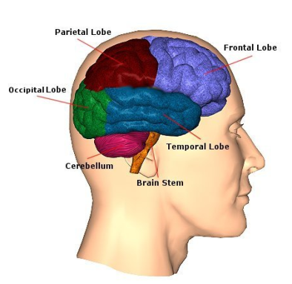
Functions of the Brain
The brain has many functioning parts including cerebral cortex, brain stem and the cerebellum
Component of Brain | Brain Function
Cerebellum | Balance and Equilibrium, memory for reflex acts
Occipital Lobe | Vision
Parietal Lobe | Visual attraction touch, movement of objects
Frontal Lobe | Consciousness
Temporal Lobe | Hearing ability & memory, categorizing objects
Brain Stem | Balance, Breathing, blood pressure, digestion, temperature etc
Notes:
The brain may be described as having the following main functions:
Cerebellum
Balance and Equilibrium, memory for reflex acts
Occipital Lobe
Vision
Parietal Lobe
Visual attraction touch, movement of objects
Frontal Lobe
Consciousness
Temporal Lobe
Hearing ability & memory, categorizing objects
Brain Stem
Balance, Breathing, blood pressure, digestion, temperature etc.

Slide 6
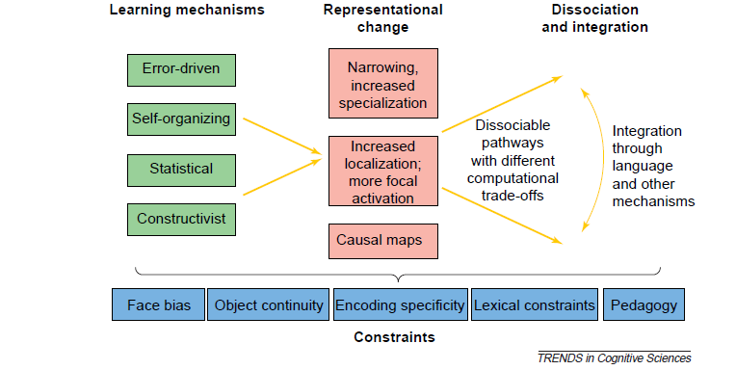
Developmental Changes
Notes:
There are a number of different learning systems that are associated with cognitive development of the brain. These are identified as being: Error Driven, Self-organizing, Statistical and constructivist learning theories. These cover the physical and social development of the child's brain structure. The model illustrated above illustrates the learning mechanisms, how these are represented through change or transformation and the subsequent constraints to the learning process.
Current though suggests that cognitive science needs to move away from more static definitions and concentrate focus on those mechanisms that are seen to generate change or transformation. This has resulted in opportunities to review and discover avenues of change. Learning mechanisms are one area where current research has been highly focused and the mechanisms that account for developmental change [ M.H. Johnson and Y. Munakata, 2005]

Slide 7
Tetragons & Child Development
Fetal alcohol syndrome caused by the mother drinking alcohol during pregnancy
Alcohol contains tetragons
These cause birth defects and neural complications in the developing fetus
The damage is done often before the woman realizes she has conceived
Women should take precautions in family planning
Notes:
One of the main concerns in recent years has related to Fetal Alcohol syndrome and the impact that alcohol (tetragons) in the mothers bloodstream has on the unborn child. This is compounded if the Mother drinks alcohol during the course of her pregnancy as it can cause potential birth defects and neural complications in the developing fetus. On numerous occasions damage can be already done prior to the woman conceiving; particularly if that person is a heavy consumer of alcohol.
Fetal Alcohol Syndrome is one of the leading causes of mental abnormality in the United States; 4 out of every thousand babies being impacted in this way. This is particularly sad because the situation is completely preventable. The need for education amongst the young and teenagers is extremely important; particularly the young sexually active who are heavily drinking. Brain damage from FAS has been cited as being irreversible [ Grace Alexander, 2009 ]
]

Slide 8
Child cognitive development
According to Piaget and his theories on child cognitive development, children are born with a great desire to interact with and understand the world around them
four areas define intelligence and child brain development and these include:
a biological approach to intelligence;
the cognitive succession of stages;
knowledge;
intellectual competence
Notes:
It was Jean Piaget that allowed many insights into the cognitive development of children. Recent studies have indicated that more mature learners benefit from encouragement from "right brain activity". The brain essentially has two different hemispheres, the left brain and the right brain. The left hemisphere is the logical, analytical, structured thinking component; whereas the right is more focused upon aspects of creativity, random patterns, holistic ( the big picture) and intuition. Individuals tend to generate their own choice of individual learning style. The right brain tends to lean towards the more creative learner and holistic learning concepts. With regard to learning different languages the right brain has the following characteristics that aid the developmental process. Experts tell us that everyone has genius-like capabilities. And, you know what I found? The right brain subconscious is so fast and intuitive that it can naturally reveal the solutions to complex questions or problems before our logical, doubting left brain kicks in. We just need to get more in touch with those right brain functions [ Shichida, 2009]

Slide 9
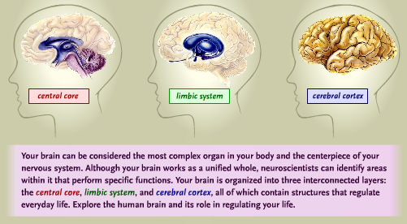
Psychology of the Brain
Notes:
In Eric Lenneberg's "Biological Foundation of Language" he was more concerned with the function of the left brain through the stage of maturity. He stated that there appeared to be a critical learning period for language acquisition and that the variable was whether the left brain was still sufficiently capable to proceed with language acquisition. This suggests that despite the receptive contents of the right brain to the elder learner, the inter dependence between the two spheres cannot be dismissed in isolation. If there is degradation of the left brain through the natural ageing process, then the right brain will be impacted from a performance or process perspective. Obler (1981) a noted brain researcher concluded that there was considerable more right brain activity in second language learners, as opposed to those with single language skills. Studies indicated that the first languages were shown to be far more left lateralized. The right brain was seen to play a much greater role in the acquisition of knowledge and particularly ability to learn languages.

Slide 10
Cognitive Psychology
Branch of psychology that studies mental processes and how people think and perceive things
Major topics include that of:-
Perception
Language
Attention & Memory
Problem Solving
Decision making and judgment
Intelligence
Notes:
One of the core elements of cognitive psychology relates to how people store and retrieve information. This particularly focusing on the use of memory and decision making. This aspect of psychology focuses more on the concern of mental states than that of behaviorism. This aspect of psychology touches upon many other disciplines including that of philosophy, sociology and anthropology. Until 1970 it was behaviorism that dominated the school of thought in psychology. After 1970 a real shift occurred into what became known as the ‘cognitive revolution’ and the first real term of cognitive psychology that embraced process models, cognitive research and a new taxonomy. Notable people in the history of cognitive psychology include such people as: Gustav Fechner, Edward Titchener, William James, Edward Tolman, Wolfgang Kohler, Jean Piaget, Noam Chomsky, and James McClelland.

Slide 11
References
Alexander, G. (2009). How to prevent fetal alcohol syndrome. Helium, 1-2.
Lehr, R. (2011). Brain Functions and Map. Retrieved 7 6, 2011, from Neuroskills: http://www.neuroskills.com/brain.shtml
R.Boone, G. d. (2005). Stages of Brain Development. Sydney, Australia: Rosemary Boone Registered Psychologist.
Shichida, D. M. (2009). Accelerated Learning Methods. Retrieved 10 27, 2009, from About Right Brain Games and Accelerated Learning Exercises : http://www.acceleratedlearningmethods.com/
Y.Munakata, M. J. (2005). Process of change in brain and cognitive development. Trends in Cognitive Science vol 9, 152-160.
Notes:
This is the reference slide

