Slide 1
Data presentation
Name
Institution Affiliation

Slide 2
Nature of Data
The data used in the analysis is a continuous numerical type of data.
I chose to work with this data because its usability. The data is simple and user-friendly.
This data represents the financial information of Apple Inc. company in the ASX listing, which was extracted from the Finance Yahoo website.
The data consists of 250 entries with two categorical variables.
The nature of the data in numbers was another consideration since the numbered values can be computed and analyzed statistically.

Slide 3
Type of variables
The variables included in the data are continuous and are qualitative variables.
The data contains a close price and an adjustment close price value. The values do not depend on each other, such that stock price, Adj Close, in the data is the dependent variable.
The change in these data variables is independent of each other. The sample used is random.
There is a minimal association between the variable in the data. However, the association between the Close variable and the Adj Close variable does not imply that one variable influence or cause the occurrence of the other variable.
The possible lurking variable that is likely to interplay on the data used may include dates.

Slide 4
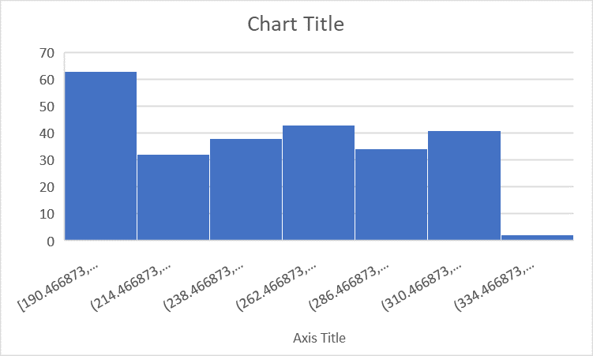
Histogram

Slide 5
The Shape of the Distribution
The historical data used in this case as the sample is collected within some period with specific dates.
The shape of the histogram is systematic. We have almost the same shape on both sides of the middle of the histogram.

Slide 6
Standard Deviation, Five Number Summary, Range, and Interquartile Range
Sample Correlation | 0.995258
mean | 257.8641 | 257.1931
standard dev | 42.83657 | 43.90579
five number summary
median | 258.74 | 260.4551
The maximum value. | 347.9 | 352.84
The minimum value. | 191.55 | 190.4669
Q1, the first quartile. | 216.42 | 214.9579
Q3, the third quartile. | 295.52 | 295.9247
Range | 156.35 | 162.3731
Interquartile range | 79.09999 | 80.9668
quartile 1 and min value | 24.87 | 24.49104
Median and quartile 1 | 42.31999 | 45.49722
quartile 3 and median | 36.78 | 35.46957
Max value and quartile 3 | 52.38001 | 56.91528

Slide 7
Standard Deviation, Five Number Summary, Range, and Interquartile Range

Slide 8
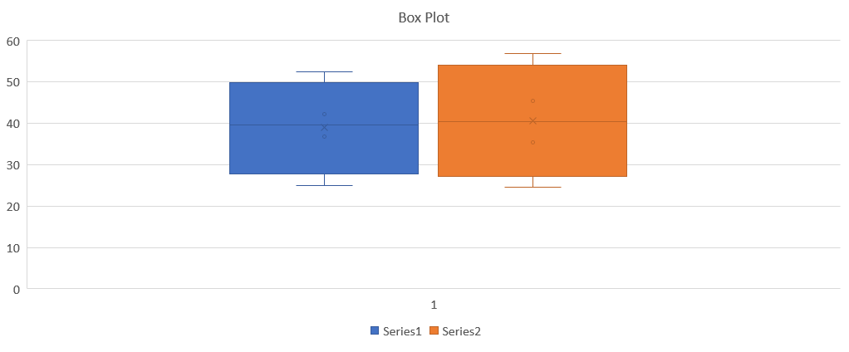
Boxplot

Slide 9
Summary of major findings
The significant findings are shown by the outputs of the histogram, boxplot, and the scatter plot. For instance, the scatter plot shows a positive correlation with both variables moving in the same direction. Therefore, the relationship implies a positive correlation between the Adj Close and the Close variables. Finally, it is prudent to note that statistically, randomized data can be analyzed using different statistical tools such as excel.

Slide 10
References
Duffield, B., Stowe, G., & Shankar, A. (2017). U.S. Patent No. 9,785,317. Washington, DC: U.S. Patent and Trademark Office.
Apple Inc. (AAPL). (n.d.). Yahoo Finance - Stock Market Live, Quotes, Business & Finance News. https://finance.yahoo.com/quote/AAPL?p=AAPL&.tsrc=fin-srch
Taylor, M. A., & Bonsall, P. W. (2017). Understanding traffic systems: data analysis and presentation. Routledge.

