Slide 1
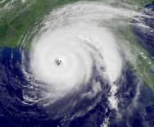
Hurricane Category 5
The Risk to Miami
Notes:
This is the Title Page

Slide 2
Miami Dade County
High Risk area for category 5 Hurricanes
Over 2.2 million people resident in area
5th largest telecommunications centre in world
Hurricane Andrew in 2002 Category 5
Potential for widespread destruction
Notes:
The Metropolitan City of Miami falls within the Miami Dade County region and is in the high risk area for Category 5 hurricanes. The area has a population in excess of 2.2 million and this becomes swelled by tourists in the summer months. The area of Miami also contains the 5th largest telecommunications centre in the world and is home to a number of prestigious business organizations. The last major disaster, that hit as a Force 5 hurricane was that of Hurricane Andrew in 2002. This hurricane struck just 40 miles south of Miami. Had it peaked further north the results would have been devastating to Miami in terms of structural damage and financial loss. The City continues to prepare for a major disaster and based upon storm characteristics Miami is in the zone for a potential Force 5 disaster.

Slide 3
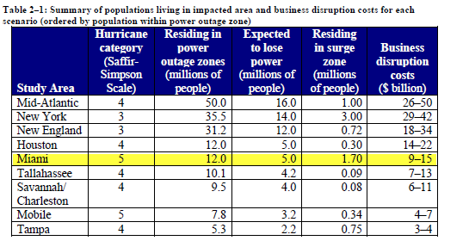
Miami and Mobile Highest Risk
Notes:
The statistics illustrated show that both Mobile and Miami are the most likely places to be singled out for a potential Force 5 hurricane disaster. The main risks will come from severe power outages and potential flooding due to severe ocean storm surges. This has the potential of causing business disruption costs of $9-15 billion in the City of Miami alone. A widespread disaster along the Eastern seaboard, from a category 5 hurricane could cause hundreds of billions of $ of damage. In addition you could see both the seaports and Airports being closed for a prolonged period, thereby adding to the disruption in communications. A direct hit on Miami from a Force 5 hurricane has brought revised insurance estimates to that of $ 130 billion. If the hurricane skirted the Tampa coast it has been estimated damages could be as high as $250 bilion.

Slide 4
Occurrence Possibility
Category 5 hurricane making a direct hit on Miami and turning north toward Orlando could cause insured losses of more than $130 billion
Category 5 hurricane impacting the Tampa/St. Petersburg area and tracking across the state could result in an insured loss of more than $70 billion
Notes:
The hurricane pattern for a level 5 occurrence is about once every three years. It is difficult to predict with any great accuracy where such a storm will land . Estimates of potential damage costs vary widely from 70 to 250 billion dollars. The situation in Miami is such that for many folk the monthly insurance premiums are in excess of their monthly mortgage payments. This increase in the insurance rates skyrocketed after the landing of Hurricane Andrew in 1992. Florida is a growth based economy and Miami is a centre for communications and other business investments. Nevertheless the chance of a category 5 hurricane, once every three years, remains a strong possibility and it is more a question of when the next event will occur. Climate change is certainly contributing towards more ferocious storm events.

Slide 5
Be prepared
Notes:
The key to surviving any major hurricane event is all about adequate preparation. This slide provides a basic checklist of survival items before the hurricane season. It is essential that properties are well boarded up and branches removed from any nearby trees. In most cases where there is adequate warning of a major Force 5 hurricane it is advisable for people to evacuate the area. This being due to the widespread damage and flooding that may occur in such an event. The morbidity rate for those in adequate shelters is extremely high. In addition you may become trapped because of air and road closures and as such place yourself in a life threatening situation after the event has struck. Hurricane Katrina provided an example of how desperate the situation becomes after such a traumatic event

Slide 6
History in Florida
Hurricane Andrew 1992 cost $26.5 billion
On average a category 5 hurricane will hit the USA every 3 years
In 20th Century | 158 Hurricanes hit USA with 64 classified as major. Florida had 57 landfalls with Miami in high risk area
August and September classified as the most dangerous months.
Notes:
The history of hurricanes on the Gulf of Mexico and the East Coast of America has increased in severity over the years. In the 20th century as many as 158 hurricanes struck the USA Coastline with 64 serious events. Amongst these Florida had 57 landfalls with Miami Dade County being listed as one of the most severe areas for the possibility of a Hurricane Force 5 event. August and September have been indicated as the worst possible months for the risk of a Force 5 event. The future concept of a Force 5 hurricane hitting Miami would prove to be a catastrophic event and potentially far more costly that the event that struck New Orleans. The Florida legislature have been criticised for masking the truth about the consequential cost and damage imposed by such an event taking place

Slide 7
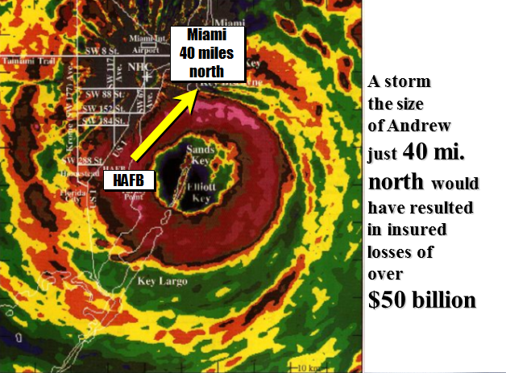
Hurricane Andrew
The impact of a category 5 hurricane hitting Miami would prove catastrophic.
Notes:
This is just an exhibit slide, in support of the previous slide.

Slide 8
References
FEMA. (2011). Hurricanes. Retrieved 9 26, 2011, from Fema: http://www.fema.gov/hazard/hurricane/index.shtm
National Hurricane Centre. (2011). Hurricane Preparedness. Retrieved 9 26, 2011, from National Hurricane Centre: http://www.nhc.noaa.gov/HAW2/english/high_winds.shtml
Sperlings. (2011). Hurricane Hotspots. Retrieved 9 26, 2011, from Sperlings: http://www.bestplaces.net/docs/studies/hurricane_hotspots.aspx

