Slide 1
CPDLC and ADS-B in Australian and Oceanic Airspace
Presenter’s Name

Slide 2
Introduction
High intensity of flights worldwide necessitate highly technical & precise air traffic control mechanisms
Information technology has brought forth new mechanisms of air traffic control
Application of such newer technologies is dependant upon financial resources and availability of hardware on the planes as well as on the ground

Slide 3
Australian & Oceanic Airspace
Much of the Australian Airspace below 18000 feet amsl is uncontrolled i.e. falls in Class G
Controlled Airspace is monitored and the traffic directed by ground based ATC
Controlled area (CTA) usually extends from 8500 feet amsl to 18000 feet amsl
CTR is the controlled zone which extends from ground level & is stepped up to lower limit of the CTA
Notes:
amsl: above mean sea level
Class G: All airsapce not promulgated as Class A, C,D,E or restricted is Class G, extends from surface level to overlying CTA base at 8500 feet amsl

Slide 4
Australian & Oceanic Airspace
The International Civil Aviation Organization (ICAO) controlled airspace classes currently used in Australia are A, C, D & E
Recreational Pilot Certificate holders flying aircraft operating under the CAO 95.55, CAO 95.32, CAO 95.12 & CAO 95.10 exemption orders are allowed to enter and fly only in Class C and D airspace
Notes:
CAO: Civil Aviation Order

Slide 5
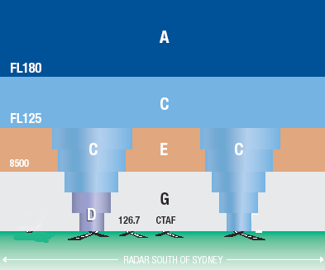
Australian Air Space
RADAR South of Sydney
Courtesy: http://www.recreationalflying.net/tutorials/navigation/airspace.html#octa

Slide 6
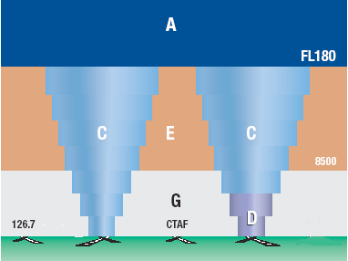
Australian Air Space
RADAR North of Sydney
Courtesy: http://www.recreationalflying.net/tutorials/navigation/airspace.html#octa

Slide 7
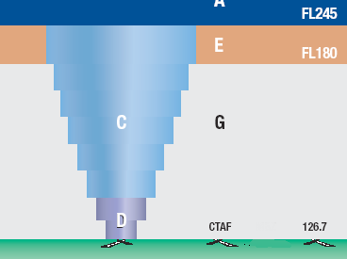
Australian Airspace
Non RADAR
Courtesy: http://www.recreationalflying.net/tutorials/navigation/airspace.html#octa

Slide 8
Oceanic Airspace near Australia
South Pacific Oceanic Airspace (SoPac) divided into the following areas:
Australian Eastern Oceanic Area
Auckland Oceanic Area
Nadi
Honiara
Nauru

Slide 9
Modern Communication Technologies between Pilot and ATC
Pilots must satisfy strict ICAO proficiency criteria for communication ability with ATC
Voice communication over radio or satellite are still reliable but outdated
ACARS is a prevalent digital datalink system for communication to and fro
ATN protocol employing internet is being developed and being made operational gradually
Notes:
ACARS: Aircraft Communications Addressing and Reporting System
ATN: Aeronautical Telecommunications Network
An ideal Data link system needs to possess the property of interoperability, which are satisfied by the newer technologies such as CPDLC & ADS-B. Simultaneous communication should be available between Aeronautical Mobile Satellite System, avionics, GNSS, Satellite Ground Stations, CSP networks and VHF/HF Radio Remote Ground Stations.

Slide 10
CPDLC & ADS-B Technologies
Two modern technologies being deployed for ensuring near flawless communication between Pilot and ATC
CPDLC: Controller Pilot Data Link Communication
ADS-B: Automatic Dependent Surveillance - Broadcast

Slide 11
CPDLC
A Data Link application for direct text based message exchange between Pilot and Air Traffic Controller
CPDLC was made operational by Maastricht-UAC with effect from 18th June 2003 and is available on a 24/7 basis.
CPDLC reduces the R/T frequency load
Maastricht- UAC accept CPDLC exchanges with aircraft equipped with ATN or FANS
FANS-1/A aircraft can have two simultaneous CPDLC connections, each with a different ATSU, but only one can be active at any given time.
Notes:
CPDLC is purely a communications application employing the concept of Data Authority. A maximum of 2 ATSUs can be connected to an aircraft simultaneously for CPDLC at any one time. The CDA (Current Data Authority) is the only one in direct communication with the aircraft. CPDLC connection has inbuilt integrity and numerous security mechanisms which empower it with advantages over previous mechanisms of datalink. It is a hands on crew tool & communication with ATSU is always present despite the communication occurring at the system level.
A four character logon code is used for logging on to the NDA (Next Data Authority) when switching between 1 ATSUs in range.
If CPDLC is not available at an NDA, NDA message is not sent and crew is instructed to establish voice contact prior to the FIR boundary.
Connection sequence is achieved after the pilot initiates a logon at the next available ATSU equipped with CPDLC.

Slide 12
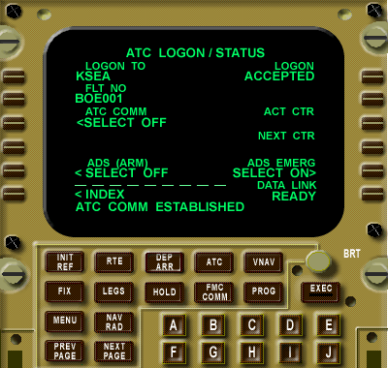
Typical Logon Status Page
Typical ATC Logon/Status page which is accessed by selecting the ATC button below the screen if no connections currently exist.
Notes:
To perform an initial logon manually the pilot types the four-letter ICAO designator for the ATSU by using the alphaneumeric pad. The flight number entered is essentially the same as that submitted in the flight plan. This text appears on a line below INDEX. The pilot has to select the LOGON TO button to move the designator to where the four boxes are displayed.
The pilot then enters the flight number and selects the FLT NO button. This action moves the flight number into the appropriate position and then activates a SEND button at the top right of the display. On selection, the pilot will see LOGON SENDING then LOGON SENT and finally LOGON ACCEPTED

Slide 13
CPLDC Logon Procedure in Australia
Aircraft departing from airports either within Australia (YBBB or YMMM FIR) or the AGGG and ANAU FIRs, using CPDLC should logon as follows:
On ground, just before the flight logon address for the FIR that the departure airport is located within should be used.
When airborne, logon should be established at any time after passing 10,000FT, using the logon address of the FIR in which the aircraft is currently operating.

Slide 14
Advantages of CPDLC
Facility for the crew to print messages
Reduction of crew input errors due to auto load of specific uplink messages into FMS
Facility to downlink complex route clearance request which can be resent back from ATC after approval as such
FMS armed by specific uplink messages to automatically downlink a report after every event
Automatic update of Flight Data Record on ground

Slide 15
Controller’s Viewpoint on CPDLC-Clip
Notes:
A German ATC Controller explains the mechanisms of communication from the ground and how workload can be simplified and streamlined while communication with more than one aircraft employing CPDLC.

Slide 16
Pilots’ Viewpoint on CPDLC-Clip I
Notes:
A European pilot explains how CPDLC has reduced the workload on the pilots in the busy air traffic that is prevalent in the region. He vouches for the superiority and ease of the technology over voice communication.

Slide 17
Pilots’ Viewpoint on CPDLC-Clip II
Notes:
Another pilot demonstrates the unit used for establishing communication with the ATC and emphasizes on familiarization with the SOPS before a flight and the necessity of getting well trained in the intricacies of the technique.

Slide 18
Rules Governing CPDLC Dialogues
Dialogues: Exchange of CPDLC messages between the flight crew and ground controller
All dialogues to be closed wherever possible
Dialogue opened by CPDLC MUST be closed by CPDLC (Exception: Connectivity Loss)
Dialogue opened by Voice must be closed by Voice and NOT CPDLC

Slide 19
CPDLC Procedures-Execution of Clearance
Profile changing ATC clearance must in addition to data link operational response be followed by a voice read back by the crew & a WILCO response
Execute Clearance
In Clearance/Instruction not requiring voice read back, WILCO response should be sent followed by execution of clearance/instruction

Slide 20
CPDLC-OPERATING CONTEXTS
Data link CPDLC exchanges to be used only in context with strategic/routine situations and not tactical situations
Strategic: routine, non time critical situations
Tactical: Time critical situations in which response is critical for aircraft safety
Data link a supplement means of communication preceded in priority by voice communication

Slide 21
Appropriateness Determination
Prevalent circumstances decide the appropriateness of data link employing CPDLC
The flight crew and air traffic controllers may suspend or terminate data link if found inappropriate by either party
CPDLC should NOT be chosen in emergency situations

Slide 22
ADS-B
Stands for ‘Automatic Dependent Surveillance – Broadcast’
Common communication, navigation and surveillance (CNS) services throughout the world
Development of Global Navigation Satellite Systems (GNSS) recently brought forth this technology
Toted as the second revolutionary development after the development of the RADAR in aviation history

Slide 23
ADS-B Explanation
Automatic, because no operator intervention is required
Dependent, because it relies on accurate GNSS signal for determining position
Surveillance, because it provides RADAR like information
Broadcast, because it continuously broadcasts data between aircraft & ground stations

Slide 24
Advantages of ADS-B
Unlike RADAR systems, it is not large & expensive
Unlike RADAR, not limited by distance, terrain and weather conditions
Provides accurate & efficient routing data
Improves safety due to reliability of data, better flight following & separation of services
Provides useful graphical data inside the cockpit
More efficient routing than RADAR
Large bandwidth and robust design support bi-directional data link

Slide 25
Graphical User Interface of ADS-B
Notes:
The demo shows the useful GUI which is colored, easily read and accompanied by voice cues which can greatly enhance the pilot's information which usually required self evaluation of data when using RADAR.

Slide 26
Aviation Experts Opinion about ADS-B
Notes:
Interview with an expert avaiaton instructor demonstrating the affordability and ease of the new ADS-B technology and its incorporation into modern flying. 50% of the fleet has been speculated to be fitted with the technology by 2014.

Slide 27
Accuracy of ADS-B
Notes:
An expert explains the details about handling traffic employing ADS-B by the pilots as well as the controller. Detailed information accessible directly from neighboring aircraft can be gathered using this technology which enables the pilot to take vital decisions in an appropriate time frame.

Slide 28
ADS-B in Australia & Oceania
Already deployed in Australia
Bundaberg, Bourke, Esperance, Longreach & Woomera groundstations in operation and 28 more being developed
In some areas it is operational in combination with RADAR
Almost the entire continent and surrounding oceanic regions covered

Slide 29
ADS-B Mechanism
Data broadcast every half-second on a 1090 MHz digital data link
Data exchange limited by ‘line of sight’ just like RADAR
Maximum range of each ground station can exceed 250 nautical miles
Compatible GPS receivers & aircraft transponders with appropriate software essential

Slide 30
ADS-B Mechanism (Contd.)
Aircraft parameters broadcast every half second include:
Flight Identity
Aircraft Address
Aircraft Position
Barometric & Geometric altitudes
Vertical Rate
Track Angle, Ground Speed
Emergency Indication
Special Position Identification
(Ref. Airservices Australia)

Slide 31
Present Status of ADS-B in Australia
By 2009, 28 sites were fully operational with 43 more stations in the pipeline
ADS-B in combination with RADAR covers the entire continent above FL300 (30,000 feet)
It has greatly increased cost effectiveness and air safety in the continent

Slide 32
Conclusion
CPDLC & ADS-B have greatly enhanced the accuracy of communication between aircraft and ATC
Both technologies are hardware and software dependent offering comprehensible graphical interface
Advances in IT and GPS have been instrumental in developing these capabilities
The future of aviation is more secure with such technological innovations

Slide 33
References
ADS-B, Australian Government, Civil Aviation Safety Authority
ADS_B Technologies, retrieved July 17, 2011 from: http://www.ads-b.com/
ADS-B For Beginners, Retrieved July 17, 2011 from: http://www.freeflightsystems.com/docs/ADS-B_For_Beginners.pdf
Airservices Australia, ADS-B Upper Airspace Program
Australian airspace regulations, Retrieved July 18, 2011 from: http://www.recreationalflying.net/tutorials/navigation/airspace.html
Automatic Dependent Surveillance Broadcast (ADS-B), retrieved July 18, 2011 from: http://www.airservicesaustralia.com/projectsservices/projects/adsb/default.asp
Controller Pilot Data Link Communications (CPDLC), Retrieved July 18, 2011 from: http://members.optusnet.com.au/~cjr/CPDLC.htm
Global Operational Data Link Document (GOLD)

Slide 34
References- Videos
ADS-B Traffic that WORKS!! with Audio Alerts! SkyVision Xtreme, Retrieved July 19, 2011 from: http://www.youtube.com/watch?v=ukhYDPl9hdw&feature=related
Aero-TV: ADS-B AND GA - The Future is Here... Now, Retrieved July 19, 2011 from: http://www.youtube.com/watch?v=jJTrVaQMxfI
CPDLC Controller-Pilot Data-Link Communications - Pilot's Perspective, Retrieved July 19, 2011 from: http://www.youtube.com/watch?v=V5SOKebwp00
CPDLC Controller-Pilot Data-Link Communications - ATC Perspective, Retrieved July 19, 2011 from: http://www.youtube.com/watch?v=OBosYth_Pjg
CPDLC Controller-Pilot Data-Link Communications - CPDLC training, Retrieved July 19, 2011 from:http://www.youtube.com/watch?v=Uf8LXMZTyOM
Highly Accurate In-Cockpit Traffic ADS-B / NextGen SkyVision Xtreme Video 2, Retrieved July 19, 2011 from: http://www.youtube.com/watch?v=qinHT1fsxM0

Slide 35
Thank You

